Slide 1

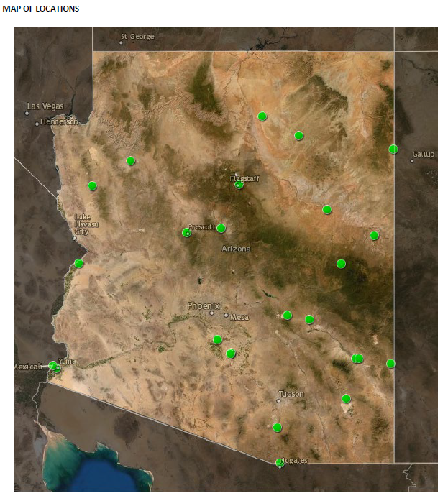
UA Experiment Station & Cooperative Extension System Sites for Accessing Online Education
Objective:
ALVSCE- Communications & Cyber Technologies (CCT) is urgently working to make 26 of UA’s Cooperative Extension System (CES) and Arizona Experiment Station (AES) sites distributed around AZ into drive-in internet “hot-spots” for UA, ASU, and NAU students who otherwise cannot continue classes. UITS will manage and secure these hot-spots to limit bandwidth for ABOR higher education traffic only. UITS and CCT must immediately upgrade local equipment to achieve this objective.
Expected Outcome:
Increased bandwidth at sites for delivering video-streaming and lectures; provide secure wireless over UAWiFi; extend signals as far as possible to parking lots/driveways promoting student access.
Proposed locations:
Three Arizona Experiment Station Units
Fifteen Cooperative Extension County Offices
Seven Cooperative Extension Tribal Offices
One Cooperative Extension System Education Site
See link for full details.
Team (or Potential Team):
Individual (Organization) | Role | Status
Cooperative Extension System | Locational Awareness, Physical Access | Confirmed
Arizona Experiment Station | Physical Access, Technical Services | Confirmed
UITS | Technical Services | Confirmed
Government & Community Relations | Funding, county, Tribal and other government cooperation | Confirmed
Proposed Budget:
$13,000 in equipment per site x 26 sites = $338,000
$62,400 in internet fees
Total requested: $400,400
Proposed Timeline:
Immediately: Cellular hotspot capabilities can access online educational services
Phase 1: Students will have access to select CE locations, estimated by April 3, 2020.
Delivery of any ABOR student within 1 week of equipment arrival.
Discriminator: what makes this team more competitive/more prepared than other potential bidders? Only Arizona Higher Education team with existing locations and cyber-infrastructure to increase network coverage throughout AZ and the tribal nations.

