Slide 1
This is a template for County Directors to distribute to their faculty and staff. (Fill in highlighted areas with your information.)
If you would like access to the fillable forms we have created please contact Evelyn Whitmer at emarkee@email.Arizona.edu

Slide 2
Corona Virus-19 Procedures
(Your County)

Slide 3
Norms
We have a lot to get through.
Hold all questions to the end.
I will be reading a lot of information. Important to get it right.

Slide 4
Today we will be covering the following as of 3/17/2020
COVID-19 overview
HR time reporting
What to do if you are ill
Working remotely
Campus information
Director information
Office proceedures

Slide 5
COVID-19
Watch for symptoms
Reported illnesses have ranged from mild symptoms to severe illness and death for confirmed coronavirus disease 2019 (COVID-19) cases.
The following symptoms may appear 2-14 days after exposure.*
Fever
Cough
Shortness of breath
This is based on what has been seen previously as the incubation period of MERS-CoV viruses.
https://www.cdc.gov/coronavirus/2019-ncov/symptoms-testing/symptoms.html

Slide 6
Emergency Warning Signs
If you develop emergency warning signs for COVID-19 get medical attention immediately. Emergency warning signs include*:
Difficulty breathing or shortness of breath
Persistent pain or pressure in the chest
New confusion or inability to arouse
Bluish lips or face
*This list is not all inclusive. Please consult your medical provider for any other symptoms that are severe or concerning.

Slide 7
Avoid getting sick and getting others sick
Wash your hands/clean your hands-20 seconds wash is best
Sanitizer with 60% alcohol
Avoid Close Contact-6 feet distance
Stay home if you are sick
Cover coughs and sneezes-in elbow then wash your hands
Wear facemask if you are sick or you are caring for others
Clean and disinfect surfaces

Slide 8
Why limit contact
the unprecedented actions we are implementing are intended to flatten the contagion curve and take pressure off of the healthcare system so that it can focus on the most serious cases and buy additional time for a vaccine to be developed.

Slide 9
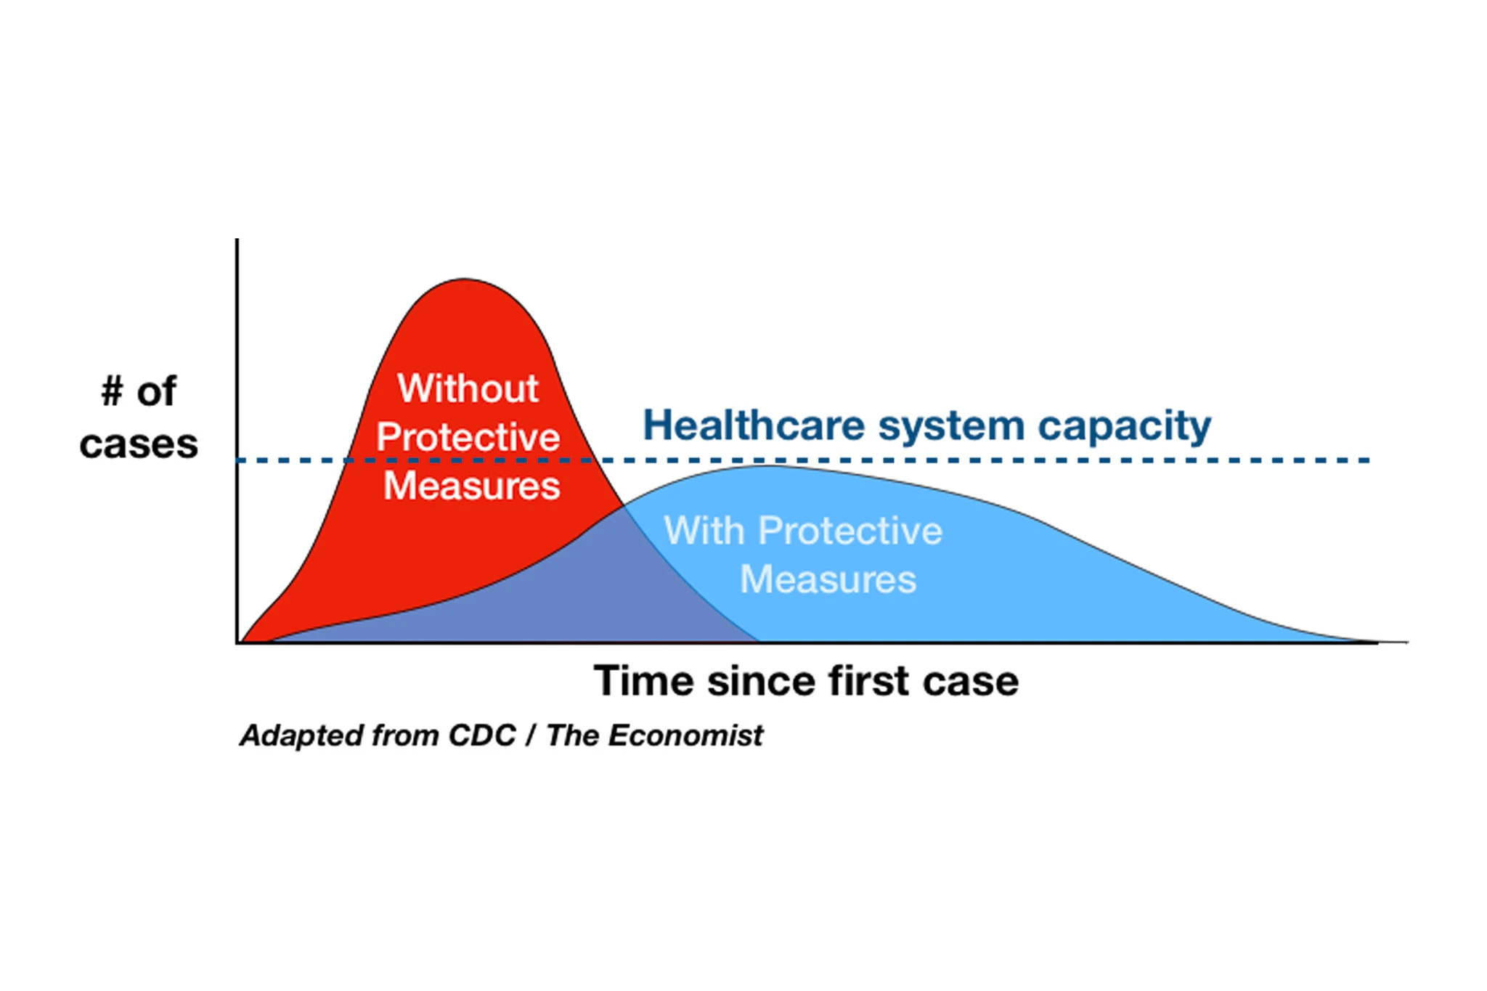

Slide 10
Human Resources Information

Slide 11
Reporting time
While the University remains in modified operations, the University Release time code is being used. Please do not use the "Pandemic" code on your time sheet until notified to do so.
Mitigating the impact of COVID-19 (coronavirus)
Please contact Human Resources for questions. We will update the information as regularly as possible to reflect the University’s continued response to mitigate the impact of COVID-19 (coronavirus).
Guidance for employees and supervisors in reporting time
The priority at this time is to protect the health and safety of students, staff, and faculty. In order to facilitate the support necessary for all employees to be able to work remotely, self-isolate or self-quarantine as necessary, and remain home while sick, employees and supervisors should utilize the following guidance to inform decisions for reporting time.
Working remotely
Employees, including non-benefits eligible employees and student workers, who have transitioned (or are expected to transition soon) to working remotely are to report time as usual and receive regular pay with no interruption or change.
Employees, including non-benefits eligible employees and student workers, who are unable to work remotely or report to the workplace due to a partial or complete closure will continue to report time based on the hours they are normally scheduled to work and record it as University Release time in lieu of regular pay time.

Slide 12
Regardless of workplace location (including remote work), when an employee or their family or household member is sick
Benefits-eligible employees who are sick and experiencing symptoms of illness are to notify their supervisors about illness, remain at home, and report Sick time on their timesheets.
Benefits-eligible employees who must remain at home to care for a family or household member who is sick may work remotely and receive regular pay. These employees who are not able to work remotely while providing care are to notify their supervisors and report Sick time on their timesheets.
Employees who have exhausted sick time and are sick, or employees (including student workers) who do not accrue sick time and are sick, are to notify supervisors about illness, remain at home, and are to report University Release time in lieu of sick time.
Employees who have exhausted sick time, or employees (including student workers) who do not accrue sick time and must remain at home to care for a family or household member who is sick may work remotely and receive regular pay. These employees who are not able to work remotely are to notify supervisors about illness, remain at home, and report University Release time in lieu of sick time.

Slide 13
Self-isolation and self-quarantine
Employees, including non-benefits-eligible employees and student workers, who believe they have been exposed to COVID-19 (coronavirus) through recent travel to affected areas or through other means are asked to self-isolate at home for a period of 14 days.
Employees are to continue to perform their job duties while working remotely from home and report time as usual with regular pay. Employees, including non-benefits eligible employees and student workers, who are not able to perform job duties remotely, are asked to self-isolate at home for a period of 14 days, receive pay with no interruption or change, and report University Release time.

Slide 14
Employees on sponsored funds, working on research grants and projects
Employees, including non-benefits-eligible employees and student workers, working on sponsored awards are to have these same temporary time-reporting practices applied to them as other University employees. Departments and principal investigators should refer to Research, Innovation, and Impact resources for questions, and consult with Human Resources as necessary.

Slide 15
Ancillary employees who are on-call and/or event-specific and do not have regularly scheduled hours
Employees who do not have regularly scheduled work hours, including those on-call, are to contact the department or unit for whom they perform work and inquire about canceled events and/or disruption to planned operations and work activity.

Slide 16
Technology

Slide 17
Meeting Virtually – Video, Chat, and Voice
Video & Voice Conferencing
Zoom: Share screens and real-time voice and/or video conversations. NetID is not required for people outside the university to attend a UA Zoom meeting.
Log into arizona.zoom.us to setup your Zoom account (if you haven’t already) and test your microphone and speaker.
If performance is lagging, turn off video and use voice only.
Microsoft Teams: Secure collaboration application in Office 365. Includes audio and video conferencing among many other collaboration tools.
Online Chat
Microsoft Teams: Includes a chat-based workspace for real-time collaboration.
Skype for Business: Another Microsoft chat tool.
Slack: Not a University service, but many units use it for chat and collaboration. If your unit has adopted it, ensure that all employees have accounts and know how to access Slack remotely.
Collaboration / Storage
Be sure files you need to work with are backed up to somewhere you can access them.
Microsoft Office 365 : Word, Excel, and PowerPoint online, and storage in One Drive. Access and share from anywhere. Log in at office.com with <netid>@email.arizona.edu, your password, and NetID+.
Box@UA: Online file storage with secure, managed access. From Box storage, open and work on Word, Excel, and PowerPoint documents collaboratively with online Office 365. Check with your local IT department for other specific requirements they might have about file storage on Box.

Slide 18
Virtual Room
Did you know you can set up Zoom to act like a virtual room that can stay persistently open for anyone to drop in? These can be helpful to hold ad-hoc office hours, lunch breaks, or to bring everyone together for an unscheduled meeting.
Each person with a NetID receives a Personal Meeting Room from Zoom. This room is a virtual meeting space permanently reserved for you that you can access with your Personal Meeting ID (PMI) or personal link. Your Personal Meeting ID (PMI) is a meeting ID that is unique to you. By default, the Zoom system selects a random PMI for you. However, you can edit your PMI to be something easy to remember, like your office phone number. That way, it will be unique to you and you won’t forget it.
Steps to change your Personal Meeting ID (PMI)
Go to your Zoom personal settings https://arizona.zoom.us/profile (you may get asked to log into WebAuth)
Click Edit next to Personal Meeting ID.

Slide 19
Know Before You Work Remote!
Prior to working in a remote location, make sure that the equipment you are using will function for the required tasks.
Laptop or desktop computer, with current antivirus (such as Sophos) installed.
Software—go to softwarelicense.arizona.edu and/or check with your departmental IT staff if you need to download software to do your work.
Internet connection from a home internet service provider (e.g., Cox, CenturyLink), wifi location such as the public library (use VPN), or hotspot from your mobile device (can incur data charges).
Microphone—may be built into your computer or you can use a plug-in microphone.
Webcam—may be built into your computer or you can use a plug-in webcam.

Slide 20

VPN
For those of us who work in offices not connected to the University regularly we use the VPN on a daily basis. At this time of working remotely we all may want to consider downloading the VPN for extra security.
Link to UArizona VPN information and downloads
https://it.arizona.edu/service/ua-virtual-private-network-vpn

Slide 21
Support
The 24/7 IT Support Center can assist you with your questions about setting up, using, or resolving issues with University IT services for working remotely.
Call (520) 626-TECH (8324)
Open a chat at support.arizona.edu. You can share your desktop with the technician, or even give control of your desktop to the technician.

Slide 22
From the Provost March 13th
Yes, faculty are included in the definition of “Employees”.
Students and ALL employees are encouraged to stay home if possible See: arizona.edu/covid19
All classes will be provided online on 3/18.
At ~4.45 today the provost told the Deans that NO group work could occur with more than four people, these four people must be at least 6ft apart at all times and all surfaces will be sterilized.
Practically #4 means all teaching laboratories will move to on-line along with all the other components of the courses. Yes, this means that an alternative must be found to what was planned in many cases.
All employees are responsible for their own health and well-being, and the university will accommodate employees’ decisions for their own health (see #2).
No senior employee may demand a more junior employee or student do something that employee or student feels is inconsistent with their own health and well-being (see #6).
PhD and MS students involved in faculty research projects must follow the research guidelines.

Slide 23
Burgess
I know our CES employees and I know that it is impossible to stop them from stepping into help their communities whenever and however possible. They can be an important part of our state’s solution to our world’s current crisis especially in our rural areas. I encourage their innovation over the coming months and also request that they ensure they are also focusing on their own, and their families’, health and wellbeing.

Slide 24
1) all in person University events, including Extension, must be canceled or postponed.
All in person meetings or gatherings, formal or informal, must be limited to a maximum of four people and they should maintain at least 6 feet distancing at all times. All surfaces in meeting places need to be cleaned and sterilized regularly.
2) please utilized appropriate technology such as teleconferencing, email, zoom sessions, etc.
Matt Rahr and CCT have already stepped up and begun working with us. Dominic is the lead person in our unit coordinating with them.
3) Travel authorizations will be heavily scrutinized. This is a good case for considering if it is not essential then do not do it.
4) all faculty and staff are encouraged to work from home or a remote site if it all possible. faculty and staff are permitted to work on campus. I have cleared this with Dr. Silvertooth that we will be working remotely.
5) all support and operational functions are expected to continue as usual, to the extent possible.
6) if anyone is ill or showing signs of illness they need to go home. We need to monitor and enforce this important step.
Thank you all very much for your commitment, calm, and professionalism. ~ Dr. Silvertooth

Slide 25
County Director
Work with your supervisors to plan your work loads.
develop a plan for your programs, reflect on your programs, participate with on-line professional development and other activities that can go towards your work time.
I anticipate that there will be some down time. I encourage you to work online through zoom with your staff and collogues to come up with some new ideas. You may spend your time working on and updating fact sheets, professional development to each other, perhaps a video online and posted on our Facebook pages with your supervisor’s approval, career conversations, and other ideas.

Slide 26
More
Other ideas set up a Facebook page on where to go for food access Have verified information on this topic and add to a thread.
Your positions are secure-permanent staff and faculty/grant funded positions/ancillary staff.
If you become Ill, please notify your supervisor who will make sure that I am notified-email is best for this.
We will be collecting emergency contact information so that we have updated contact information and emergency contact information. Fillable forms will be sent out to you via e-mail. Please have them returned by Friday. Please send your information to admin assistant (add name and e-mail)

Slide 27
Emergency Contact Form
(see notes below for information on what to collect) I will send you the fillable form from emarkee@email.Arizona.edu
Notes:
EMPLOYEE EMERGENCY INFORMATION FORM(Please provide all information requested)
Employee Name: _______________________ ________________________ ___________Last First MI
Address: ____________________________________________________________________Address City State Zip
Email Address: ______________________________ Cell Phone: ____________________
Person to notify in emergency:
1)___________________________________ First Name ___________________________________ Last Name ___________________________________ Relationship___________________________________ Phone ___________________________________ Alternate Phone ___________________________________ Address___________________________________ Address2___________________________________ City, State, Zip
Person to notify in emergency:
2)___________________________________ First Name ___________________________________ Last Name ___________________________________ Relationship___________________________________ Phone ___________________________________ Alternate Phone ___________________________________ Address___________________________________ Address2___________________________________ City, State, Zip
If your emergency information changes, complete a new Employee Emergency Information form as soon as possible.
Date submitted: ___________________________________

Slide 28
More from the Director
You may enter the building if necessary to gather items as long as you adhere to the 4 people at a time and 6 feet apart rules.
You may want to change your greetings on your phones with a message that we will be out until further notice and they may e-mail you at your e-mail address and any other pertinent information.
I have established a box folder named COVID-19 information. I will add the latest updates from campus there.

Slide 29
I have set up Point of Contacts for the office(s).
If you need to process any paperwork or other business that requires administrative assistance, please scan and send documents-you may download a scan app to your phone if necessary.
(Instructions on how to retrieve voice mail.)

Slide 30
Mail
Mail will be on hold until the end of the week. POC (point of contact) will be responsible for picking up the mail and conveying pertinent information to the programs.
If you have bulk orders expected, call the transport company to hold the item.
Please let POC know if you are expecting something that is time sensitive.

Slide 31
Holding Mail
Establish an online USPS account to use to hold mail during closures as well as ordering mailing supplies.
Here is a direct link: https://www.usps.com/manage/hold-mail.htm
Add an extra to the notes, here is a sample note for the current mail hold.
Hold all mail for the University of Arizona Cooperative Extension. Admin staff may pick up mail from the local Post Office during this time of University closure.
Choose the pick up option each time so you can go into the post office and pick up as necessary. Your hold runs to a specific date, if this date is extended you can log back into the website and update as needed.

Slide 32
Events
All in person University events, including Extension, must be canceled or postponed
Please refrain from developing new events, meetings, etc. You may make tentative plans. Caution not to distribute tentative plans widely until further notice.

Slide 33

Handling the Public
There may be some skepticism out there.
Be professional-don’t argue the facts.
I will send you an e-mail with the wording that campus is working if you get any feedback.
IF they are still not satisfied, they can contact the County Director via e-mail at (email of County Director here)

Slide 34
The list for the office contacts are as follows:
(Add information here)
Office 1
POC: Name (XXX)XXX-XXX
E-mail
Office 2
POC: Name (XXX)XXX-XXX
E-mail

Slide 35
Please regularly check your e-mails for updates.
We are constantly getting new updates from campus, the county and other sources.
This circumstance is emerging and new to all of us.
I appreciate your patience and cooperation.
Please feel free to contact myself or your supervisor with questions.

Slide 36
Door signs must read as follows
Announcement
Per directions from the University of Arizona, all scheduled in-person Cooperative Extension events and meetings are being postponed and/or cancelled. All staff at the (Enter County Name) County Cooperative Extension offices will be working remotely, closing the physical offices until further notice.
Please communicate with your point of contact for support or questions. If you do not have a point of contact, please call (include message number) or email County Director, Evelyn Whitmer at emarkee@arizona.edu.

Slide 37

Resources
Thank you and remember social distancing of 6 feet between you and others. This is a time to slow the spread of the virus so please adhere to the CDC advice. For more information on this, here are some sites you can visit:
https://www.cdc.gov/coronavirus/2019-ncov/prepare/prevention.html
https://www.cdc.gov/coronavirus/2019-nCoV/index.html
https://www.who.int/
https://www.cochise.az.gov/
Facebook page for Santa Cruz County: Santa Cruz County Coronavirus/CORVID-19 info
Facebook page for Cochise County: Cochise County – Government

Slide 38

Questions?

