Slide 3
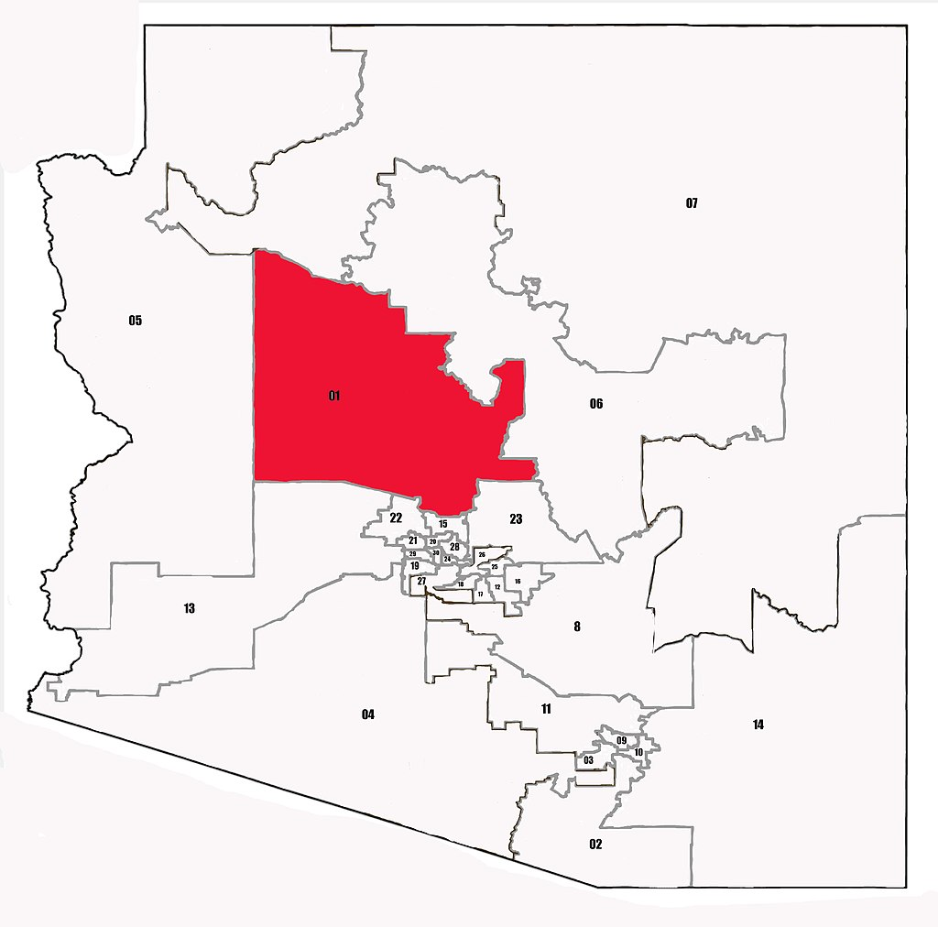
Arizona Legislative District 1
State Funded Employees | 4.4
Soft Funded Employees | 4.5
State Payroll Budget / Expenditures | $219,730
Earned Payroll Expenditures | $313,662
1 : 1.3
For every 1 state-funded Cooperative Extension FTE residing in AZ LD 1, 1.3 additional non-state-funded FTE are supported in AZ LD 1 by the presence of Extension in the state. These additional jobs are supported both within AZ LD 1 through earned, non-state funding, as well as through multiplier effects in the community.

Slide 4
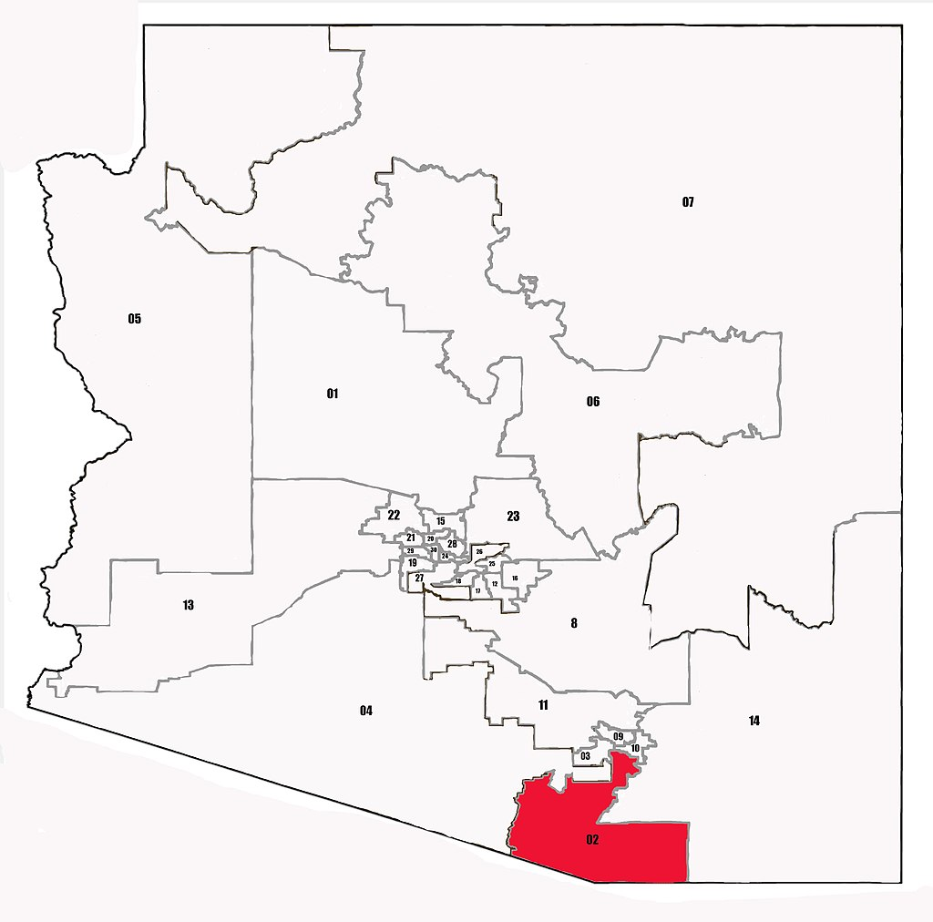
Arizona Legislative District 2
State Funded Employees | 13.2
Soft Funded Employees | 5.2
State Payroll Budget / Expenditures | $630,218
Earned Payroll Expenditures | $249,266
1 : 0.4
For every 1 state-funded Cooperative Extension FTE residing in AZ LD 2, 0.4 additional non-state-funded FTE are supported in AZ LD 2 by the presence of Extension in the state. These additional jobs are supported both within AZ LD 2 through earned, non-state funding, as well as through multiplier effects in the community.

Slide 5
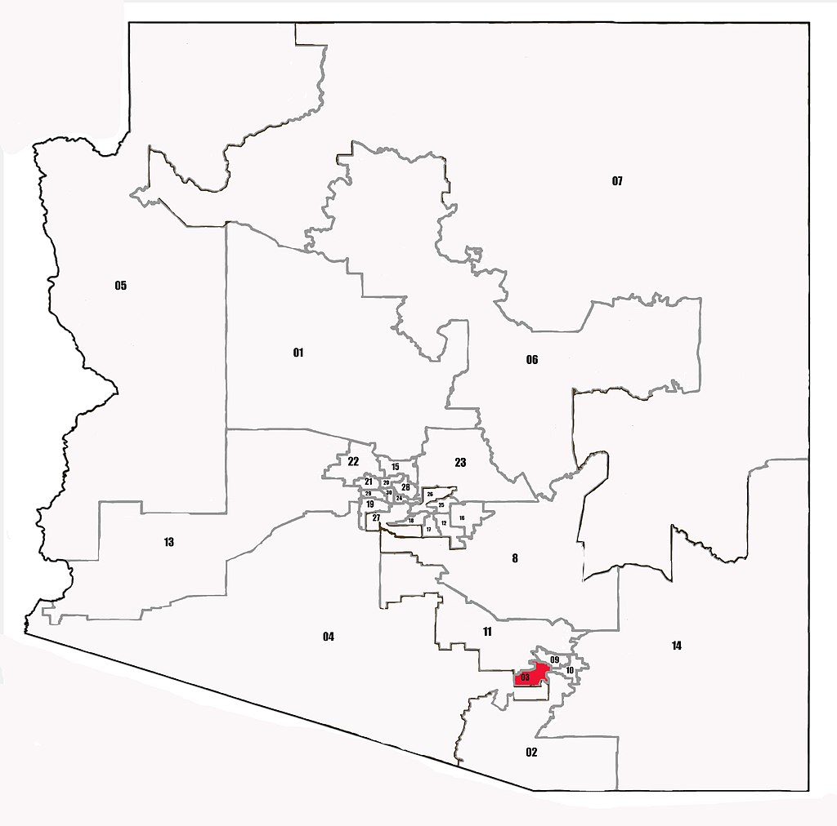
Arizona Legislative District 3
State Funded Employees | 9.6
Soft Funded Employees | 16.0
State Payroll Budget / Expenditures | $742,179
Earned Payroll Expenditures | $838,564
1 : 1.9
For every 1 state-funded Cooperative Extension FTE residing in AZ LD 3, 1.9 additional non-state-funded FTE are supported in AZ LD 3 by the presence of Extension in the state. These additional jobs are supported both within AZ LD 3 through earned, non-state funding, as well as through multiplier effects in the community.

Slide 6
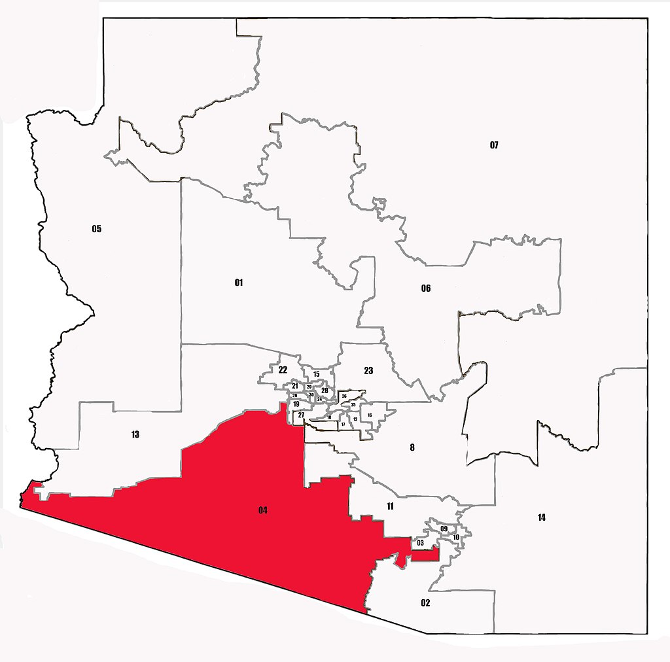
Arizona Legislative District 4
State Funded Employees | 3.6
Soft Funded Employees | 2.6
State Payroll Budget / Expenditures | $305,481
Earned Payroll Expenditures | $173,199
1 : 0.9
For every 1 state-funded Cooperative Extension FTE residing in AZ LD 4, 0.9 additional non-state-funded FTE are supported in AZ LD 4 by the presence of Extension in the state. These additional jobs are supported both within AZ LD 4 through earned, non-state funding, as well as through multiplier effects in the community.

Slide 7
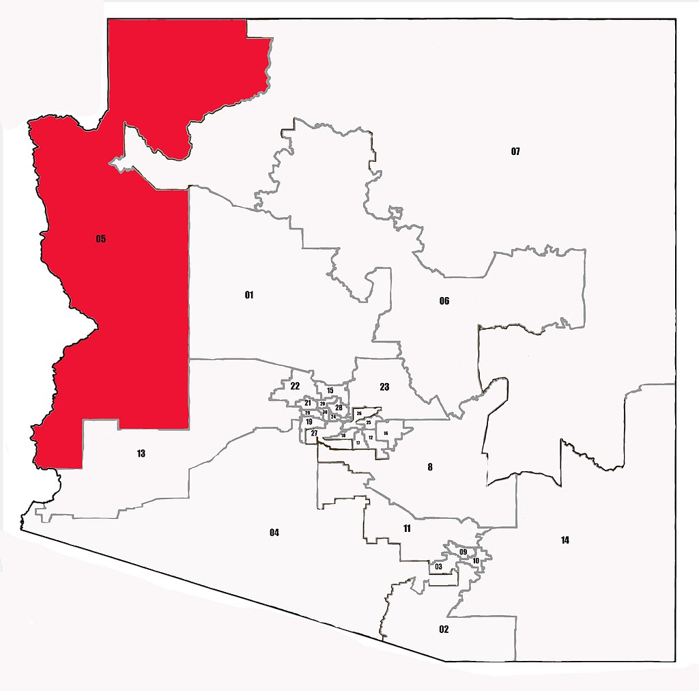
Arizona Legislative District 5
State Funded Employees | 5.3
Soft Funded Employees | 7.7
State Payroll Budget / Expenditures | $224,901
Earned Payroll Expenditures | $430,021
1 : 1.8
For every 1 state-funded Cooperative Extension FTE residing in AZ LD 5, 1.8 additional non-state-funded FTE are supported in AZ LD 5 by the presence of Extension in the state. These additional jobs are supported both within AZ LD 5 through earned, non-state funding, as well as through multiplier effects in the community.

Slide 8
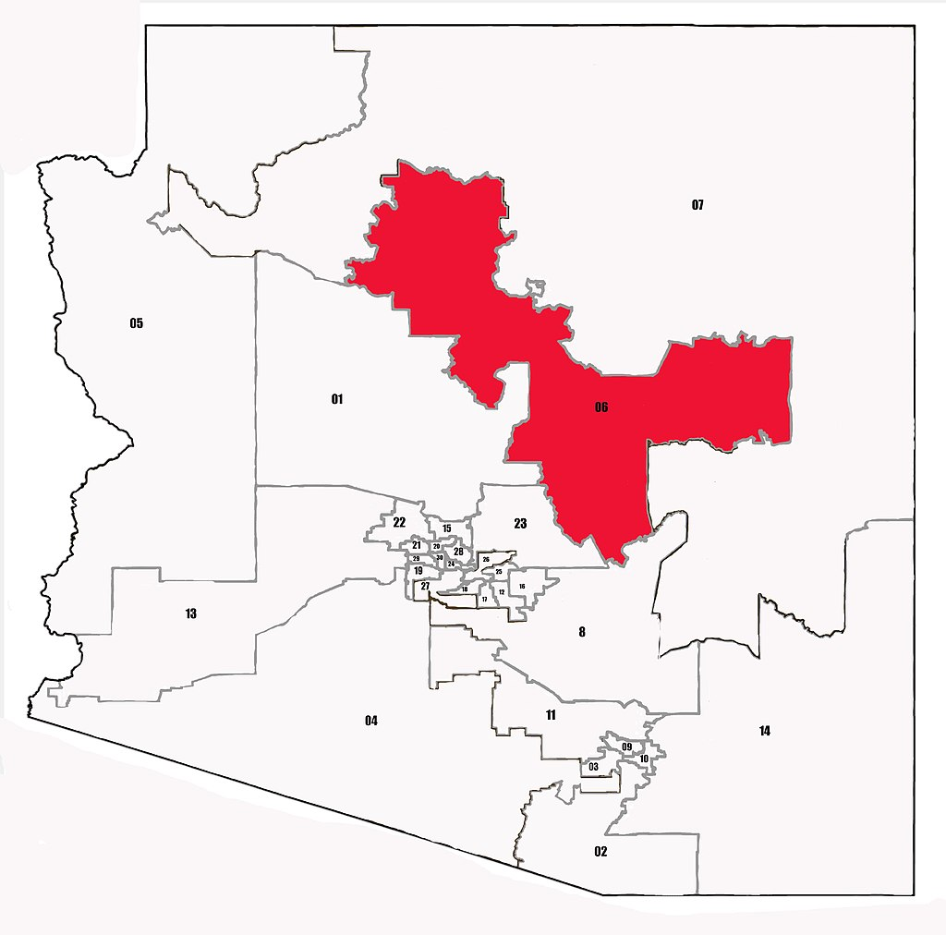
Arizona Legislative District 6
State Funded Employees | 6.3
Soft Funded Employees | 2.7
State Payroll Budget / Expenditures | $355,375
Earned Payroll Expenditures | $117,380
1 : 0.5
For every 1 state-funded Cooperative Extension FTE residing in AZ LD 6, 0.5 additional non-state-funded FTE are supported in AZ LD 6 by the presence of Extension in the state. These additional jobs are supported both within AZ LD 6 through earned, non-state funding, as well as through multiplier effects in the community.

Slide 9
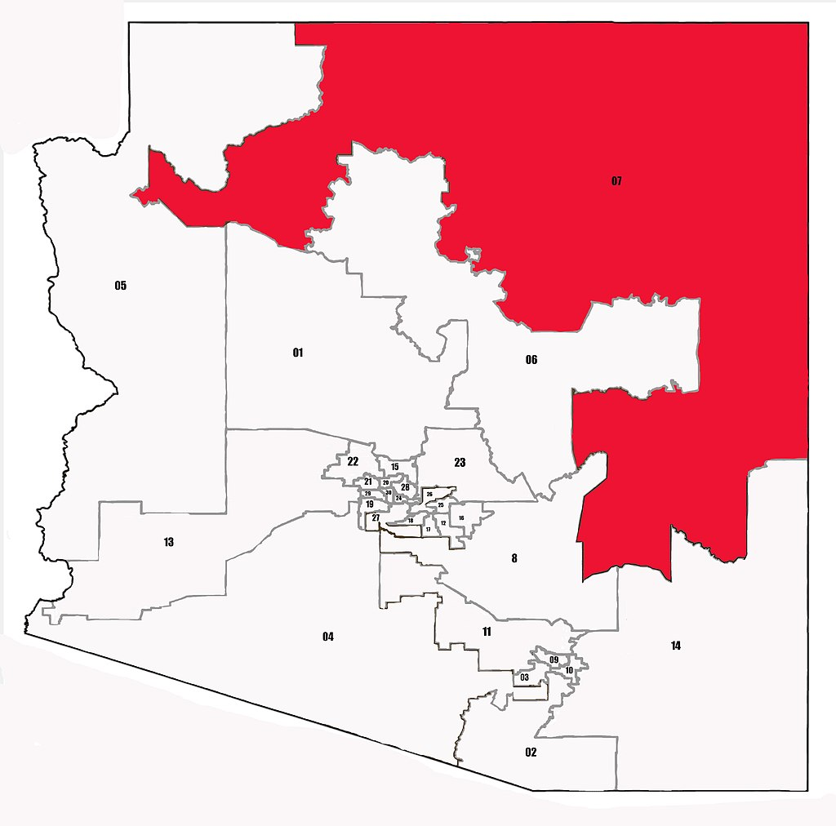
Arizona Legislative District 7
State Funded Employees | 6.5
Soft Funded Employees | 12.4
State Payroll Budget / Expenditures | $257,345
Earned Payroll Expenditures | $763,353
1 : 2.3
For every 1 state-funded Cooperative Extension FTE residing in AZ LD 7, 2.3 additional non-state-funded FTE are supported in AZ LD 7 by the presence of Extension in the state. These additional jobs are supported both within AZ LD 7 through earned, non-state funding, as well as through multiplier effects in the community.

Slide 10
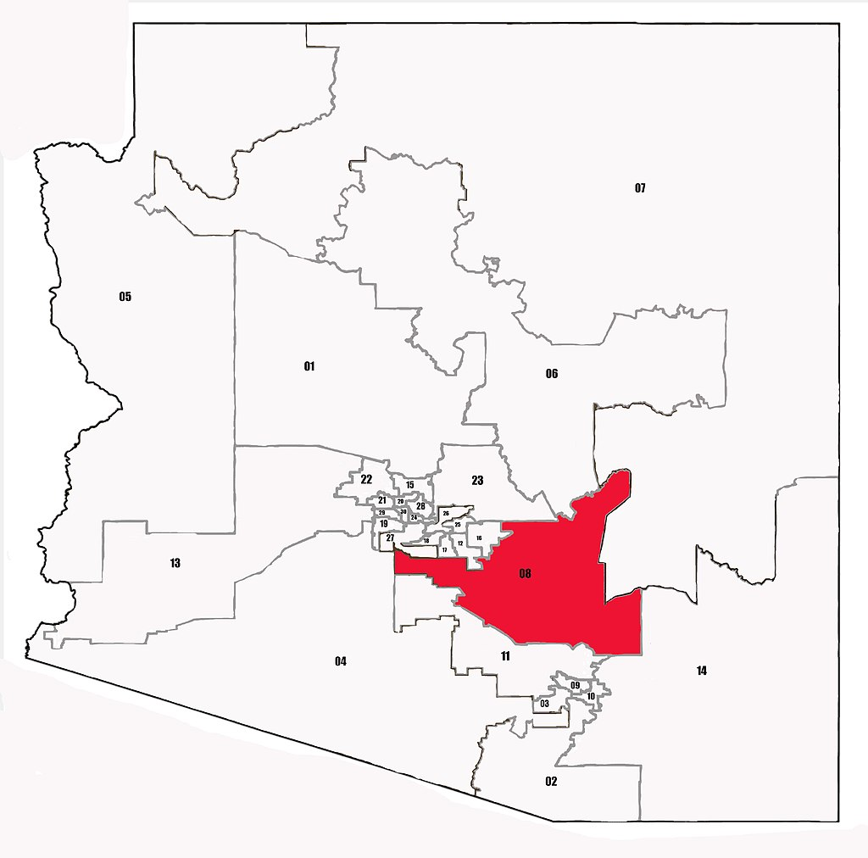
Arizona Legislative District 8
State Funded Employees | 8.4
Soft Funded Employees | 14.2
State Payroll Budget / Expenditures | $424,816
Earned Payroll Expenditures | $756,198
1 : 2.0
For every 1 state-funded Cooperative Extension FTE residing in AZ LD 8, 2.0 additional non-state-funded FTE are supported in AZ LD 8 by the presence of Extension in the state. These additional jobs are supported both within AZ LD 8 through earned, non-state funding, as well as through multiplier effects in the community.

Slide 11
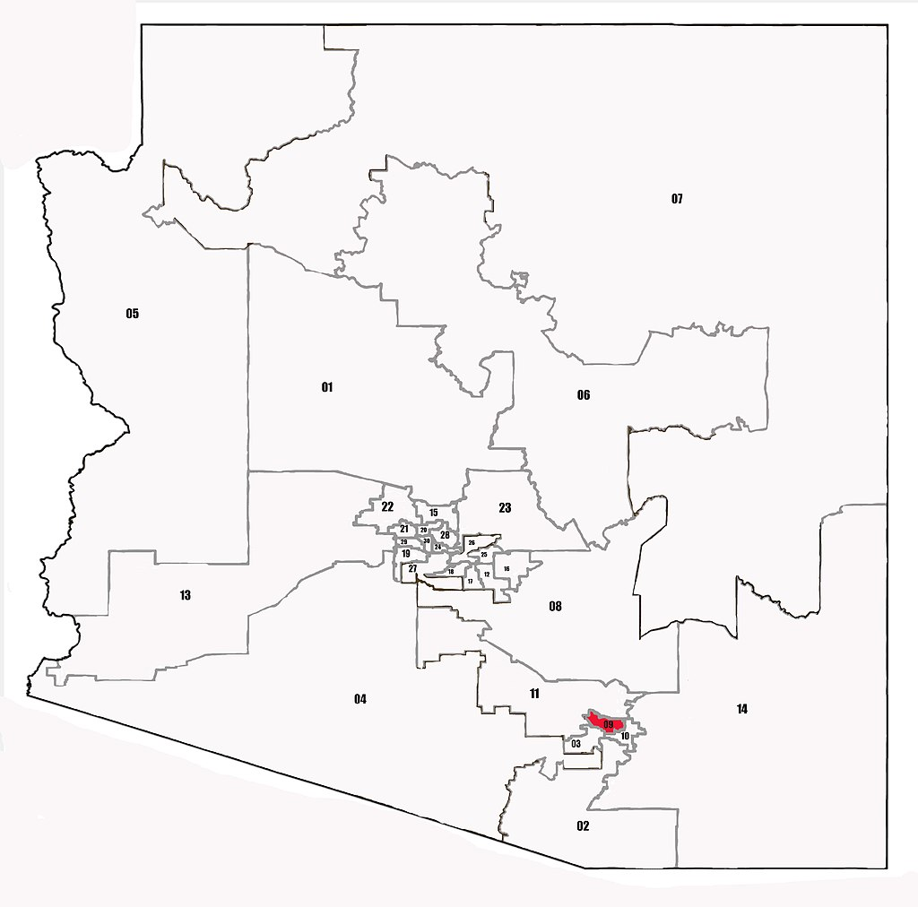
Arizona Legislative District 9
State Funded Employees | 17.2
Soft Funded Employees | 27.3
State Payroll Budget / Expenditures | $1,756,748
Earned Payroll Expenditures | $1,809,643
1 : 2.1
For every 1 state-funded Cooperative Extension FTE residing in AZ LD 9, 2.1 additional non-state-funded FTE are supported in AZ LD 9 by the presence of Extension in the state. These additional jobs are supported both within AZ LD 9 through earned, non-state funding, as well as through multiplier effects in the community.

Slide 12
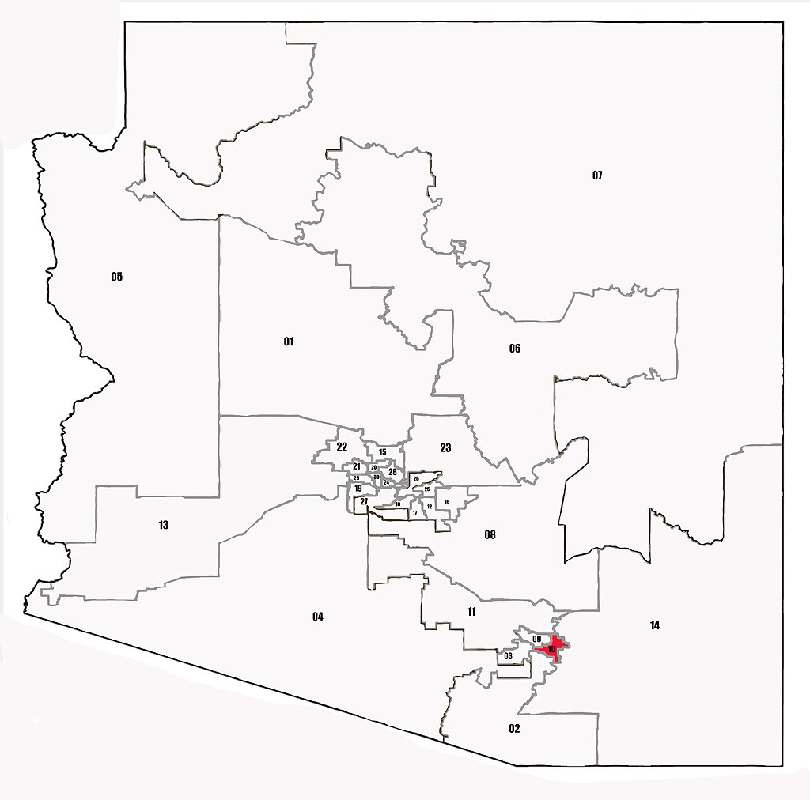
Arizona Legislative District 10
State Funded Employees | 16.1
Soft Funded Employees | 14.6
State Payroll Budget / Expenditures | $1,333,093
Earned Payroll Expenditures | $1,105,835
1 : 1.3
For every 1 state-funded Cooperative Extension FTE residing in AZ LD 10, 1.3 additional non-state-funded FTE are supported in AZ LD 10 by the presence of Extension in the state. These additional jobs are supported both within AZ LD 10 through earned, non-state funding, as well as through multiplier effects in the community.

Slide 13
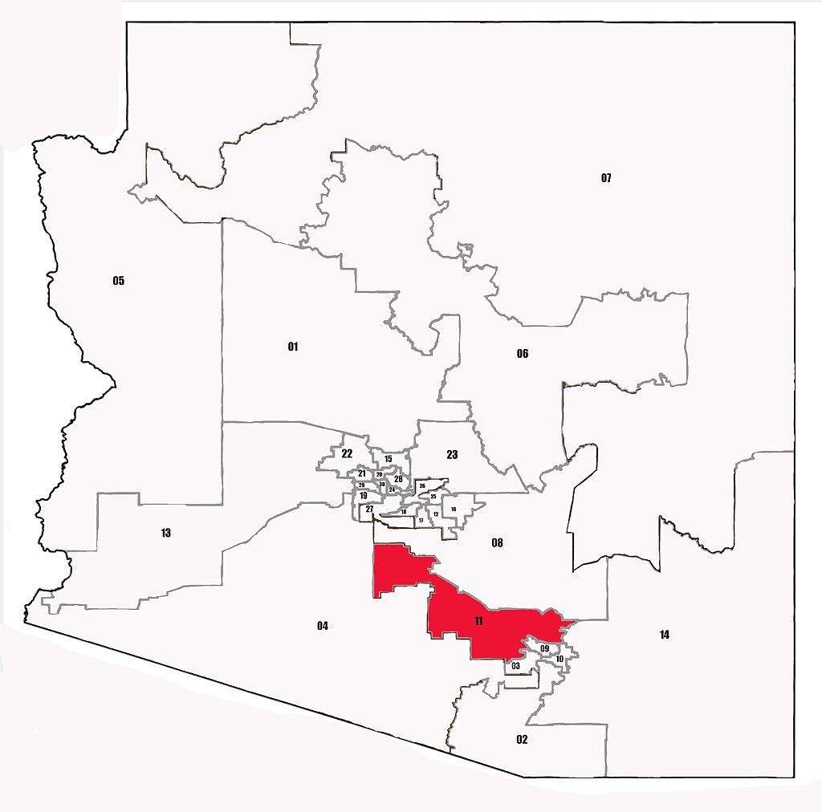
Arizona Legislative District 11
State Funded Employees | 6.9
Soft Funded Employees | 11.0
State Payroll Budget / Expenditures | $698,644
Earned Payroll Expenditures | $865,741
1 : 2.0
For every 1 state-funded Cooperative Extension FTE residing in AZ LD 11, 2.0 additional non-state-funded FTE are supported in AZ LD 11 by the presence of Extension in the state. These additional jobs are supported both within AZ LD 11 through earned, non-state funding, as well as through multiplier effects in the community.

Slide 14
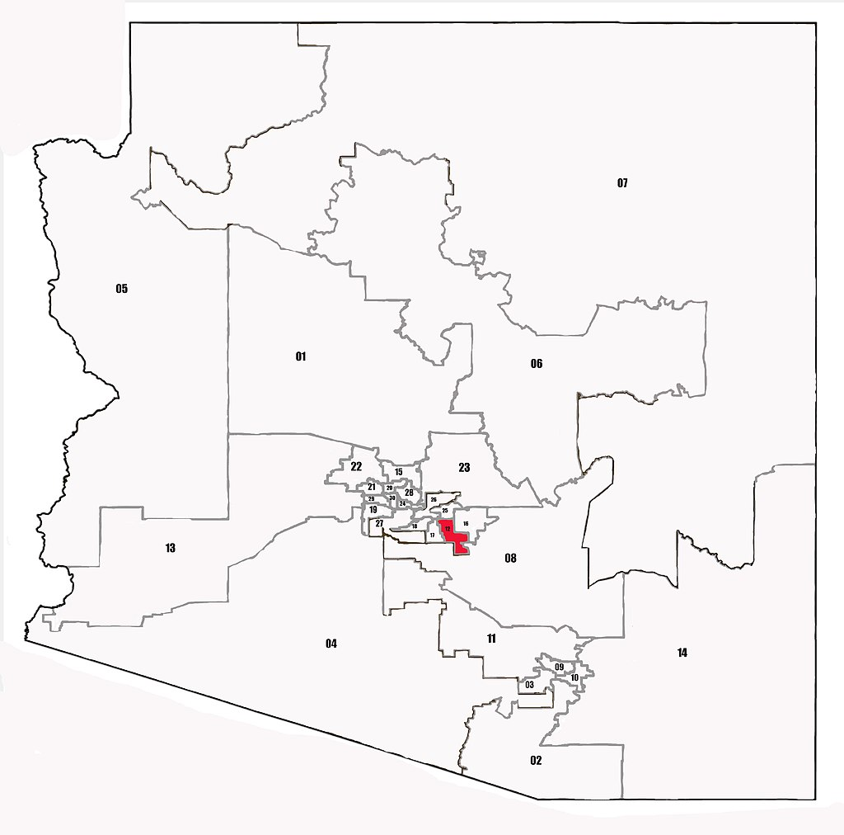
Arizona Legislative District 12
State Funded Employees | 0.9
Soft Funded Employees | 3.9
State Payroll Budget / Expenditures | $75,884
Earned Payroll Expenditures | $166,158
1 : 5.3
For every 1 state-funded Cooperative Extension FTE residing in AZ LD 12, 5.3 additional non-state-funded FTE are supported in AZ LD 12 by the presence of Extension in the state. These additional jobs are supported both within AZ LD 12 through earned, non-state funding, as well as through multiplier effects in the community.

Slide 15
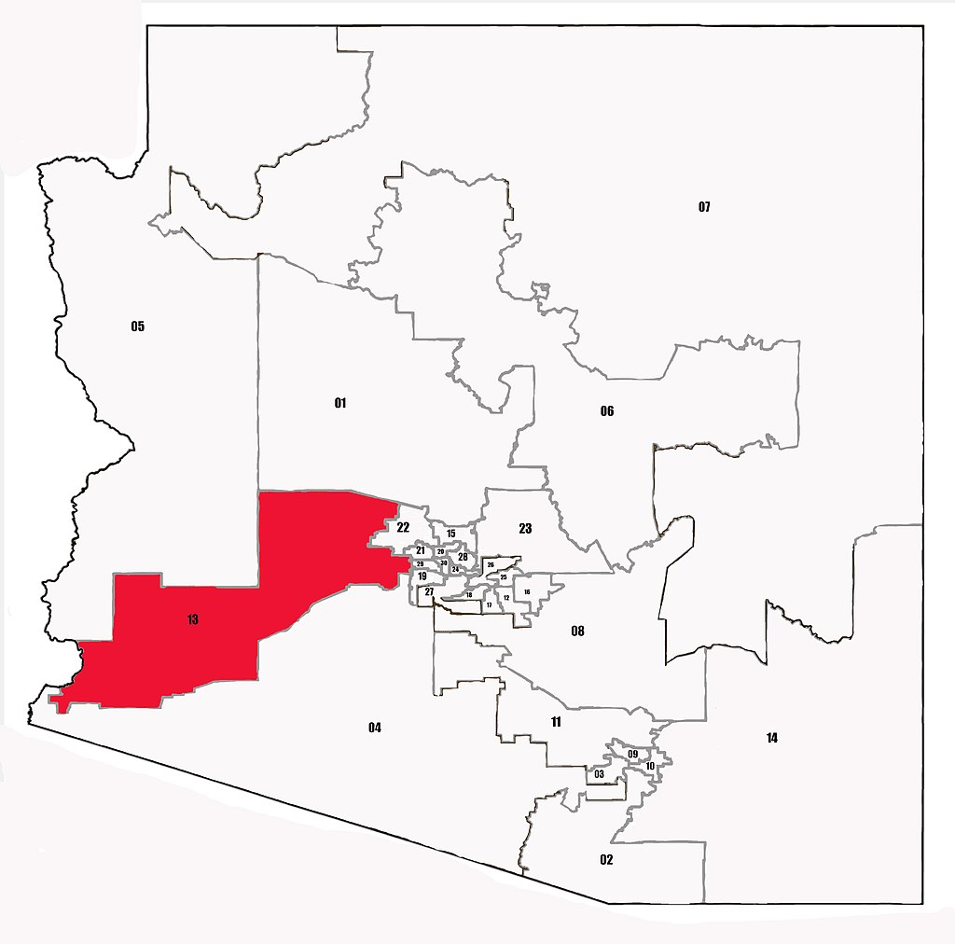
Arizona Legislative District 13
State Funded Employees | 5.1
Soft Funded Employees | 5.3
State Payroll Budget / Expenditures | $413,997
Earned Payroll Expenditures | $423,958
1 : 1.3
For every 1 state-funded Cooperative Extension FTE residing in AZ LD 13, 1.3 additional non-state-funded FTE are supported in AZ LD 13 by the presence of Extension in the state. These additional jobs are supported both within AZ LD 13 through earned, non-state funding, as well as through multiplier effects in the community.

Slide 16
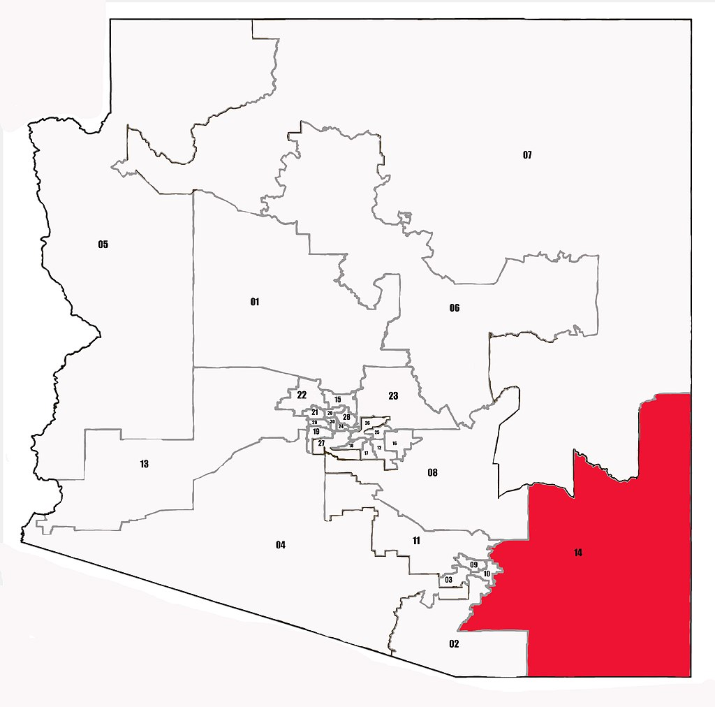
Arizona Legislative District 14
State Funded Employees | 16.2
Soft Funded Employees | 27.0
State Payroll Budget / Expenditures | $977,381
Earned Payroll Expenditures | $1,375,639
1 : 2.0
For every 1 state-funded Cooperative Extension FTE residing in AZ LD 14, 2.0 additional non-state-funded FTE are supported in AZ LD 14 by the presence of Extension in the state. These additional jobs are supported both within AZ LD 14 through earned, non-state funding, as well as through multiplier effects in the community.

Slide 17
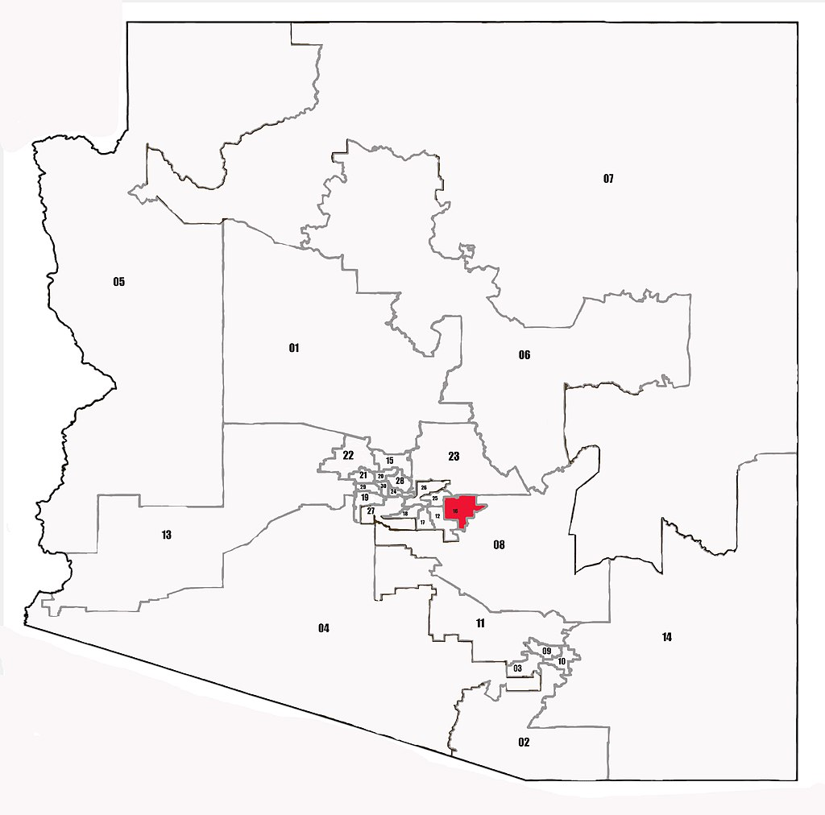
Arizona Legislative District 16
State Funded Employees | 1.5
Soft Funded Employees | 2.4
State Payroll Budget / Expenditures | $56,505
Earned Payroll Expenditures | $134,433
1 : 1.9
For every 1 state-funded Cooperative Extension FTE residing in AZ LD 16, 1.9 additional non-state-funded FTE are supported in AZ LD 16 by the presence of Extension in the state. These additional jobs are supported both within AZ LD 16 through earned, non-state funding, as well as through multiplier effects in the community.

Slide 18
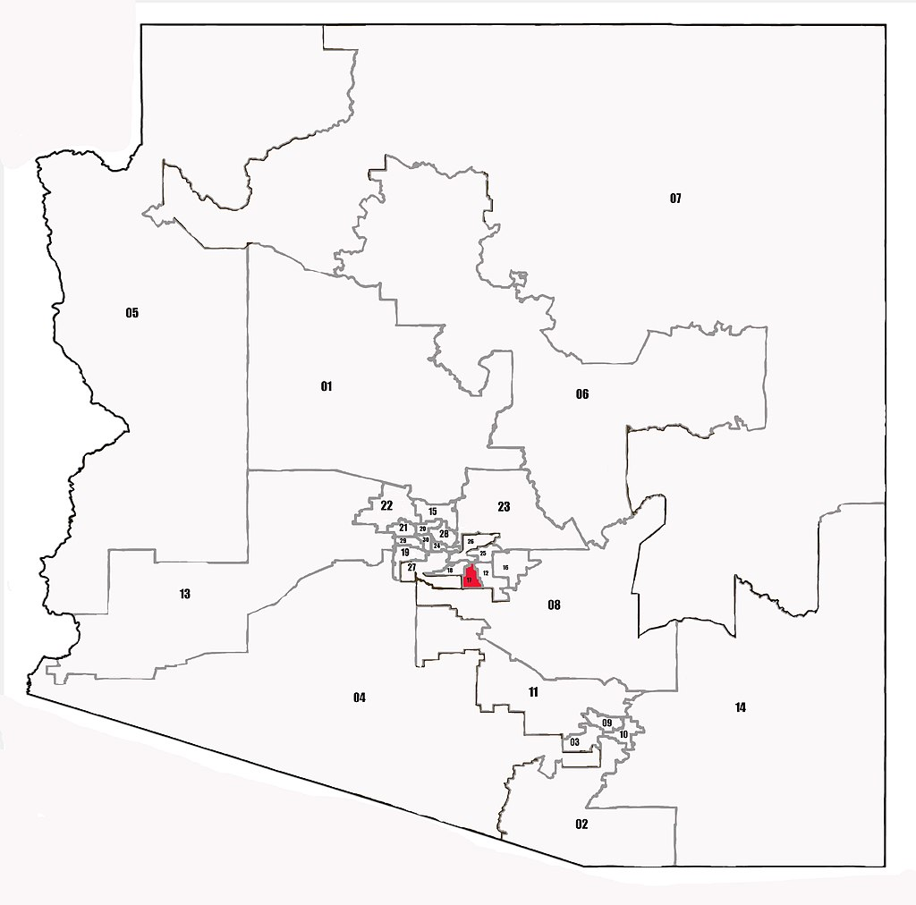
Arizona Legislative District 17
State Funded Employees | 1.1
Soft Funded Employees | 5.6
State Payroll Budget / Expenditures | $136,824
Earned Payroll Expenditures | $424,306
1 : 6.2
For every 1 state-funded Cooperative Extension FTE residing in AZ LD 17, 6.2 additional non-state-funded FTE are supported in AZ LD 17 by the presence of Extension in the state. These additional jobs are supported both within AZ LD 17 through earned, non-state funding, as well as through multiplier effects in the community.

Slide 19

Arizona Legislative District 18
State Funded Employees | 2.2
Soft Funded Employees | 8.5
State Payroll Budget / Expenditures | $123,658
Earned Payroll Expenditures | $631,659
1 : 4.9
For every 1 state-funded Cooperative Extension FTE residing in AZ LD 18, 4.9 additional non-state-funded FTE are supported in AZ LD 18 by the presence of Extension in the state. These additional jobs are supported both within AZ LD 18 through earned, non-state funding, as well as through multiplier effects in the community.

Slide 20
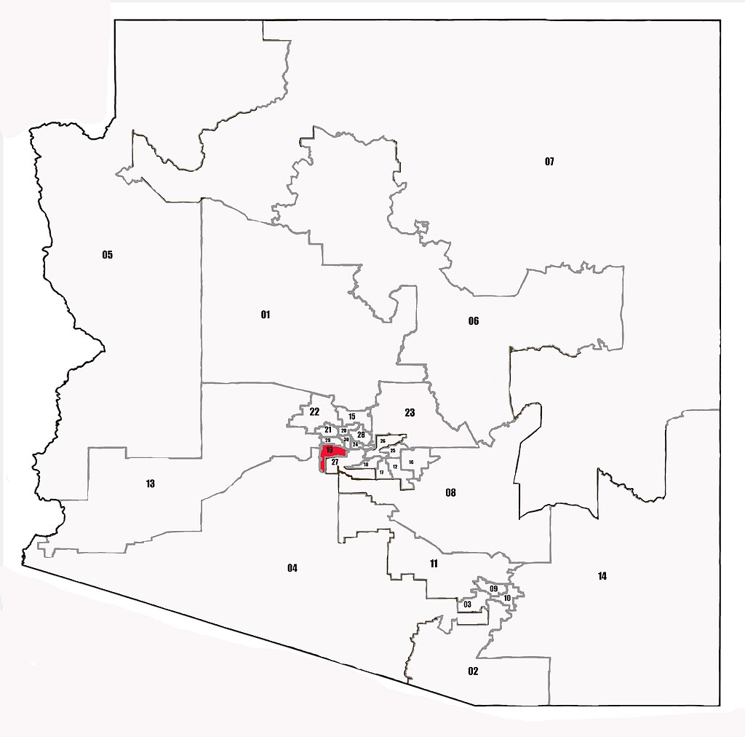
Arizona Legislative District 19
State Funded Employees | 2.8
Soft Funded Employees | 1.8
State Payroll Budget / Expenditures | $146,180
Earned Payroll Expenditures | $63,714
1 : 0.7
For every 1 state-funded Cooperative Extension FTE residing in AZ LD 19, 0.7 additional non-state-funded FTE are supported in AZ LD 19 by the presence of Extension in the state. These additional jobs are supported both within AZ LD 19 through earned, non-state funding, as well as through multiplier effects in the community.

Slide 21
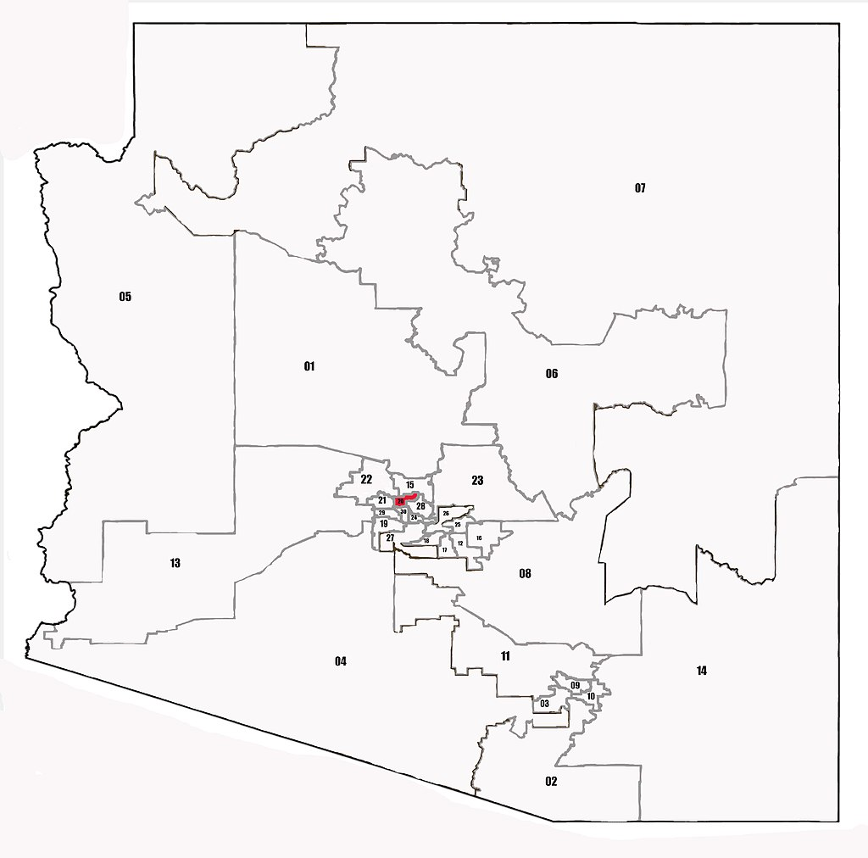
Arizona Legislative District 20
State Funded Employees | 0.5
Soft Funded Employees | 1.0
State Payroll Budget / Expenditures | $11,722
Earned Payroll Expenditures | $59,504
1 : 2.4
For every 1 state-funded Cooperative Extension FTE residing in AZ LD 20, 2.4 additional non-state-funded FTE are supported in AZ LD 20 by the presence of Extension in the state. These additional jobs are supported both within AZ LD 20 through earned, non-state funding, as well as through multiplier effects in the community.

Slide 22
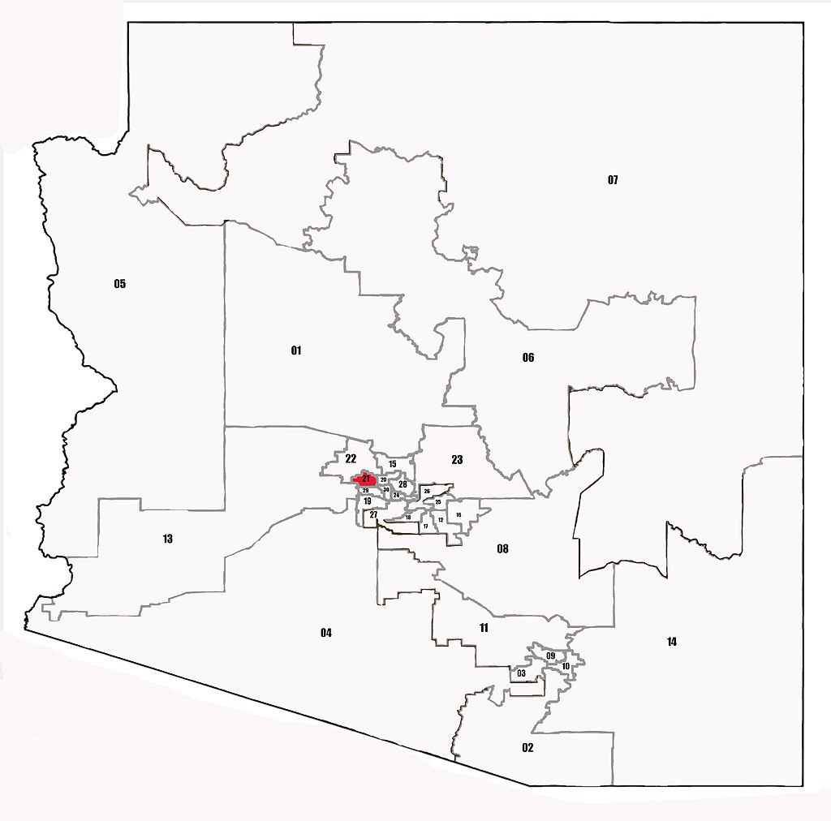
Arizona Legislative District 21
State Funded Employees | 0.1
Soft Funded Employees | 0.8
State Payroll Budget / Expenditures | $5,764
Earned Payroll Expenditures | $47,213
1 : 9.9
For every 1 state-funded Cooperative Extension FTE residing in AZ LD 21, 9.9 additional non-state-funded FTE are supported in AZ LD 21 by the presence of Extension in the state. These additional jobs are supported both within AZ LD 21 through earned, non-state funding, as well as through multiplier effects in the community.

Slide 23
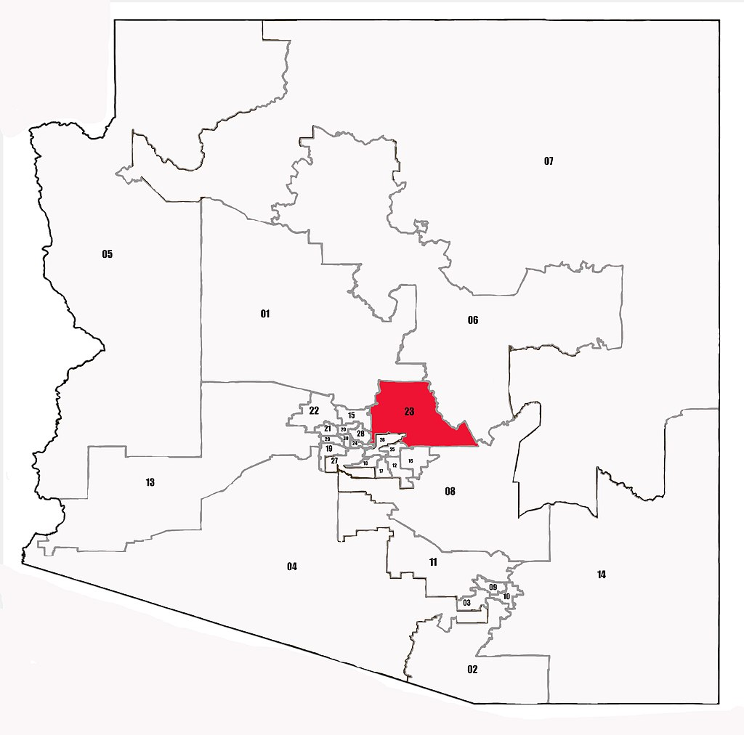
Arizona Legislative District 23
State Funded Employees | 1.0
Soft Funded Employees | 0.4
State Payroll Budget / Expenditures | $53,567
Earned Payroll Expenditures | $5,970
1 : 0.4
For every 1 state-funded Cooperative Extension FTE residing in AZ LD 23, 0.4 additional non-state-funded FTE are supported in AZ LD 23 by the presence of Extension in the state. These additional jobs are supported both within AZ LD 23 through earned, non-state funding, as well as through multiplier effects in the community.

Slide 24

Arizona Legislative District 24
State Funded Employees | 2.0
Soft Funded Employees | 2.5
State Payroll Budget / Expenditures | $178,414
Earned Payroll Expenditures | $110,756
1 : 1.3
For every 1 state-funded Cooperative Extension FTE residing in AZ LD 24, 1.3 additional non-state-funded FTE are supported in AZ LD 24 by the presence of Extension in the state. These additional jobs are supported both within AZ LD 24 through earned, non-state funding, as well as through multiplier effects in the community.

Slide 25
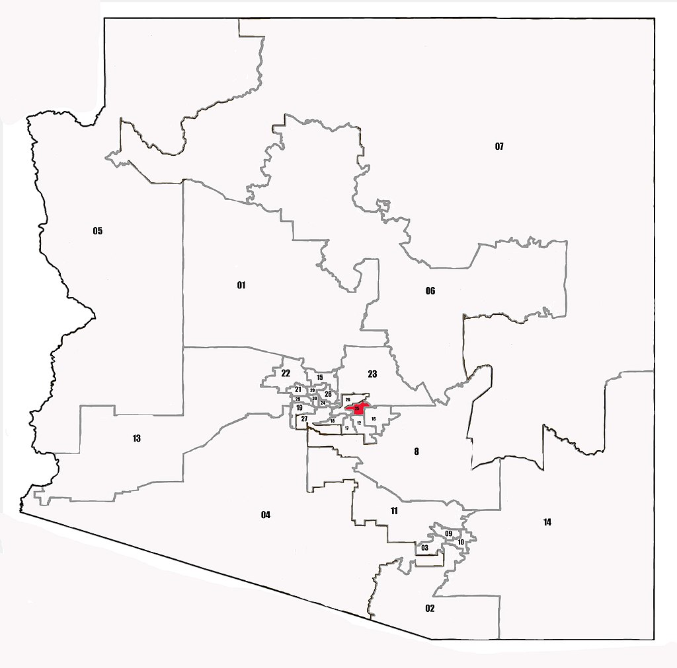
Arizona Legislative District 25
State Funded Employees | 1.0
Soft Funded Employees | 2.1
State Payroll Budget / Expenditures | $41,842
Earned Payroll Expenditures | $69,224
1 : 2.3
For every 1 state-funded Cooperative Extension FTE residing in AZ LD 25, 2.3 additional non-state-funded FTE are supported in AZ LD 25 by the presence of Extension in the state. These additional jobs are supported both within AZ LD 25 through earned, non-state funding, as well as through multiplier effects in the community.

Slide 26
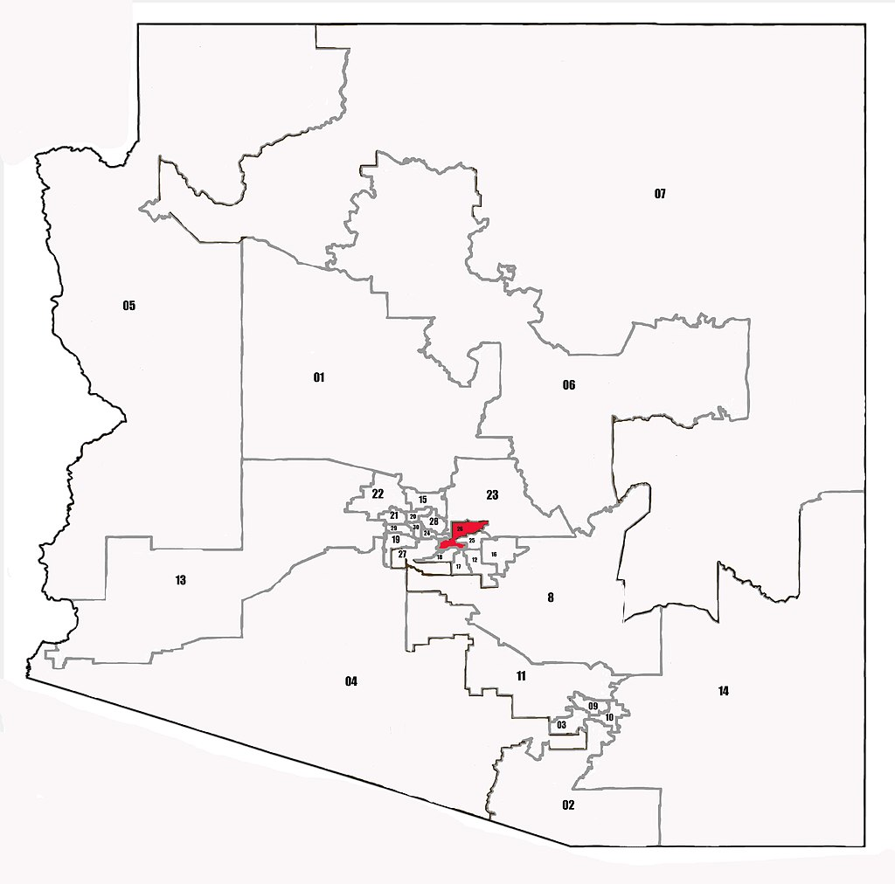
Arizona Legislative District 26
State Funded Employees | 0.1
Soft Funded Employees | 3.4
State Payroll Budget / Expenditures | $3,363
Earned Payroll Expenditures | $142,547
1 : 42.5
For every 1 state-funded Cooperative Extension FTE residing in AZ LD 26, 42.5 additional non-state-funded FTE are supported in AZ LD 26 by the presence of Extension in the state. These additional jobs are supported both within AZ LD 26 through earned, non-state funding, as well as through multiplier effects in the community.

Slide 27
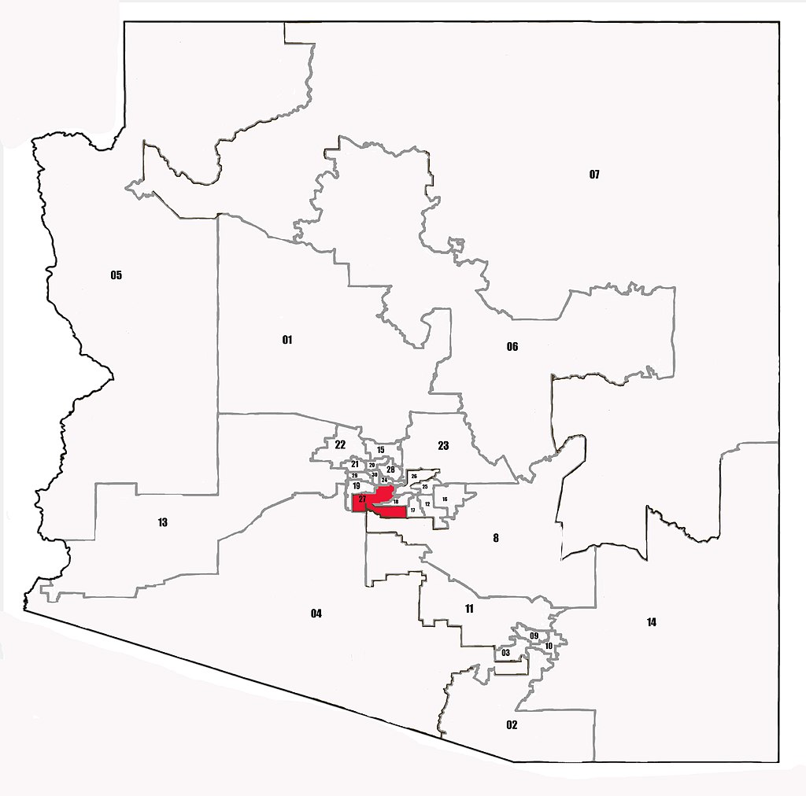
Arizona Legislative District 27
State Funded Employees | 1.9
Soft Funded Employees | 1.5
State Payroll Budget / Expenditures | $53,081
Earned Payroll Expenditures | $48,186
1 : 0.8
For every 1 state-funded Cooperative Extension FTE residing in AZ LD 27, 0.8 additional non-state-funded FTE are supported in AZ LD 27 by the presence of Extension in the state. These additional jobs are supported both within AZ LD 27 through earned, non-state funding, as well as through multiplier effects in the community.

Slide 28
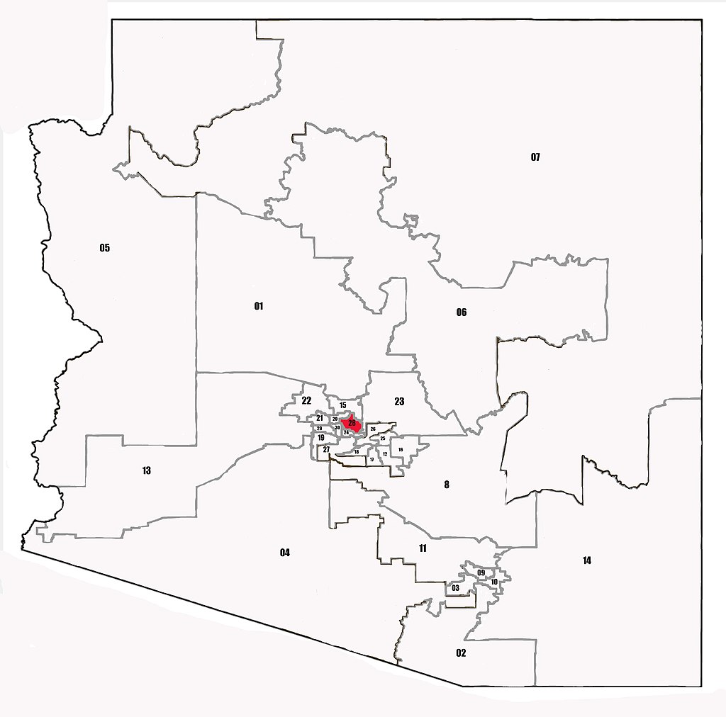
Arizona Legislative District 28
State Funded Employees | 2.5
Soft Funded Employees | 1.0
State Payroll Budget / Expenditures | $118,573
Earned Payroll Expenditures | $49,741
1 : 0.5
For every 1 state-funded Cooperative Extension FTE residing in AZ LD 28, 0.5 additional non-state-funded FTE are supported in AZ LD 28 by the presence of Extension in the state. These additional jobs are supported both within AZ LD 28 through earned, non-state funding, as well as through multiplier effects in the community.

Slide 29
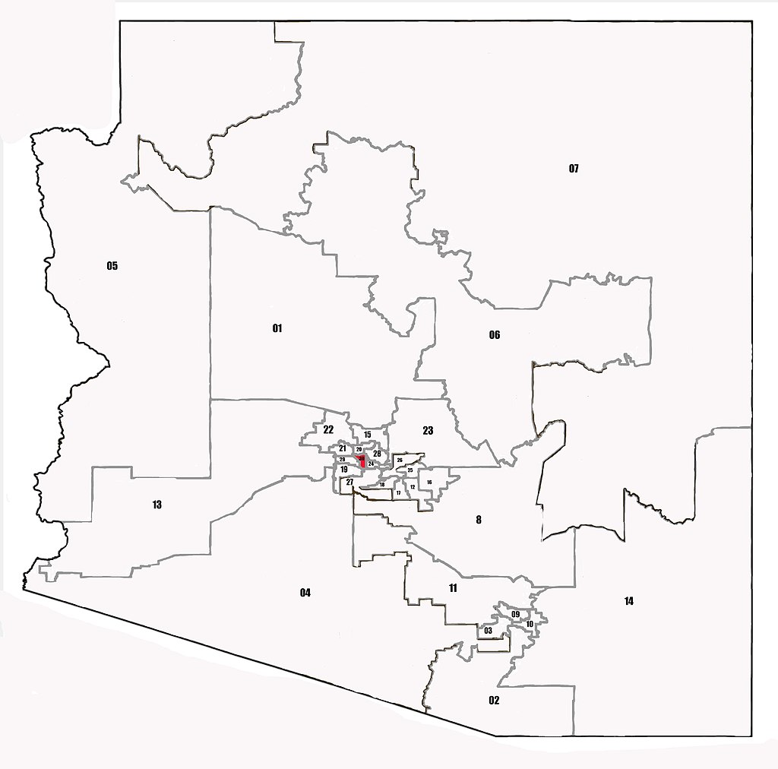
Arizona Legislative District 30
State Funded Employees | 1.0
Soft Funded Employees | 1.5
State Payroll Budget / Expenditures | $45,822
Earned Payroll Expenditures | $54,905
1 : 1.7
For every 1 state-funded Cooperative Extension FTE residing in AZ LD 30, 1.7 additional non-state-funded FTE are supported in AZ LD 30 by the presence of Extension in the state. These additional jobs are supported both within AZ LD 30 through earned, non-state funding, as well as through multiplier effects in the community.

