Slide 1
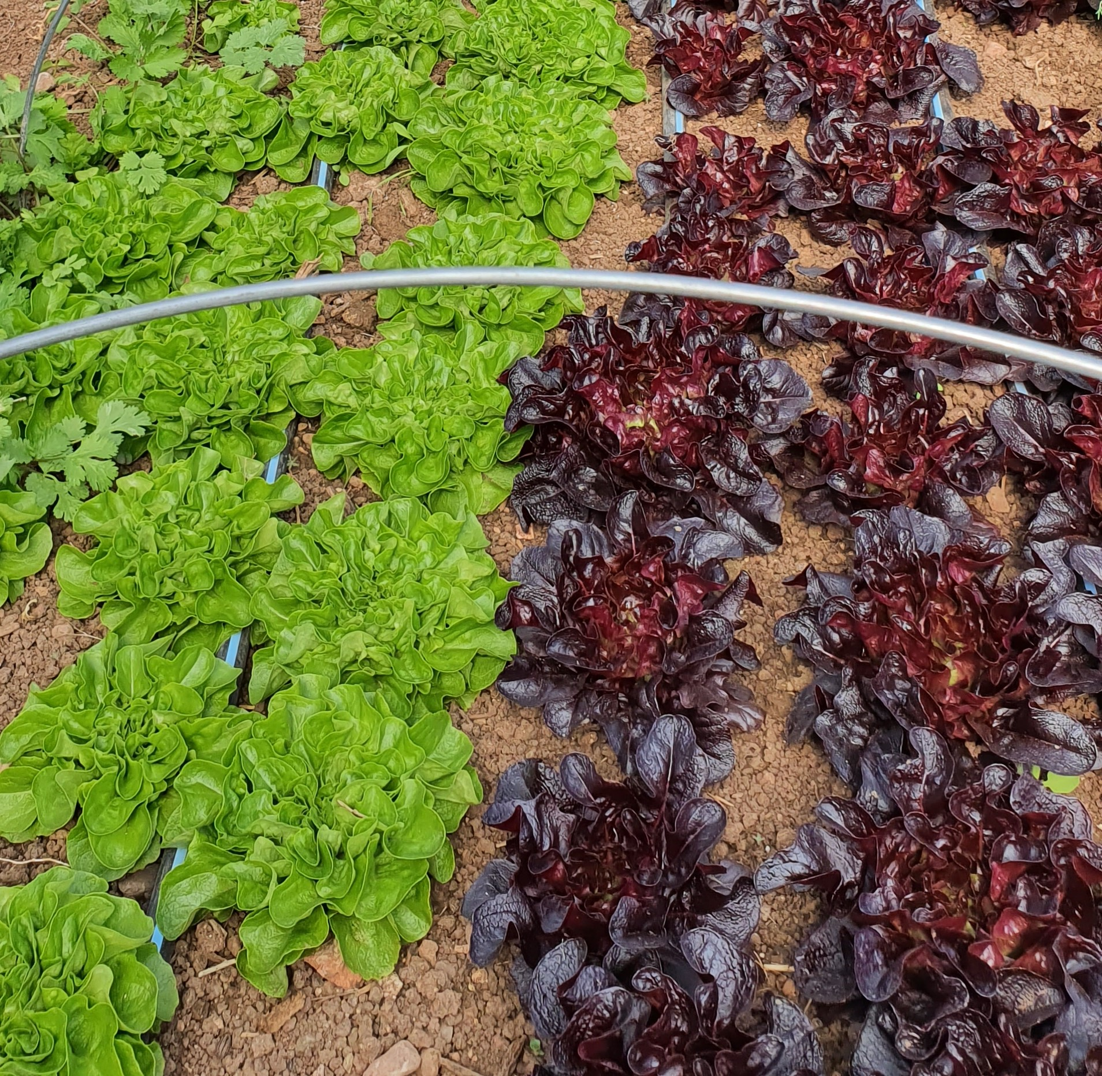

Small-scale farmers colloquium, 2020
This is a maiden monthly meeting for commercial horticulture and small-scale farmers to share science-based information on diverse topics (soil, water, pest, diseases, weeds, farm management, marketing, food safety, etc.) that will help improve farm productivity, profitability, sustainability, food safety, food security.
Dates: July 20, August 17, September 14, October 19, and November 16.
Time: 4-5pm on each date
Location: Zoom
REGISTRATION REQUIRED
To register, email your name, gender (optional), and location (county) to yavapaipres@cals.arizona.edu
Contact:
Dr. Isaac Mpanga
Area Associate Extension Agent
Comm. Hort. and Small Acreage
Email: mpangai@arizona.edu
Issued in furtherance of Cooperative Extension work, acts of May 8 and June 30, 1914, in cooperation with the U.S. Department of Agriculture, Jeffrey C. Silvertooth, Associate Dean & Director, Extension & Economic Development, Division of Agriculture, Life and Veterinary Sciences, and Cooperative Extension, The University of Arizona. The University of Arizona is an equal opportunity, affirmative action institution. The University does not discriminate on the basis of race, color, religion, sex, national origin, age, disability, veteran status, sexual orientation, gender identity, or genetic information in its programs and activities.

Slide 2
Small-scale farmers colloquium, 2020
This is a maiden monthly meeting for commercial horticulture and small-scale farmers to share science-based information on diverse topics (soil, water, pest, diseases, weeds, farm management, marketing, food safety, etc.) that will help improve farm productivity, profitability, sustainability, food safety, food security.
Dates: July 20, August 17, September 14, October 19, and November 16.
Time: 4-5pm on each date
Location: Zoom
REGISTRATION REQUIRED
To register, email your name, gender (optional), and location (county) to yavapaipres@cals.arizona.edu
Contact:
Dr. Isaac Mpanga
Area Associate Extension Agent
Comm. Hort. and Small Acreage
Email: mpangai@arizona.edu
Issued in furtherance of Cooperative Extension work, acts of May 8 and June 30, 1914, in cooperation with the U.S. Department of Agriculture, Jeffrey C. Silvertooth, Associate Dean & Director, Extension & Economic Development, Division of Agriculture, Life and Veterinary Sciences, and Cooperative Extension, The University of Arizona.
The University of Arizona is an equal opportunity, affirmative action institution. The University does not discriminate on the basis of race, color, religion, sex, national origin, age, disability, veteran status, sexual orientation, gender identity, or genetic information in its programs and activities.

