Slide 1
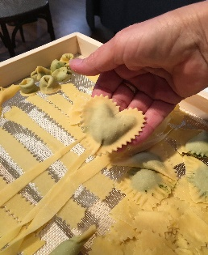
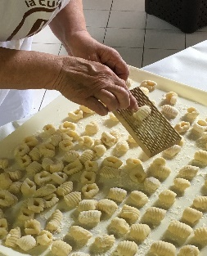
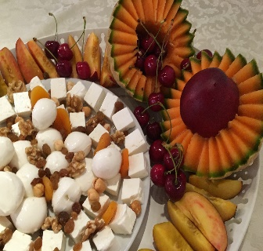
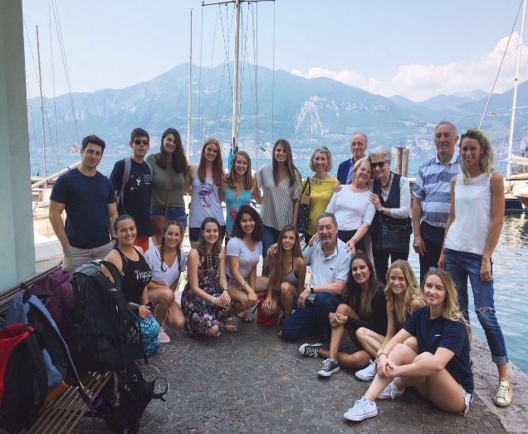
Mediterranean Diet and Health Club
presents
“Keeping track of the years by the trips we take”
Speakers: Louise and Dale Henderson
Florida Southern College and University of Arizona Alumni, Real Estate Investor and Investment Banker, Ranch Owners
and Now Retired to Travel
Join us for our ﬁrst Fall 2019 club meeting!
September 25th, 2019
5:30 PM-6:30 PM
Room N595 in ENR2 Building
(Located on the 5th ﬂoor)

