Slide 1


General Education Policy Updates:
Fall 2026
Civic Institutions
February 19, 2026

Slide 2
General Education
Fall 2026 Catalog
Changes to the General Education curriculum are approved (and being approved) to take effect for students in the 2026-2027 catalog year. Current students with a catalog year prior to Fall 2026 will continue to follow the current curriculum and policies, unless they opt to change to the 2026-2027 catalog year through the Choice of Catalog policy.

Slide 3

Gen Ed Eras
The Tiers Era
1998-2022
The Refresh Era
Spring 2022 through Aug 2026
The Next Era
Fall 2026-the far future
Curriculum: 39 units
Foundations (9 units)
Math (3 units)
Writing (3-7 units)
Second Language (variable)
Tier One (18 units, 6 units each; course #s 150/160/170s)
“INDV”; “TRAD”; “NATS”
Tier Two (12 units, 3 units each)
“INDV”; “HUM”; “NATS”; ARTS
Original Foundations
No 305 course for Composition
G, M, and S Math strands based on major
Second Language 2nd semester proficiency for non-BA plans, 4th semester proficiency for BA plans, and exception for Engineering
Curriculum: 32 units
UNIV 101 (1 unit)
Foundations (9 units)
Math (3 units)
Writing (3-7 units)
Second Language (variable)
Exploring Perspectives (12 units)
Building Connections (9 units)
UNIV 301 (1 unit)
Original Foundations
No 305 course for Composition
G, M, and S Math strands based on major
Second Language 2nd semester proficiency for non-BA plans, 4th semester proficiency for BA plans, and exception for Engineering
Curriculum: 32 units
UNIV 101 (1 unit)
Foundations (9 units)
Math (3 units)
Writing (3-7 units)
Second Language (variable)
Exploring Perspectives (12 units)
Building Connections (6 units)
Civic Institutions (3 units)
UNIV 301 (1 unit)
Fall 2026 Foundations
WRIT 305 option added to Composition, replacing Portfolio
Single Math Foundations list
Second Language (no approved update)
Students connect with advisor for major-specific math requirement
(likely meets Foundation Math requirement).

Slide 4


Policy Changes
Civic Institutions
Introducing Civics
Reduction in Building Connections requirement

Slide 5

Introducing Civics
In Civic Institutions courses, students will cover the breadth of the study of Civics. Comprised of seven identified areas, students will complete one course at 3 units to meet the American Institutions requirements for General Education programs by the Arizona Board of Regents General Education policy 2-210.

Slide 6

ABOR Policy 2-210 General Education
Civic Institutions courses will address:
how the history of the United States continues to shape the present.
the basic principles of American constitutional democracy and how they are applied under a republican form of government.
the United States Constitution and major American constitutional debates and developments.
the essential founding documents and how they have shaped the nature and functions of American Institutions of self-governance.
landmark Supreme Court cases that have shaped law and society.
the civic actions necessary for effective citizenship and civic participation in a self-governing society – for example civil dialog and civil disagreement .
basic economic knowledge to critically assess public policy options and to inform professional and personal decisions.

Slide 7
Civic Institutions vs. Civics Exploration Attribute
Civic Institutions is a general education course requirement for graduation. It provides breadth of knowledge regarding Civics.
Other EP and BC courses can be tagged with a Civic Exploration attribute indicates that there will be a civics ‘flavor’ to the course, but does not fulfill the Civic Institutions requirement. Attributes are not visible to students but are required of all Gen Ed courses.
Notes:
Only Building Connections and Exploring Perspectives courses will be eligible to carry the Civic Exploration Attribute. Civic Institutions courses are not eligible to carry the Civic Exploration Attribute. (Voted on by UWGEC 10/29/25)

Slide 8
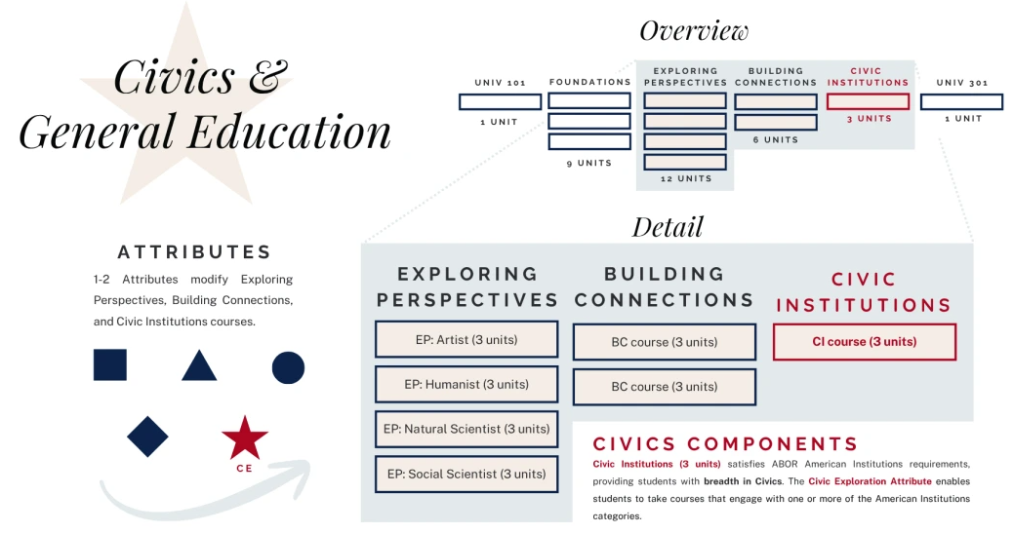

Slide 9
Building Connections
For students admitted Fall 2026 or later, they are required to complete 2 Building Connections courses (6 units).
The overall 32 unit requirement for General Education is consistent with the addition of Civic Institutions.

Slide 10
UNIV 301
Prerequisites for the course will be edited so that it requires completion of 5 out of 7 courses from Exploring Perspectives, Building Connections, and/or Civic Institutions.
Students also need to have completed their Foundation Writing and Math before UNIV 301.

Slide 11
Civics Courses
Courses on the Schedule of Classes for Fall 2026 - Spring 2027; 25+ additional courses moving through proposal process
POL 201
HIST 150C3
AP Credit
American National Government
Approved!
U.S. Society and Institutions Since 1877
Approved!
AP US History scores of 4/5 are currently articulated at the UA as HIST 150C3. AP US Government & Politics 4/5 scores are articulated POL 201. So students’ civic institutions requirement could be satisfied with AP credit!
Notes:
If you would like to encourage your faculty to submit their courses for consideration for Spring 2027 and beyond, please do!
We anticipate that more courses will be approved for Civic Institutions for Spring 2027 and so students without an urgent need to complete it right away may find more options in Spring.

Slide 12

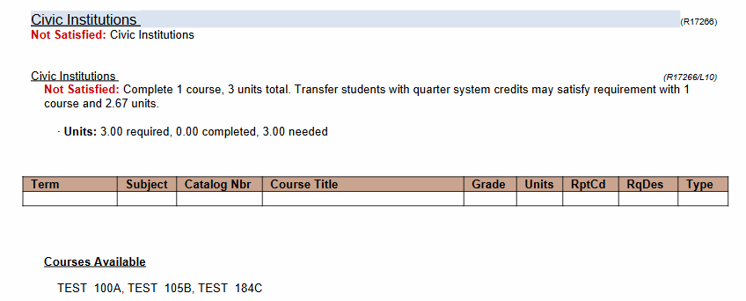
ADVIP Screenshot for Civic Institutions
Notes:
Stephanie

Slide 13
Transfer Credit
If a student has completed the AGEC/IGETC/CSU GE/Previous Bachelor’s, their Civic Institutions requirement, like all their other general education courses, will be satisfied.
Courses from AZ Community Colleges will be articulated and applied to the ADVIP based on the AZ Transfer guides.
Other transfer courses may be applied individually to the Civic Institutions requirement as determined on a course-by-course basis with their primary major Academic Advisor.
Notes:
Stephanie

Slide 14
Reviewing Civics Courses
Consider these things when reviewing potential Civic Institutions transfer courses:
Civic Institutions Learning Outcome
Alignment with all 7 ABOR Areas
Perspective-taking
In order to ensure alignment with the perspective-taking foundations of the Gen Ed program, Civic Institutions courses must name one or more perspectives that will be taken in the course. These may be disciplinary perspectives, professional perspectives, or social positions.
From one or more perspectives, students will demonstrate understanding of civic institutions by analyzing the U.S. Constitution and other founding documents; assessing the development of principles and institutions of governance including the judiciary; and applying historical, economic, and other domains of knowledge to inform civic action and participation in public policy and decision making.
See ABOR Policy 2-210 General Education
Notes:
If you would like to encourage your faculty to submit their courses for consideration for Spring 2027 and beyond, please do!
We anticipate that more courses will be approved for Civic Institutions for Spring 2027 and so students without an urgent need to complete it right away may find more options in Spring.
Devon

Slide 15
Reviewing Civics Courses
What to look for when evaluating Transfer Courses:
Green Flags
Red Flags
Is about some time period of US History and includes contemporary application
Includes Civic action, behaviors, duty, commitment, engagement
Includes Civic Institutions-established organizations that serve the community and helps uphold societal values, rights, responsibilities
How these shaped our government, constitution, court cases, economy
Can’t just be a US history course
Only focuses on the present without historical context
Is not US based
Does not describe multiple perspectives that topics could be viewed through
Does not connect to any US core documents or judicial decisions
Notes:
Stephanie
https://ge.arizona.edu/advising-principles-policies
"Spirit of the requirement"

Slide 16
AGEC- Fall 2026 Updates
Community Colleges are adjusting the AGEC for Fall 2026:
One AGEC, no longer AGEC-A, B, or S
Required AGEC course category, Institution of the Americas
Some similarities to Civic Institutitions
Working on list of Civic Institutions transfer course list from Pima CC and other Arizona CCs institutions
https://www.aztransfer.com/resources/documents/agec/agec_redesign_categories_criteria_final.pdf
Notes:
Stephanie

Slide 17

Case Studies
For each scenario, you and your small group will discuss:
How would you advise the student?
What questions would you ask the student?
What would you look for in UAccess?
What other resources could you use?

Slide 18
Jed
Jed is a new BA Economics major at the UA entering in Fall 2026. He won’t know his AP scores for US History, Calculus, and Spanish Language & Culture until July. When you meet with him during orientation Course Scheduling, what will you advise?
Notes:
delay enrolling in civics since he may earn credit for it from AP US history.
second language placement until AP score comes?
does the student otherwise have a math placement? dual enrollment?

Slide 19
Kate
Kate is a Fall 2026 incoming Human Development and Family Science major who placed into MATH 100 with a PPL of 10. She has no transfer credit in UAccess. At her orientation Course Scheduling she asks what general education courses she should be completing in her first semester.
Notes:
Degree Search recommends these for a first semester HDFS major:
-WRIT 101
-MATH 100 (UNIV 100?)
-HDFS 195
-HDFS 117
-Second Language
-UNIV 101
Civics might best wait until Spring 2027 or sophomore year for most course availability.

Slide 20
Joey
Joey is a Fall 2026 transfer student to the Rehabilitation Studies and Services major. Joey did not complete an AGEC in her time at Paradise Valley Community College. She had taken POS 113 “United States and Arizona Social Studies” and asks if it will complete her Civic Institutions requirement.
Notes:
POS 115 is currently articulated as POL Dept elective and as an EP Social Scientist for the 2025-2026 catalog.

Slide 21
Abby
Abby took a course in Fall 2026 that in Spring 2027 was approved as a Civic Institutions course, but it was not when she took it. She has not otherwise completed the Civic Institutions requirement. What do you advise?

Slide 22
Will
Will started at the University of Arizona in Fall 2024 and took some time off under Back2UA. While at Pima he completed an AGEC. However, it is not satisfying his Foundation Math requirement. He asks you if he needs to complete his math?
Notes:
Choice of catalog policy

Slide 23
Danny
Danny took a course at Gonzaga University. He wonders if this course that he completed can be used for Civic Institutions:
POLS 301. Politics of Food. (3 Credits)
Examines the nature and origins of local, state, and federal policies impacting the U.S. food system. Major topics include food safety, nutrition guidelines, the problems of hunger and obesity. Significant attention is paid to the interplay of ordinary citizens, corporations, and local, state and federal governments and the role of each in the policy making process. Spring, alternate years. Offered occasionally.
Notes:
https://ge.arizona.edu/civics-rubric
Does impact US-based history and its impact on people ("origins")
Discussion of levels of government
Discusses policy making process
Multiple perspectives- citizens, corporations, governments
Value of looking at a course description vs. title.

Slide 24

Policy Changes
Writing Foundations
ENGL Prefix discontinuation
Transfer Portfolio Discontinued
300-Level course to satisfy Foundation Writing requirements for transfer students

Slide 25
Transfer Portfolio
The end of the era is August 1, 2026!
August 1, 2026
Transfer Equivalency
New Course Option
This is the last day that students can submit a portfolio for a Foundations Writing waiver.
Transfer students should submit course equivalency requests through the Transfer Credit Evaluation team in the Registrar’s Office.
If previous coursework doesn’t satisfy Foundation Writing requirements, students can be advised to take WRIT 305 (ENGL 306T) to meet the requirement.

Slide 26
Introducing WRIT 305
A great option for transfer students!
Course Rebrand
Recommended Population
Course Logistics
Beginning Fall 2026, WRIT 305 will become a Foundations Writing course option, replacing WRIT 306T.
This course is designed for students with more than 40 transfer units AND one or no transferable writing courses.
Currently only offered in Fall & Spring in 7W2 session (online only)
TBD on offering frequency over time.

Slide 27

Policy Changes
Math Foundations
Single GE Math list for all students/majors
No More Math Strands
Must have course credit
GE Math Multiple Use Policy

Slide 28
One GE Math List
This list will show for all majors!
AREC 239, ISTA 116, LING 123, MATH 106, MATH 107, MATH 108, MATH 112, MATH 113, MATH 116, MATH 119A, MATH 120R, MATH 122B, MATH 125, MATH 129, MATH 163, MATH 263, PHIL 110, PHIL 202, PSY 230, SBS 200, BASV 314, APCV 302.

Slide 29
GE Math List
What this means...
Current List
Applies to All Majors
Major Math Requirements
The current list is all approved GE Math courses at or below the level of MATH 129.
Once the GE Math has been satisfied it applies to any major.
Major math requirements and promoting them in advising will be more important than ever. Need to pay attention to the major requirement, which likely overlaps with Foundation Math.

Slide 30

How an Idea becomes a Policy

Slide 31
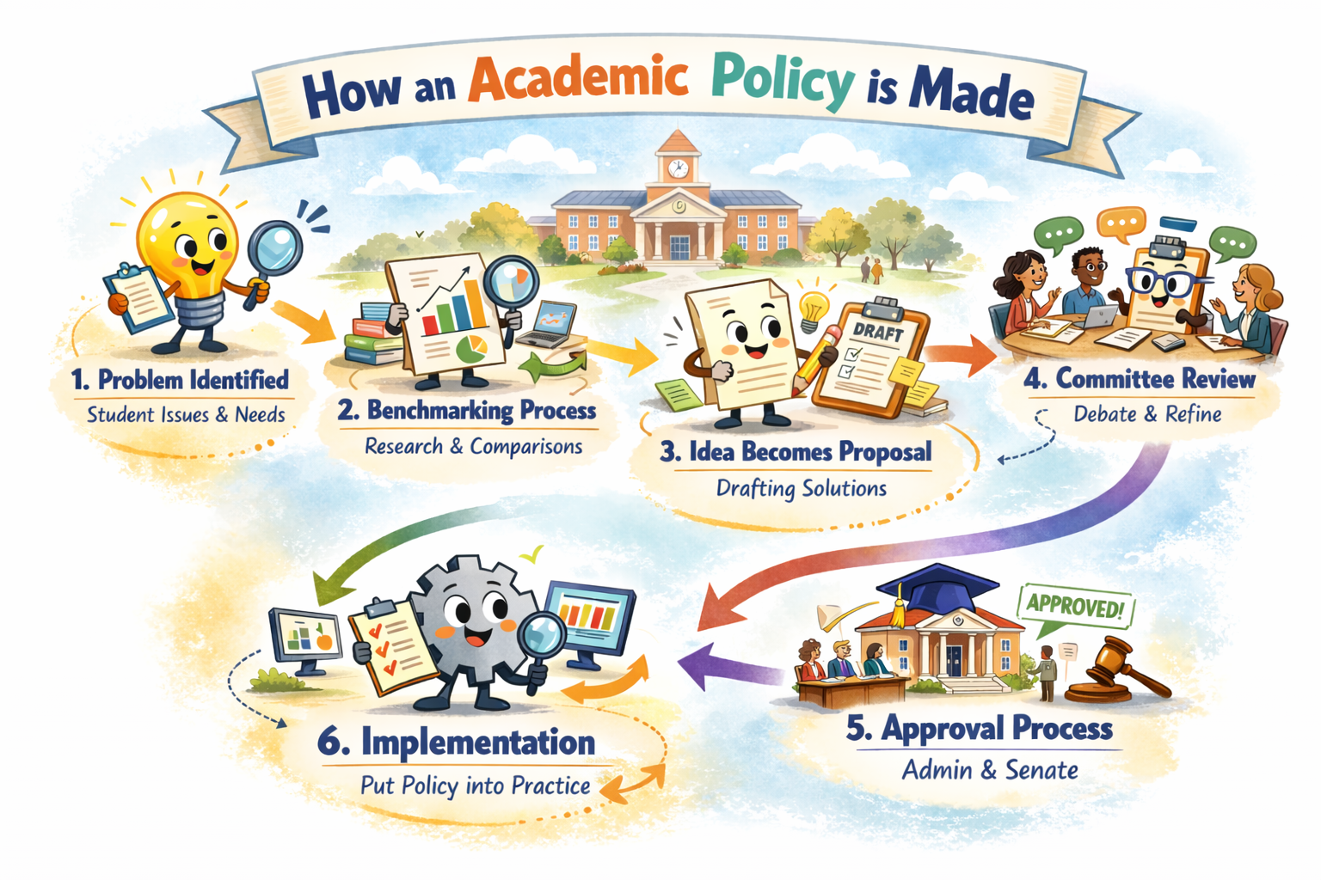
Advisor Insight in Policy Revisions or Updates
Identifying patterns or unintended consequences
Provide student centered perspectives
How will it work in real life?
Notes:
As an advising community, the work we do can help inform future policies or provide direct input into policies as they develop.
Let's use the example of the recent changes to the Course Repeat Policy to frame this discussion to discuss how the changes (the "idea") made their way to policy and how advisors worked with committees to help it get there

Slide 32




Vision & Goals
Substantial impact on retention & graduation
Eliminate obstacles & promote student success
Prioritize equity & create a more inclusive environment
Simplify academic operations

Slide 33
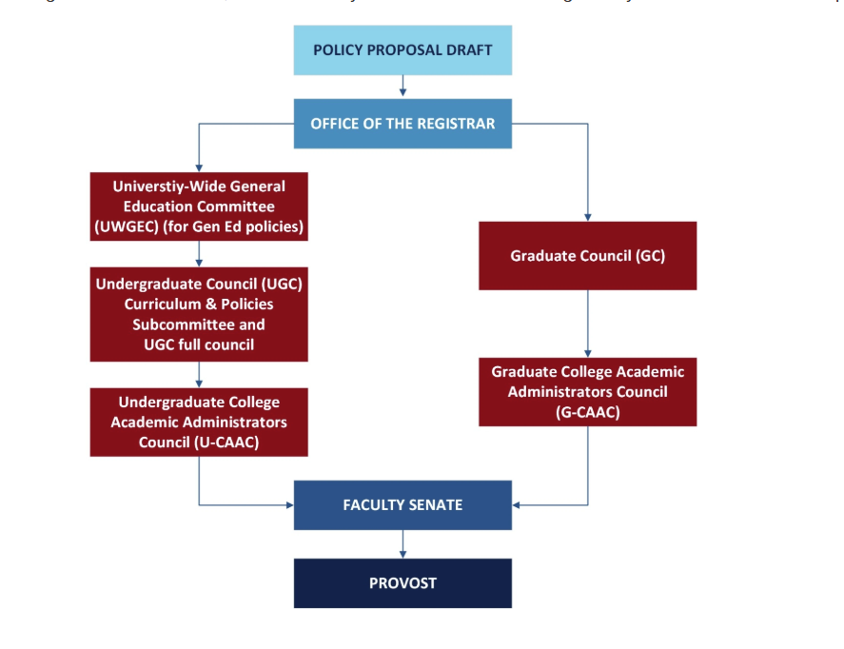
Our Big Idea’s Journey through Committee

Slide 34
Undergraduate Councils & Committees
University Wide General Education Committee (for Gen Ed)
Undergraduate Council (UGC)- Subcommittees and Full Council
Undergraduate College Academic Administrators Council (U-CAAC)
Faculty Senate

Slide 35

Our Idea is now a Policy!
Advisor input at each stage makes a policy easier to implement, understand and apply!

Slide 36
Policy Proposals
What follows are a few policy proposals that can impact General Education. They are not fully approved, but we wanted to put it on your radar early.

Slide 37

Policy Proposal
Second Language
For now, assume that there are no changes to the Sound Language Foundations policy.
There is discussion to adjust Second Language requirements by degree type. Unknown if policy will change at this time.

Slide 38
Second Language Proposal
This is not approved, but is in early discussion stages.
GE Foundation
BA Second Language Requirement
All students would have a second semester proficiency requirement, consistent across all majors.
There is discussion around potential new ways to demonstrate proficiency.
Proposal for a fourth semester proficiency or an additional second semester proficiency in another language beyond GE requirement.
Would be a degree-specific university requirement.

Slide 39
Substitutions Policy Proposal
There is a policy change working through the approval process
(Pending final approvals)
If there is a UA course that is not approved as a General Education course, the Office of General Education can review it for use in a student’s General Education curriculum.
Academic Advisors would not be substituting UA courses into General Education, unless it is for a DRC accommodation.
Once a course substitution is approved, it will be honored by all undergraduate programs for the student.
This policy does not apply to ADVIP exceptions for Transfer Credit, which has a separate policy.
Notes:
If you would like to encourage your faculty to submit their courses for consideration for Spring 2027 and beyond, please do!
We anticipate that more courses will be approved for Civic Institutions for Spring 2027 and so students without an urgent need to complete it right away may find more options in Spring.

Slide 40
Transfer Credit Policy Proposal
Early discussion of proposing edits to this policy
Current policy discusses transferring individual general education courses for EP and BC.
Plan to expand policy to include discussion of Foundations and Civic Institutions
Current practice is that Academic Advisors are not making decisions about what transfers for the Foundations. Discussion of codifying that into policy.
Notes:
If you would like to encourage your faculty to submit their courses for consideration for Spring 2027 and beyond, please do!
We anticipate that more courses will be approved for Civic Institutions for Spring 2027 and so students without an urgent need to complete it right away may find more options in Spring.

Slide 41





General Thoughts on General Education
WRIT is the new ENGL
One Math for All
Civics
AGEC et al.
GE Math Foundations will be consistent for all students, but majors will have more math variation than ever.
The Civic Institutions requirement will replace one BC gen ed. Courses launch Fall 2026 and will add more options for Spring.
The AGEC et al. will satisfy all General Education Requirements (including Foundations) for students admitted Spring 2025 and later.
WRIT is the new prefix for Writing Foundations Classes, which includes WRIT 305.

Slide 42
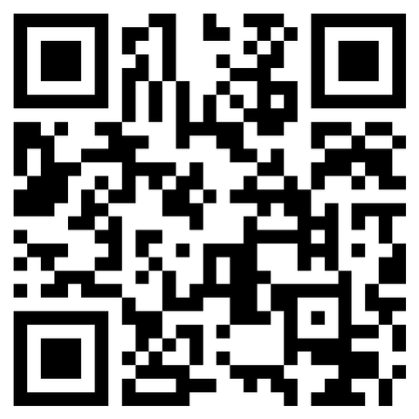
Questions?
Collaboratively, we want to make sure that the new Fall 2026 GE structure is being implemented consistently around campus. Please submit questions that you or you think your students might have so that we can build an evolving FAQ for Academic Advisors!

