Slide 1

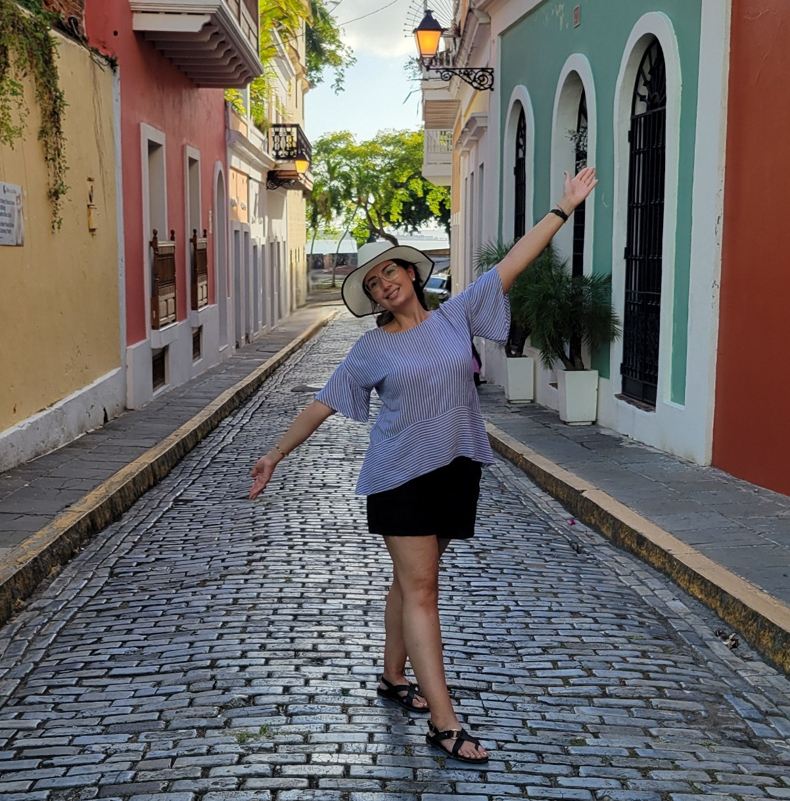
SERENA VALLE
HOMETOWN: Tucson, Arizona
JOB TITLE: Senior Academic Advisor
This summer outside of Orientations. I was able to travel to San Juan, Puerto Rico for a conference and complete personal travel. My favorite experience from this was visiting a bioluminescent bay in Fajardo.
I also played in our summer staff/faculty softball league. Our team made it to the championships!

