Slide 1
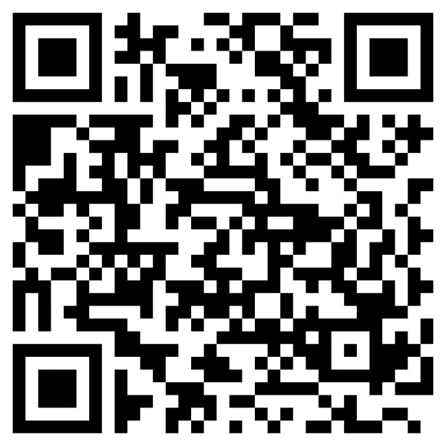
APPLY NOW
FOR CALES SCHOLARSHIPS!
Scan the QR code for a custom-created CALES How to Apply Guide.
$1.1 million+ in scholarships for CALES students
Academic year 2025-2026
Deadline: April 1, 2025 (11:59PM AZ time)
You are eligible!
✓ All academic levels: First-Year through Graduate
✓ All CALES majors
✓ All CALES certificates
✓ All students with a minor in CALES (even if your major is elsewhere)
✓ All campuses: Main, Online, Near You Network (Distance)
✓ All new students: First-Year, Transfer, Graduate
✓ All GPA levels
Visit cales.arizona.edu/current-students/scholarships-financial-aid for more information.

