Slide 1
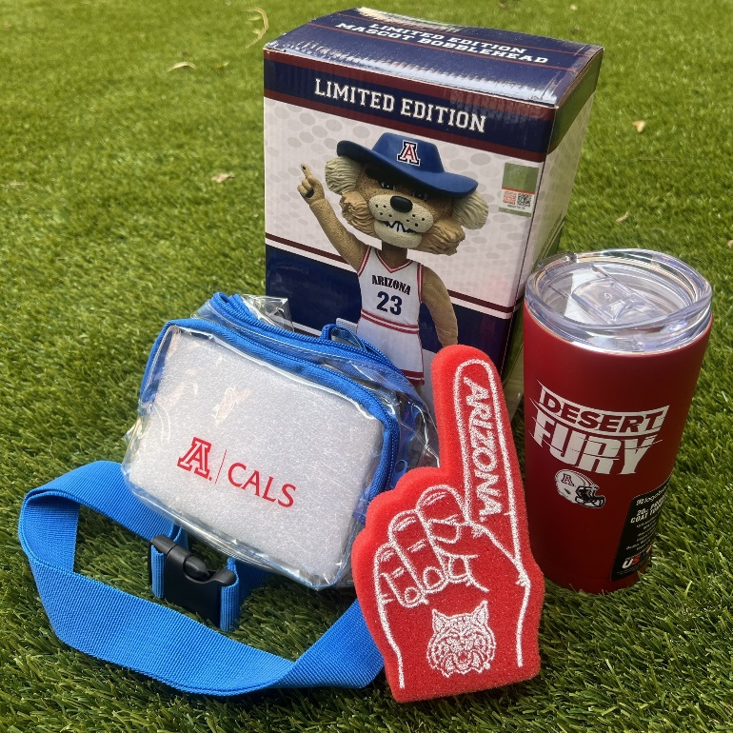
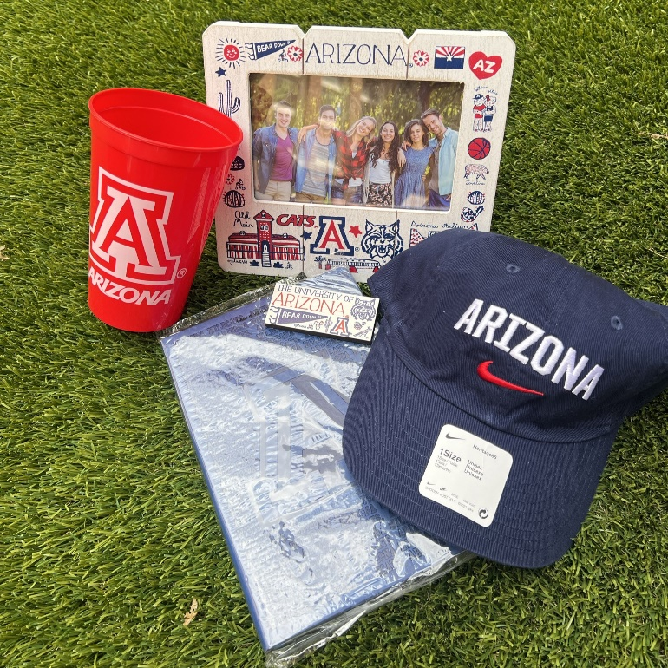

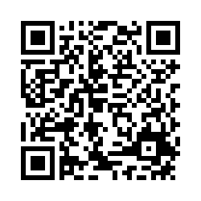

Share your experience. Win Wildcat gear!
CALES Annual Student Experience Survey
Your voice matters! Share your feedback to improve your college resources and enter to win one of six University of Arizona prize bundles.
Who is eligible?
Undergraduate students in a CALES major, minor or certificate.
Deadline: May 10, 2024
Scan Me!
We listen to your feedback
Every year, we apply your feedback to how we develop, communicate and provide resources to CALES students like you.

