Slide 1
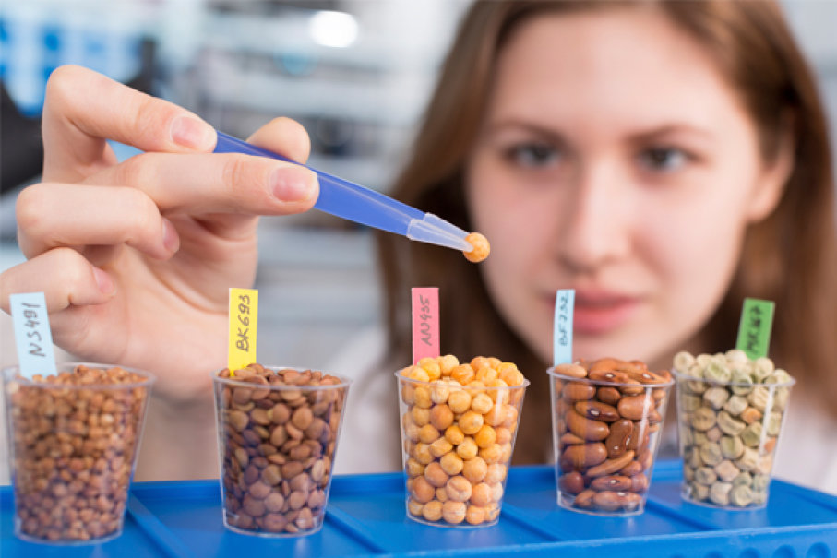
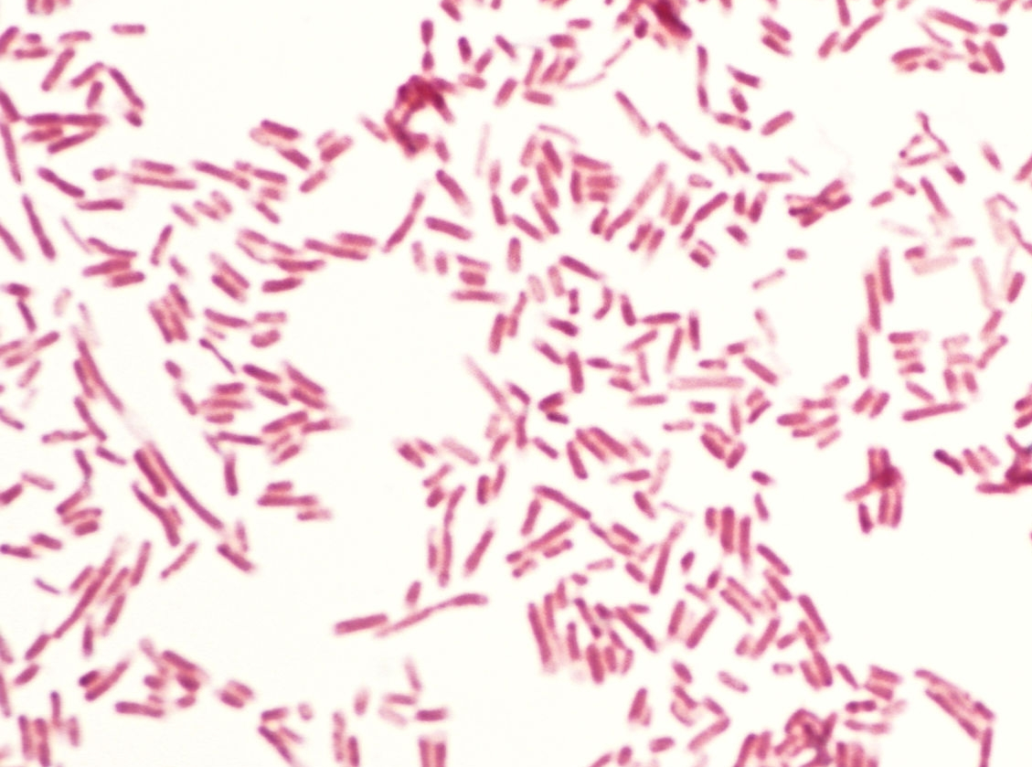
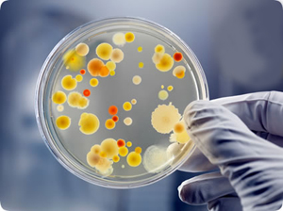


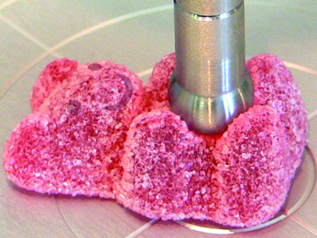
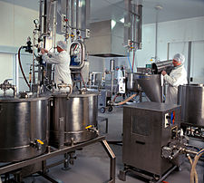

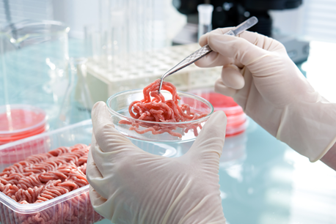

MIC/NSC 430/530 L – Advanced Food Science & Microbiology Laboratory
Spring 2024; MW, 10:00 am to 12:45 pm; Koffler 108/Shantz 101
Dr. Sadhana Ravishankar and Prof. Yonarki Garcia Varela
Microorganisms and the Food Industry
Food processing techniques and product development
Sensory evaluation
Lab techniques to evaluate food safety, quality and shelf-life
Prevention strategies in the food industry
New product formulation and development

Slide 2
Course Objectives
To gain an understanding of the laboratory techniques used to evaluate food safety, quality, and shelf-life.
To determine the effects of processing and storage conditions on food safety, quality, acceptability, and shelf-life.
To apply these techniques and concepts learned in determining the safety, acceptability, and shelf-life of new product formulations.

Slide 3

What Would You Learn From This Course?
Perform basic skills relevant to food product development and food microbiology laboratory assays.
Investigate the microbiological quality and safety of food.
Analyze the color, textural, and other qualities of food and select quality and flavor attributes that contribute to a marketable product.
Explain how packaging and ingredient selection impact product safety and shelf-life.
List the basic concepts of food chemistry and microbiology that relate to product development and analysis.
Work in a group and creatively research, design, and test your own new product formulation which may be patentable!

