Slide 1
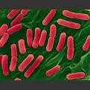

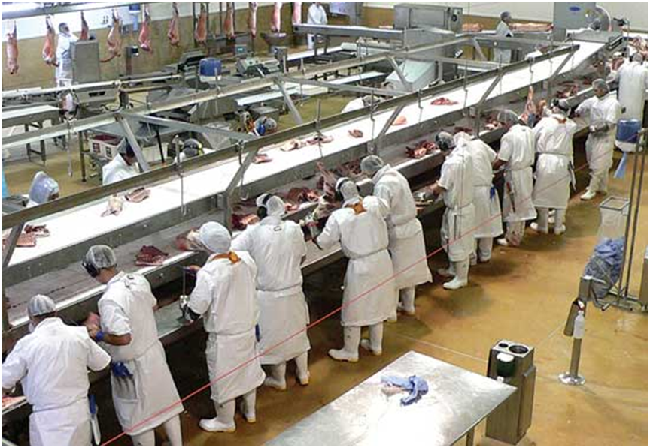



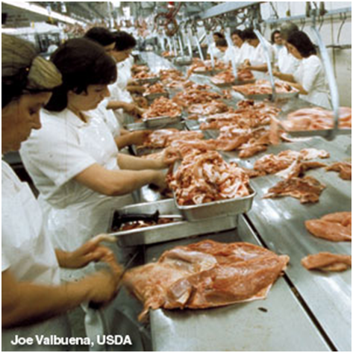

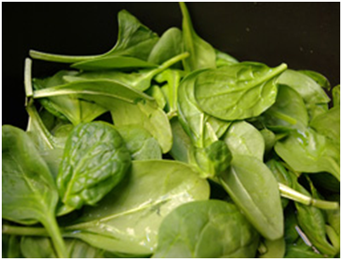
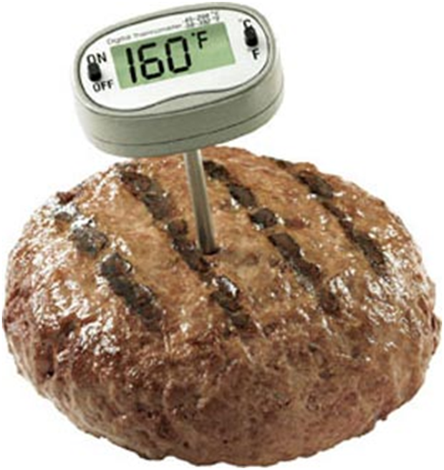


z
MIC 430/530 – Food Microbiology & Biotechnology Lecture Spring 2024; TTH 9:30 am – 10:45 am ACBS 129; Dr. Sadhana Ravishankar
Microorganisms causing foodborne illness & food spoilage
Detection & prevention of food spoilage and pathogenic organisms
Role of regulatory agencies in foodborne outbreak investigations
Microorganisms in food production

Slide 2
Course Objectives
To become familiar with microorganisms involved in food, food safety and food biotechnology
To learn and integrate principles from chemistry, biochemistry and molecular biology for understanding of application in food technology and food safety

Slide 3
What would you learn from this course?
Microorganisms of importance to food safety and food fermentations
Principles of microbial occurrence and control in food
Mechanisms of microbial inactivation
Industrial applications of microbial food fermentations
Microbiological contaminants and methods for their detection
Foodborne disease outbreaks, causes, investigation and agencies involved

