Slide 1

NEW FEATURES OF
Josh Butcher – Assistant Director, Instructional Technologies
Webinar offered by:
University Center for Assessment, Teaching, & Technology (UCATT)
UITS Collaborative and Academic Technologies

Slide 2

Housekeeping Items
Session is being recorded and the recording will be sent to you in a follow-up email.
This presentation slide deck will be shared with you in the follow-up email along with a condensed summary of all the chat questions and answers.
Microphones will be muted until the very end for questions.
Chat will be disabled for participant entry however host/co-hosts will still be providing information for you to read in the chat.
Questions?
  Type them in the Q&A tool.
  Save them until the end to ask verbally.
Don’t get your questions answered during our session?
  Follow up afterwards with us by emailing d2l@arizona.edu.

Slide 3
AGENDA
FEATURE UPDATES
  New D2L Integration Features
    Appointment Scheduler
    Auto import course roster for breakout rooms
    Course-level publishing of cloud recordings
    Syncing an attendance report to D2L gradebook
    Zoom Team Chat for courses
  Share multiple desktop screens
  Suspend participant activities enhancement for breakout rooms
  Raise hand enhancements
  Continuous meeting chat
  Continuous meeting chat file and images synchronization
  Retain chat messages from breakout rooms
  Interpreter exemption to host preventing participants from unmuting

Slide 4
ZOOM RELEASE NOTES
Zoom will typically release new versions of their products 2-3 times a month.
While we don’t highlight ALL of the features that Zoom releases in this webinar, you can read about and explore the newest features from their release notes.
Current and Past Release Notes for Zoom Client

Slide 5
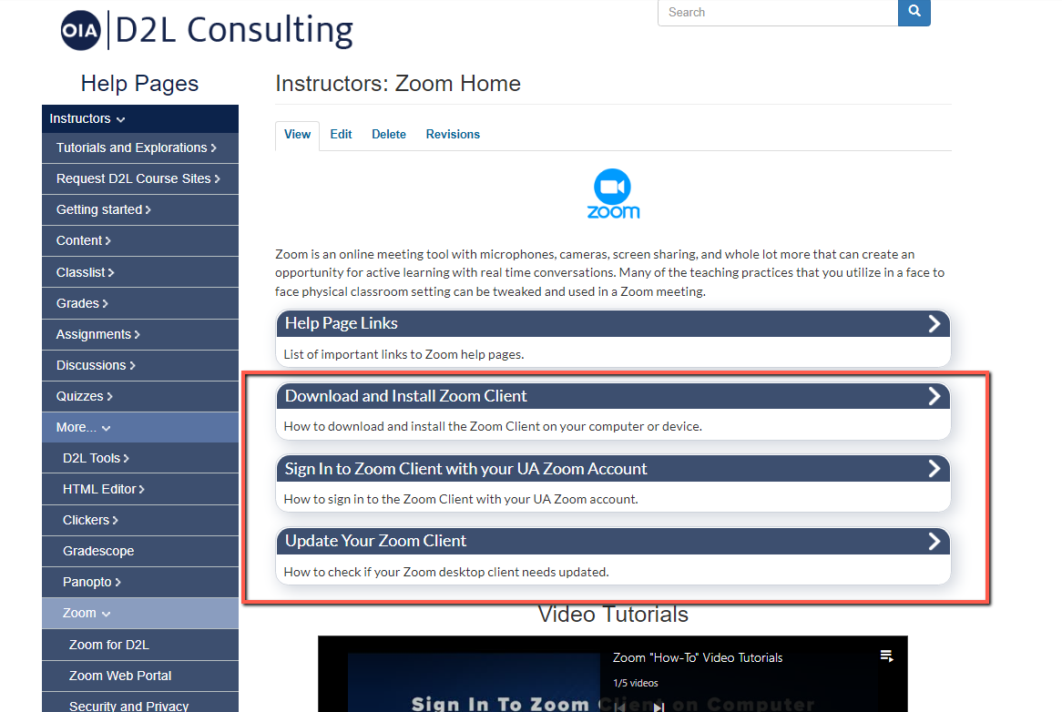
ZOOM CLIENT
Download / Sign-In / Update
UA Zoom Help Page

Slide 6
D2L Integration – Appointment Scheduler
This feature focuses on providing an office hours, scheduling, and calendar system through the use of Zoom. Instructors can create, edit and publish their availability for office hours. Students can view active bookable schedules in their course and schedule 1:1 appointments with their instructors. Note: Schedules are set at the course level. Any appointments will be applied to that course only.
Limitations
Appointments that have already been scheduled will not be deleted when an Instructor edits their schedule
Currently does not support Personal Meeting IDs or students as the host.
Using LTI Easy Scheduler for office hours

Slide 7
D2L Integration – Auto Import Course Roster for Breakout Rooms
Meeting hosts can pre-assign participants into breakout rooms when scheduling meetings. Administrators can enable the integration to pull a list of participants from the LMS and pre-populate the breakout room participants list. The meeting host can then select which participants to add to the breakout room.

Slide 8
D2L Integration – Course-level Publishing of Cloud Recordings
With course-level publishing, instructors can quickly manage cloud recordings for a course, and bulk publish or unpublish recordings
Using course-level publishing as an instructor

Slide 9
D2L Integration – Syncing Attendance Report to D2L Gradebook
With the LTI Attendance Report feature for D2L, instructors can sync the Zoom Meeting Attendance Report with their D2L Gradebook. This allows instructors to quickly generate attendance grades based on the meeting attendance report.
From the link below, review the many important considerations before using this feature, a few of which are:
Feature does not support meetings that utilize personal meeting IDs.
Feature does not support Join Before Host.
Feature only supports meetings created by instructors.
If meeting duration is less than 5 minutes, a report will not be generated.
If the meeting starts too early or too late, there will not be a generated attendance report. Meeting must be started within the expected time frame for when it was scheduled (no more than 10 minutes before the scheduled start time, and no more than 10 minutes after the scheduled end time).
Syncing attendance report with D2L Gradebook

Slide 10
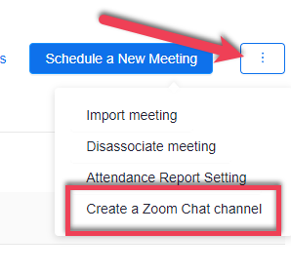
D2L Integration – Zoom Team Chat for Courses
Instructors can have Zoom Team Chat channels automatically created and managed using their course roster.
Within a D2L course, select UA Tools > .Zoom.
Select the 3 dots button.
Select Create a Zoom Chat Channel
Using Zoom Team Chat with a D2L Course

Slide 11
Share Multiple Desktop Screens
Screen sharing has been enhanced to allow meeting participants to share 2 desktop screens at once. Previously, participants could only share one desktop or multiple different open programs at the same time.
Select Share Screen button in meeting toolbar.
Hold down Ctrl key (PC) or Shift key (Mac) and select multiple desktop screens.
Select Share button.

Slide 12
Suspend Participant Activities Enhancement for Breakout Rooms
When the host of the meeting uses the Suspend Participant Activities option under Security controls, in addition to stopping all screen shares, video, and audio, all breakout rooms will be closed and participants are returned to the main session. Previously, breakout rooms were unaffected by this security control.

Slide 13

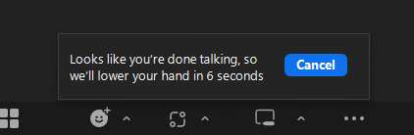
Raise Hand Enhancements
The visibility of participants that have raised their hand is enhanced to make it easier for hosts to be aware of raised hands and take action to address that participant. A new notification will appear for those who raised their hand, with the option to immediately open the Participants panel and take action, such as requesting their unmute to ask their question. Users can enable an audio chime through client settings for when someone raises their hand. Lastly, after speaking with your hand raised, Zoom will start a countdown to lower your hand, unless manually canceled by the user.

Slide 14
Continuous Meeting Chat
Meeting hosts can schedule a meeting and invite contacts, who are added to both the calendar event for the meeting and the dedicated Team Chat group chat. This group chat and its messages are accessible by members before, during, and after the scheduled meeting.
Enabling Continuous Meeting Chat
Creating and Using Continuous Meeting Chat
Frequently Asked Questions for Continuous Meeting Chat

Slide 15
Continuous Meeting Chat File and Images Synchronization
Files and images shared during the meeting synchronize with the dedicated group chat created for the meeting, allowing participants to access them after the meeting. In the same fashion, files and images shared in the dedicated meeting group chat will synchronize with in-meeting chat.

Slide 16
Retain Chat Messages from Breakout Rooms
When using the new meeting chat experience, users will be able to view the main meeting chat message history when they join a breakout room and also view breakout room chat history when they return to the main meeting. Previously, the new meeting chat experience did not support messages following in and out of breakout rooms.

Slide 17
Interpreter Exemption to Host Preventing Participants from Unmuting
Host designated interpreters will be able to unmute themselves even when the host prevents participants from unmuting themselves. Previously, all participants in a meeting, except for the host and co-host, were blocked from unmuting if the host prevented unmuting through the in-meeting security controls.

Slide 18

QUESTIONS?
To ask a question verbally, please select the Raise Hand icon in the meeting toolbar and we will call on you to unmute your microphone.

Slide 19
FUTURE WEBINARS
Interested in attending future webinars that UCATT might be providing, including these New Features of Zoom webinars?
Future webinars and events will be advertised on our UCATT Events page!

Slide 20
CONTACT US
Email
Phone – 520.626.6804
Website
Calendly (Schedule a 1-on-1 Consult)
When you leave this meeting, you will be prompted in your browser to go to an anonymous survey about today’s webinar session. Please consider taking a few minutes to fill that out and provide us useful feedback to make these webinar sessions better.
Thanks!

