Slide 1
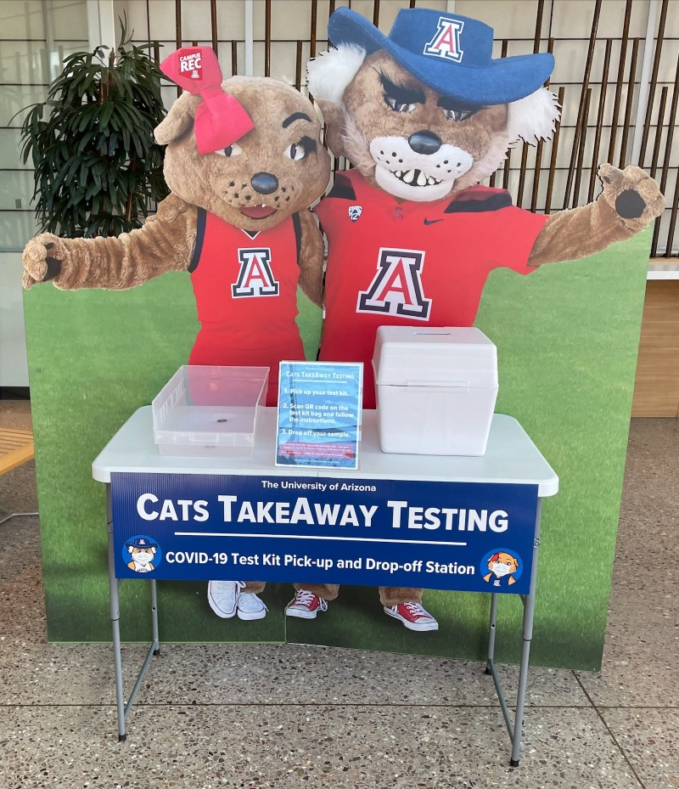

The University of Arizona
Cats TakeAway Testing
Launched
September 15, 2021

Slide 2
What is TakeAway Testing?
PCR Saline Gargle COVID-19 virus test (self-administered)
Free and convenient pick-up and drop-off
Available for all students, employees and DCCs
9 locations across campus
Campus Health outdoor location for people with symptoms
Results usually delivered in 2 business days or less
Not suitable for domestic or international travel
Reminders:
Do not eat, drink, use mouthwash, brush your teeth, chew gum, smoke, or vape for 30 minutes before your saline gargle test.
Find an appropriate place to collect your sample (away from the TakeAway pick-up / drop-off station) within 4 hours prior to dropping-off your sample
Cats
TakeAway
Testing
Launched September 15
https://arizona.edu/takeawaytesting

Slide 3
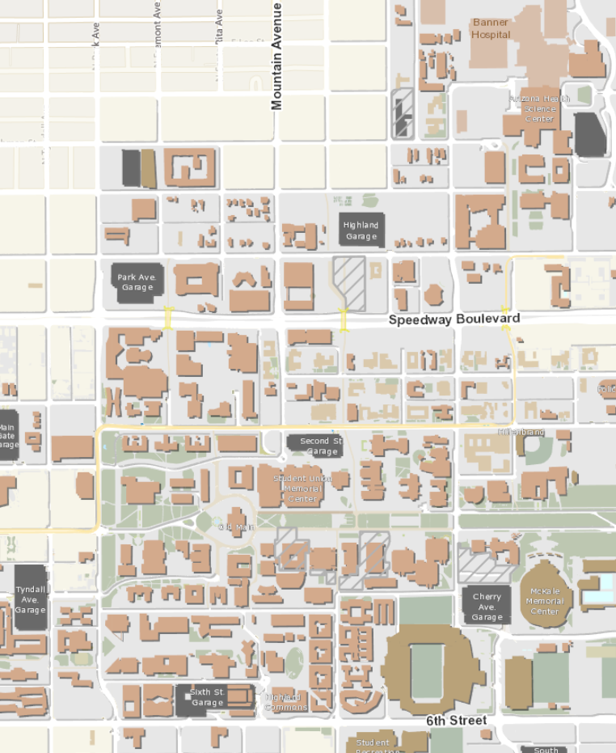

FM
TakeAway Testing
Phase I Locations*
HS Library
Eller
Administration Building
Campus Health
Campus Rec
Facilities Management
Global Center
Health Sciences Library
Integrated Learning Center (ILC)
McClelland Hall (Eller)
Student Union
Admin
Student Union
ILC
* Additional campus and statewide locations planned
Global Center
Campus Health
Rec Center

