Slide 1
KEEPING
OUR CLASS
HEALTHY

Slide 2

BEAR DOWN and…
3 SIMPLE STEPS TO KEEP EACH OTHER SAFE

Slide 3

FACE COVERINGS
ARE REQUIRED
IN THIS CLASSROOM
AND EVERYWHERE YOU SEE THIS SIGN

Slide 4
FACE COVERINGS ARE STRONGLY RECOMMENDED EVERYWHERE YOU SEE THIS SIGN, INCLUDING WHEN YOU ENTER
THIS BUILDING

Slide 5
Make sure your mask covers your nose and mouth

Slide 6
If you forget your mask,
please just ask and we’ll aim to find one for you.
And … pick up FREE cloth masks at the Bookstore!

Slide 7
Failure to comply will result in students being asked to leave the classroom and / or other disciplinary actions, including possibly being dropped from this class.

Slide 8
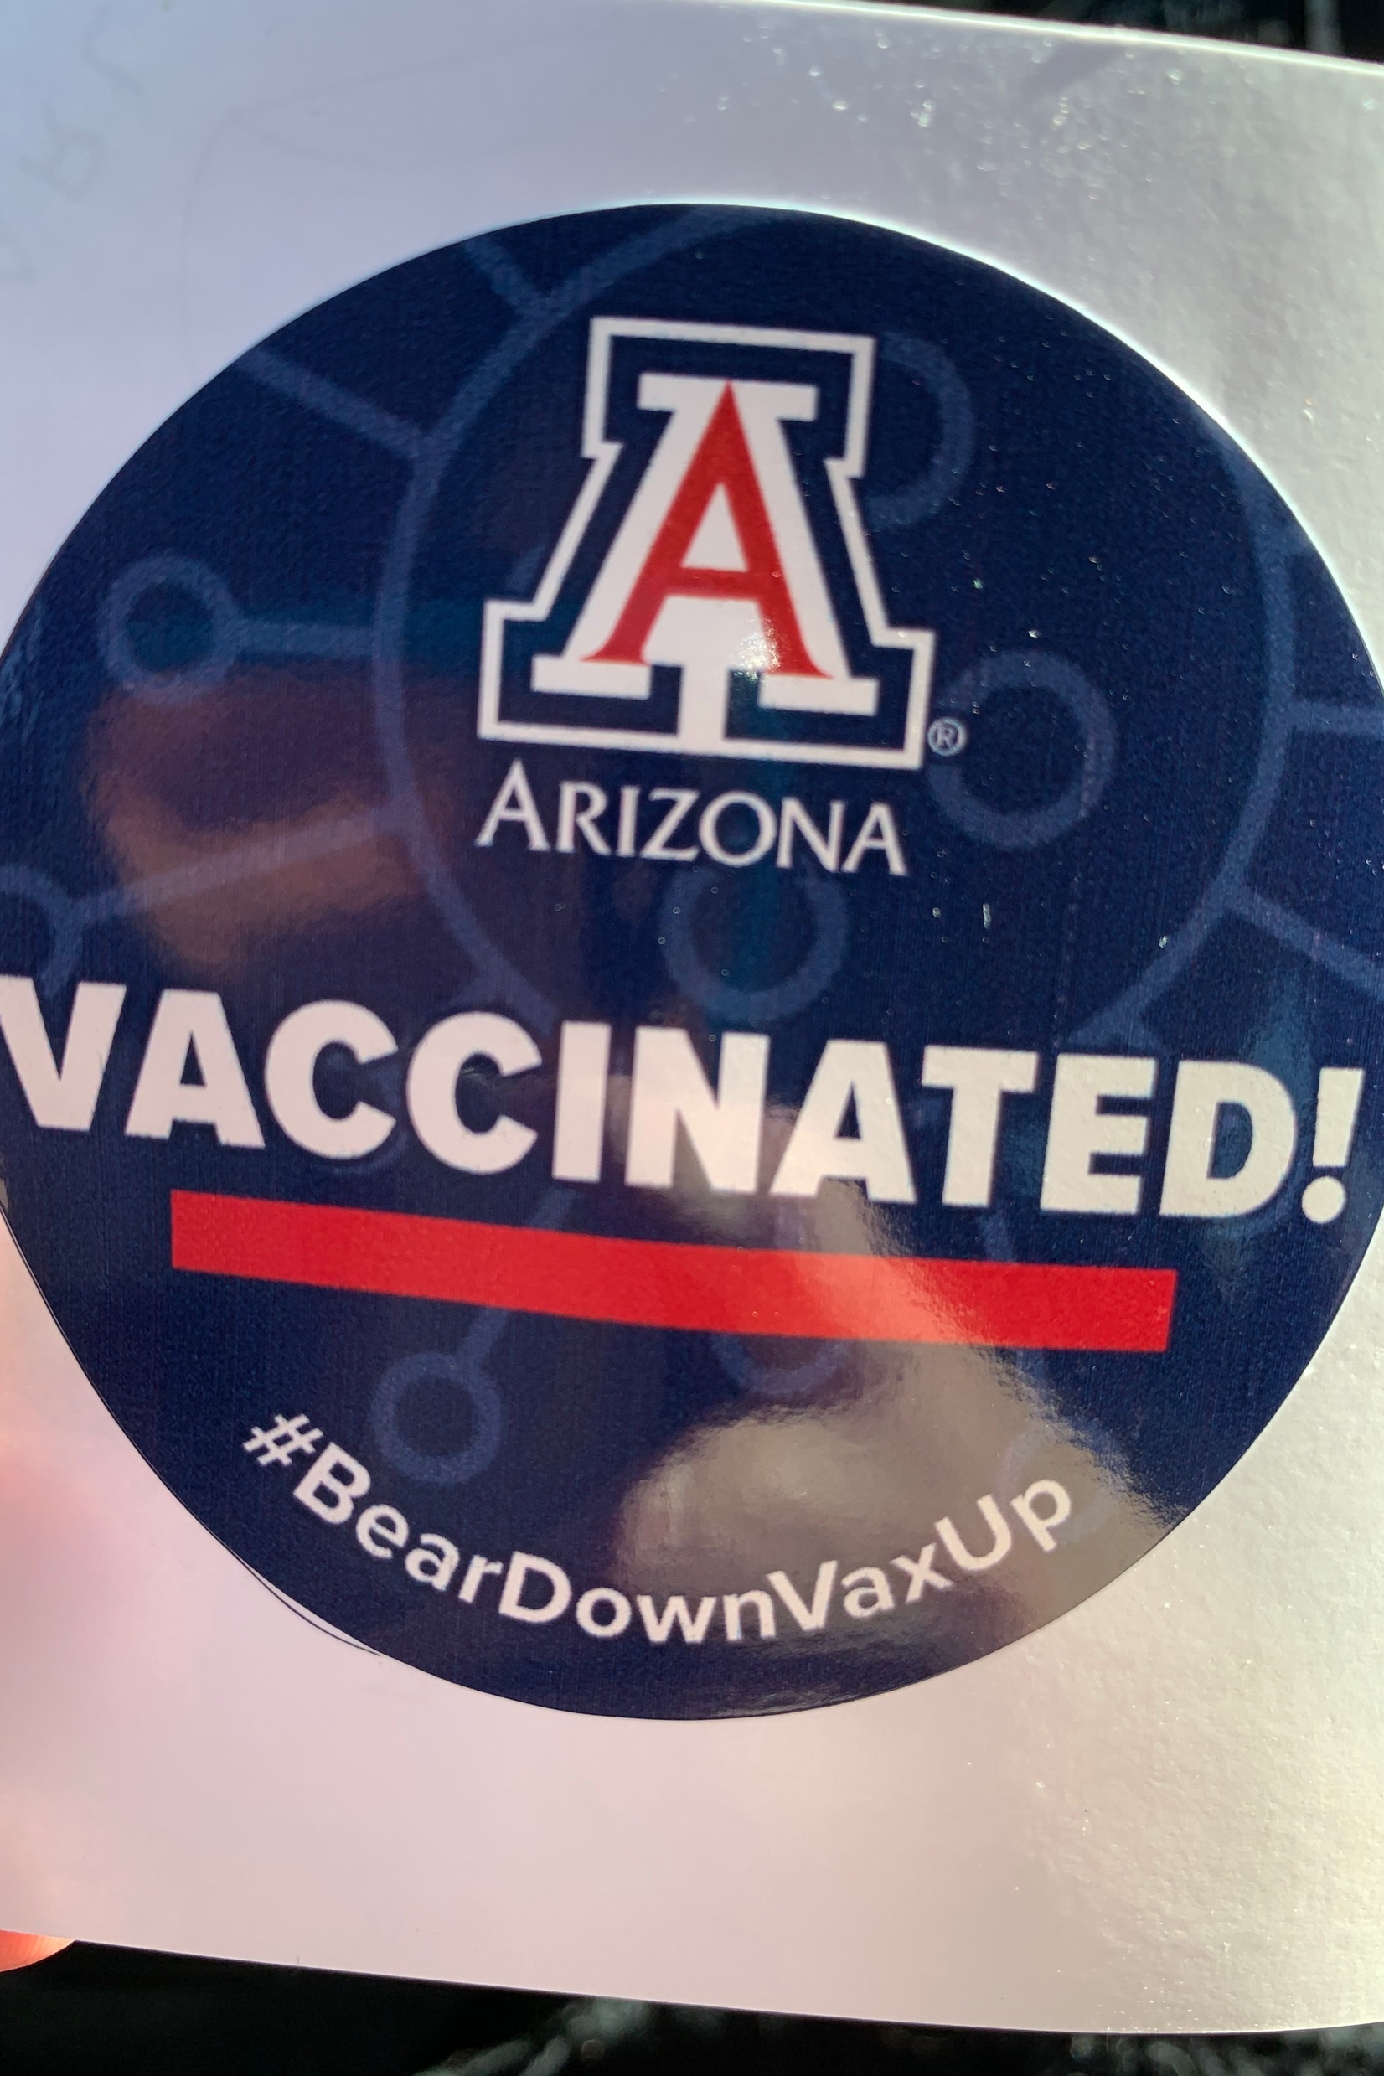

  Upload your vaccine data and enter a chance to win prizes!
  This helps us know how many people on our campus are already protected.
Get vaccinated at Campus Health
(or any other location).
See more at health.arizona.edu.

Slide 9
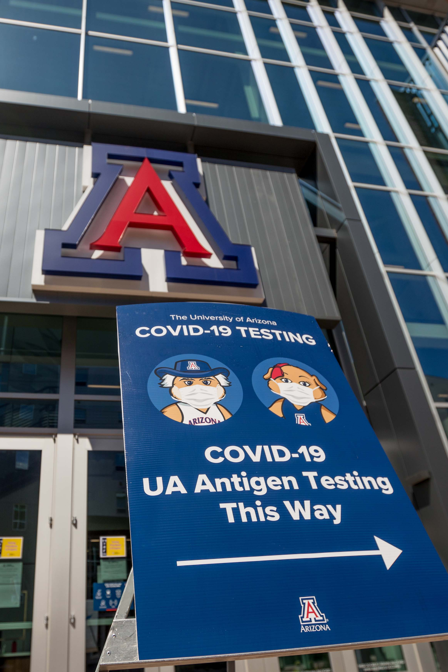

Testing regularly – ideally once a week – helps minimize your risk of unknowingly infecting others, even if you’ve been vaccinated.
It’s free, fast and easy – find locations and hours at COVID19.arizona.edu

Slide 10

LET’S KEEP EVERY WILDCAT
SAFE AND HEALTHY!
AND BEAR DOWN!

