Slide 1


Monthly SME Network Meeting May 22nd, 2020

Slide 2

Monthly SME Network Meeting Agenda
Product Updates
Review recent updates for Trellis Advise
Automated sync from Trellis to Outlook – In beta. Launching May 27th
Important cases
Create drop-in checkbox
Referrals
Reports & Dashboards
Incoming groups and data sharing
Upcoming updates
Recurrence for availability
Student Community expansion
Training & Support Updates
Open Q&A

Slide 3
Trellis – Delivered Feature Highlights
March
May
April
Onboarding New Groups (Ongoing)
Onboarding Study Abroad/ISS
Create busy blocks on advising calendar to easily remove appointment availability
Updated Case Detail workflow to retain data entered from step to step
No Show email notification to students
Student unable to cancel appointment within one hour of appt start time
COVID-19 Support banner in Trellis Advise student community
Post-advising appointment survey to students (deferring sending to students)
Resolved issue with some students not receiving appointment reminders
Remove appointment blocks from student view with Busy blocks
IN PROGRESS: Outlook integration
Expansion: Change of “Advise” app to “Console” and removal of Appointment Type to assist with expansion of features for incoming groups
Auto-fill appointment fields from Availability
In addition to in the appointment popover and email notification, also display UAccess Student Center link on the contact page
Enhance Drop-in blocks in student view to help students see additional information about the drop-in is available
Added information on how to use Zoom in calendar pop-in and appointment confirmations
Various bug fixes and
IN PROGRESS: Outlook integration
Expanded and set default width on “Comments” column in Case Details tab
Added ability to see Preferred First Name in results when searching for contacts (Searching by Preferred Name is available)
Streamlined information displayed in My Appointments Today widget on the calendar page
Added the ability to track and send Referral (Beta) emails to students
Added the ability to call attention to important Cases
Updated the "Major" filter in the student's Advisor Search to include "No Major Selected" options
Automated sync from Trellis to Outlook
Various bug fixes
IN PROGRESS: Outlook, Ability to create recurring availabilities, advising dashboards

Slide 4
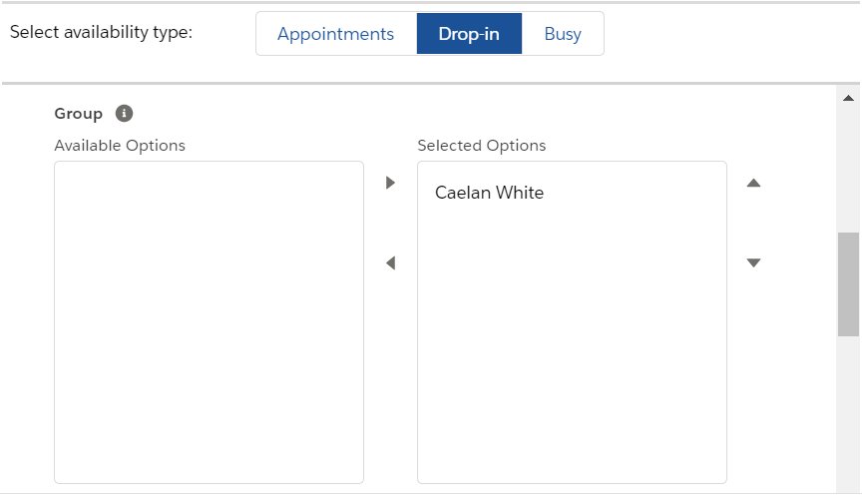
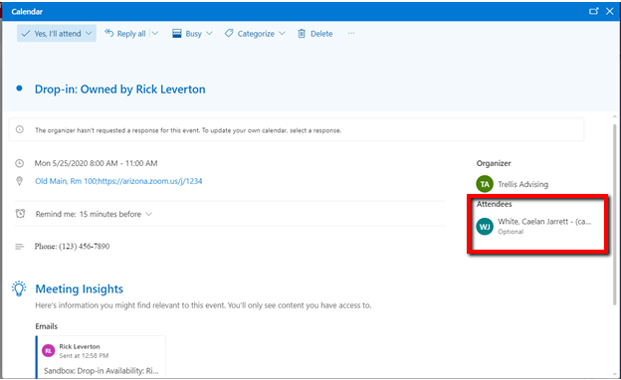
Outlook Integration
Automated Sync from Trellis to Outlook
The new Outlook integration automatically updates your Outlook calendar based on updates to your Trellis calendar.
When you create or update availability or appointments on your calendar:
Appointment and Drop-in availability types will automatically sync. No email will be sent.
The “Busy” availability type does not sync to Outlook
Group members you select for a group drop-in will receive an invite email and be set as Attendees on your/their Outlook calendar
Selecting a colleague to participate in a group drop-in
Group drop-in Outlook invite

Slide 5
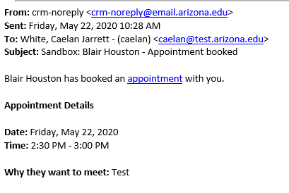
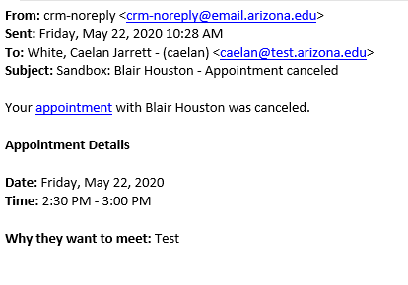
Outlook Integration
Automated Sync from Trellis to Outlook
When someone else adds or updates an availability or appointment on your calendar:
For appointments created by others (students, colleagues), you will receive an email notification as an alert. No action is required. The appointment will automatically sync to your Outlook calendar.
Changes to appointments will automatically sync. No email notification will be sent.
Canceled and deleted appointments will automatically be removed from your Outlook calendar. Email notifications for canceled appointments will be sent. No action is required.
An email notification for a booked appointment
An email notification for a canceled appointment

Slide 6
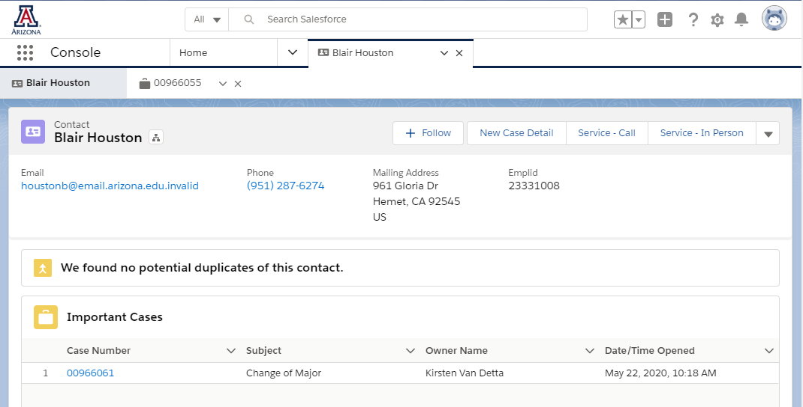
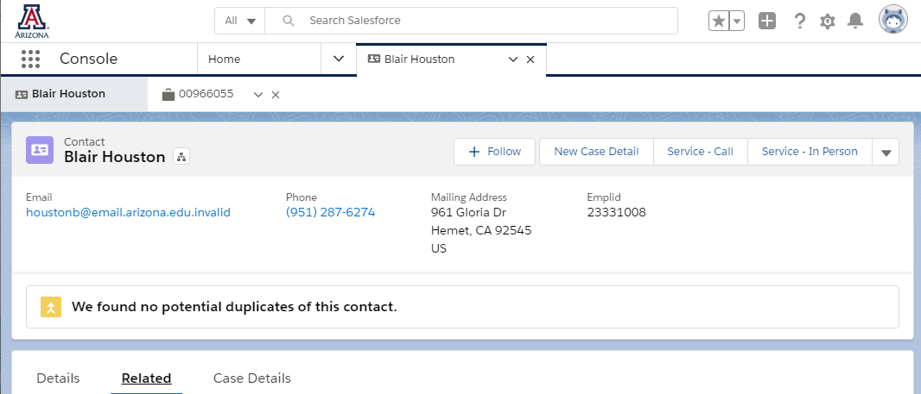
Important Cases
Purpose
To provide users with a way to call attention to case notes that should be elevated in view
Examples
Dean of Students flags a “Welfare Check” case as important
Advisor flags a “Change of Major” case as important
When viewing a student’s record, important cases will appear at the top of the screen
If none of the student’s cases are flagged as important, the section will not appear
Student record with important cases
Student record without important cases

Slide 7
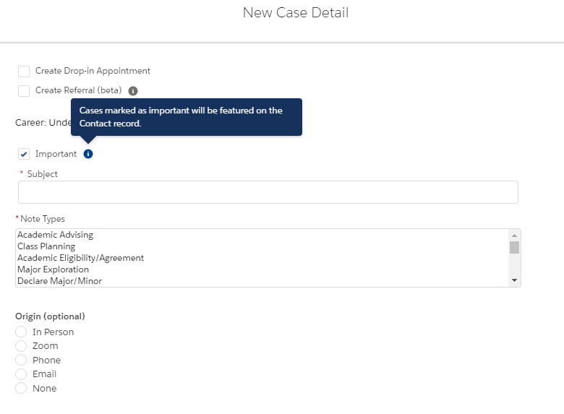
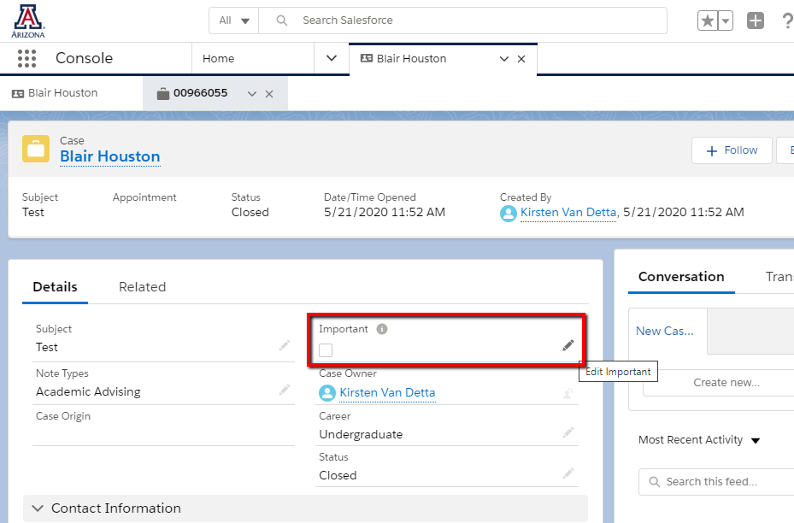
Important Cases
“Flag” a case as important
When entering a case detail via the New Case Detail button
When editing an existing case (before midnight the same day it was created)
Check “Important” in the New Case Detail process
Edit “Important” in the Case form

Slide 8
Drop-in Checkbox
Moved checkbox to the top of the form

Slide 9
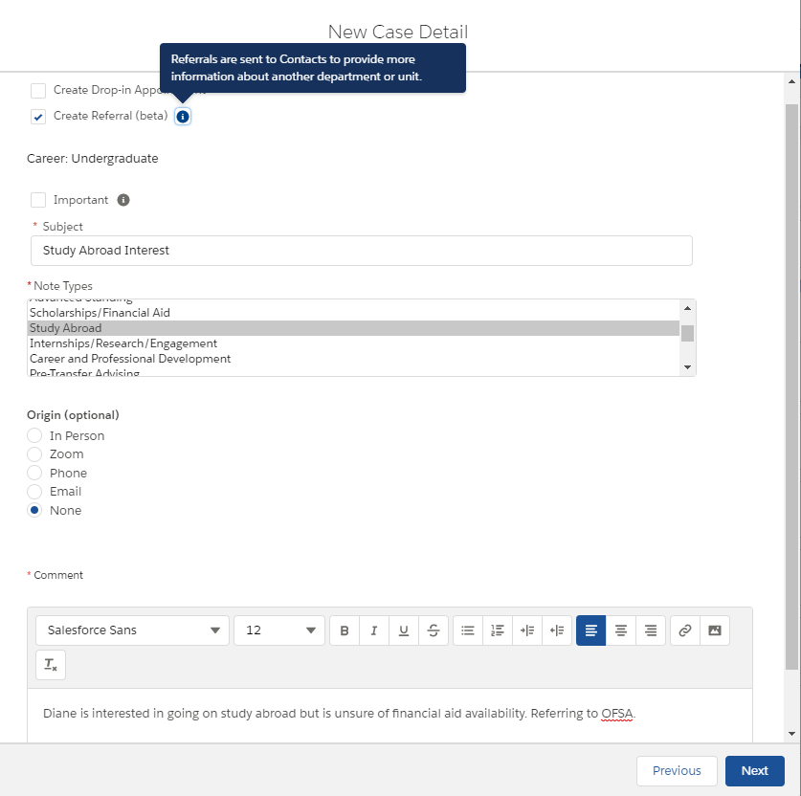
Ability to Send and Track Referrals
Phase I Beta Now Available (as a beta test for all users). Includes:
Ability to select Referring organization and Referred To organization (e.g. Advising referring to Financial Aid)
Ability to enter referral information to be sent to the student
Ability to preview student referral email when creating referrals in the New Case Detail workflow
Ability to view a student’s referrals
Step 1: Choose “Create Referral” if you would like to create a referral to be sent to the student for follow-up

Slide 10
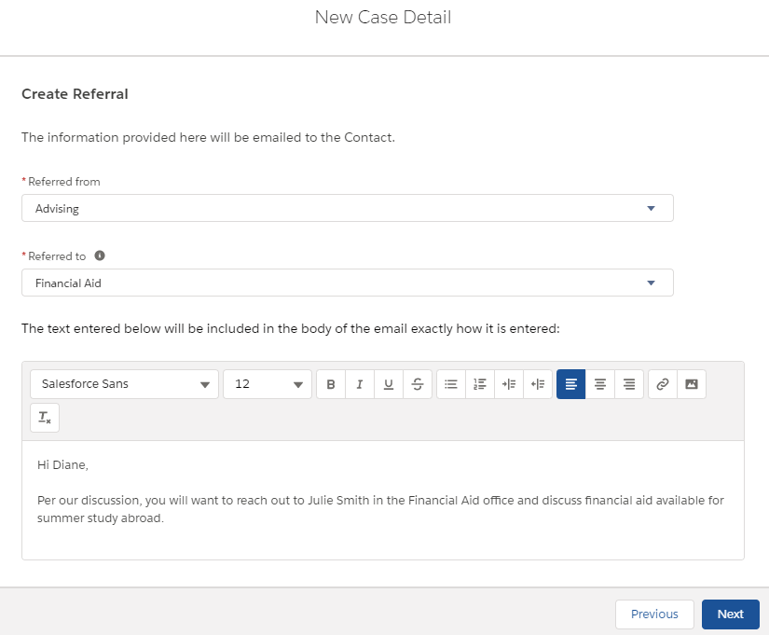
Ability to Send and Track Referrals
Steps to Create a Referral
Check the “Create Referral” box on the first page of the New Case Detail process (on previous screen)
Select your organization in the “Referred From” field and the organization you are referring the student to in the “Referred To” field
In the text area, enter the information you would like to send to the student.
IMPORTANT:
There is no need to address the student in the text box. The system does that automatically.
Anything entered in the text box is sent to the student.
Step 2 & 3: Choose your organization as the “Referred From” and the organization you are referring the student to in the “Referred To” field, then enter the information you want to send to the student in the text box.

Slide 11
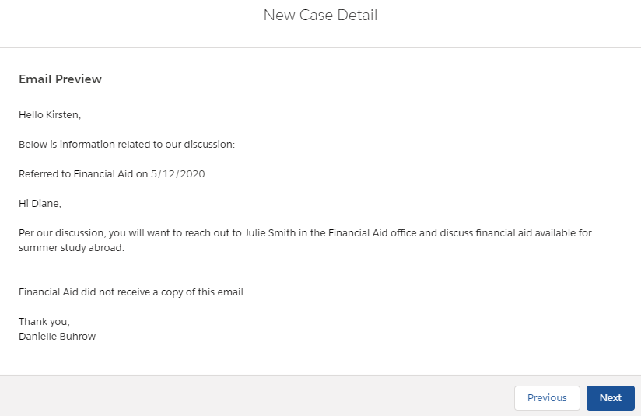
Ability to Send and Track Referrals
Steps to Create a Referral
4. Preview the email to the student to see the additional information the email template appends
5. Your configured signature is included.*
*You can configure your signature for use in email templates. More details to follow.
Steps 4 & 5: Preview your email. If you need to make changes, click Previous to update your entry.

Slide 12
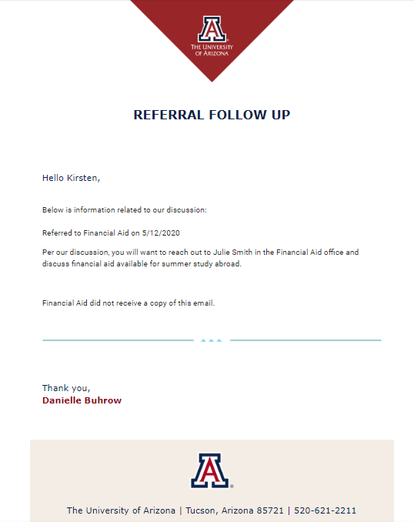
Ability to Send and Track Referrals
Student Email Received
Branded template

Slide 13
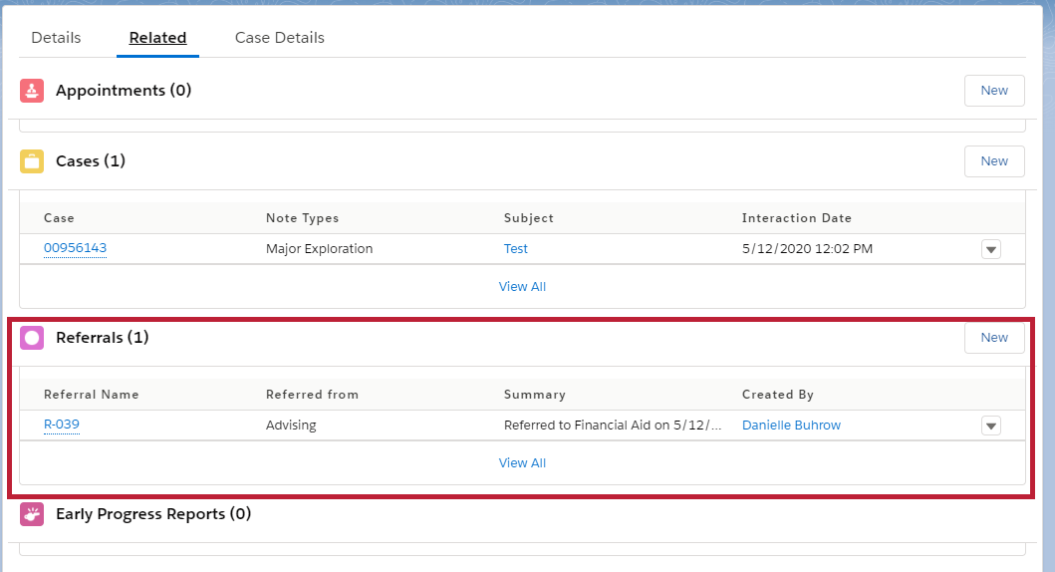
Ability to Send and Track Referrals
View Referrals
Navigate to contact record > Related tab > Referrals list view
Referrals can be viewed but not edited
Currently, Referrals are considered “openly available” within Trellis to aid departments on campus in viewing what the student was instructed to do with their referral
View the detail of the referral by clicking on the referral ID in the Referral Name column

Slide 14
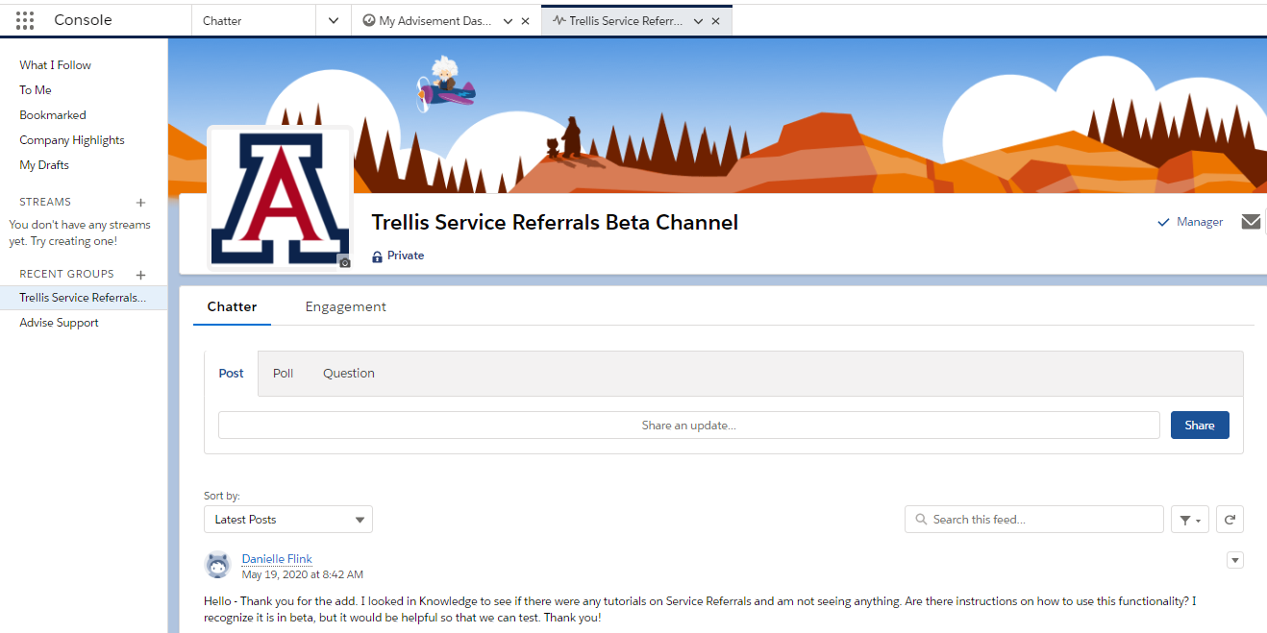
Ability to Send and Track Referrals
Submitting Feedback
We are collecting feedback for the Referral feature
Submit feedback to Chatter group “Trellis Service Referrals Beta Channel”
Submit feedback in the Trellis Service Referrals Beta Channel Chatter group

Slide 15
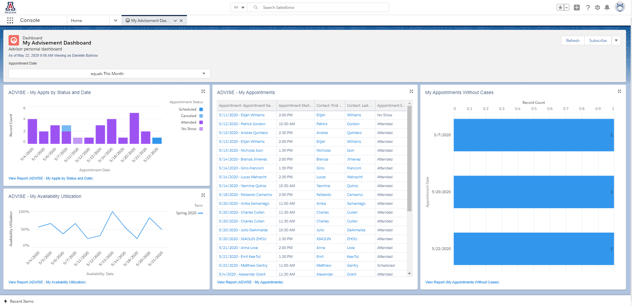
Advising Dashboard

Slide 16
Trellis Expansion
Current Groups In Progress
**Next
Study Abroad/ISS – *Cases & Case Details, Referrals
Registrar – Scheduling (MCBC, Grad Services & Residency Classification Only), *Cases & Case Details, Forms approval (Cases), Referrals
Dean of Students – *Cases & Case Details, Referrals
Faculty/Instructors – Scheduling, *Cases & Case Details, EPR, Forms approval (Cases)
SSRI Retention – *Cases & Case Details, Referrals, EPR
SSRI (SOS) – Service Desk (service cases)
Financial Aid – Service Desk
DRC
THRIVE
Financial Aid
Bursar
*Viewing, editing and creating advising Case Details permissions are granted by Roxie Catts, the data steward of advising case notes. Incoming groups will not receive access to those without permission being granted by Roxie.
**“Next” list is subject to change based on readiness of group(s).

Slide 17
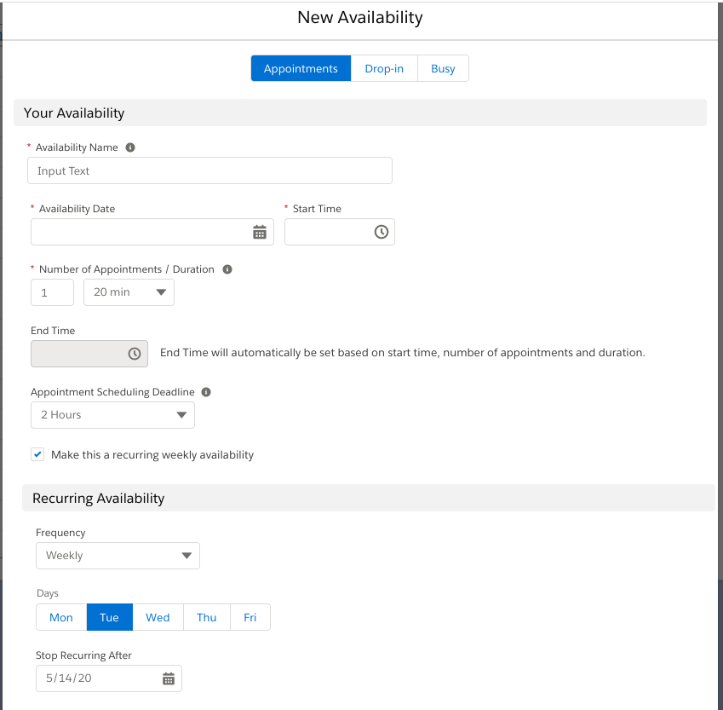
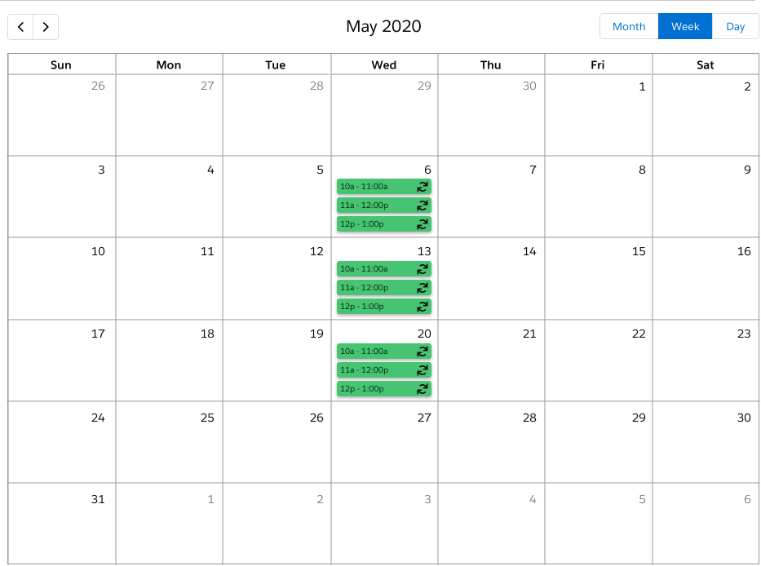
Upcoming Updates
Ability to create recurring availability
Initial release will include a “Weekly” option with multiple day selector and recurrence end date up to 90 days out. (ex: 10am-12pm every Tuesday and Wednesday until July 3rd)
Recurrence icon on availability records in the month calendar view

Slide 18
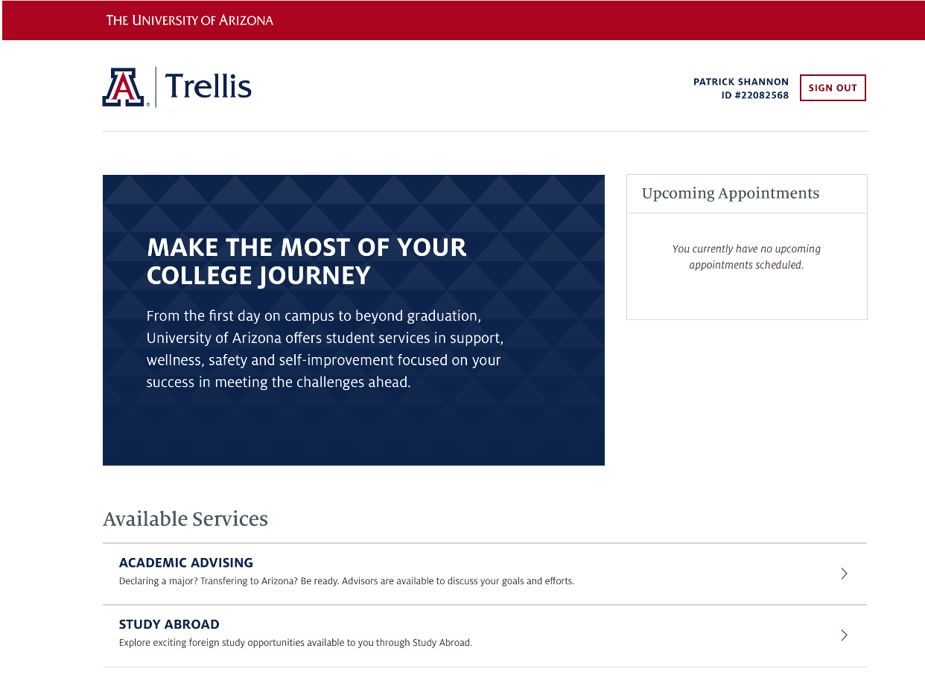
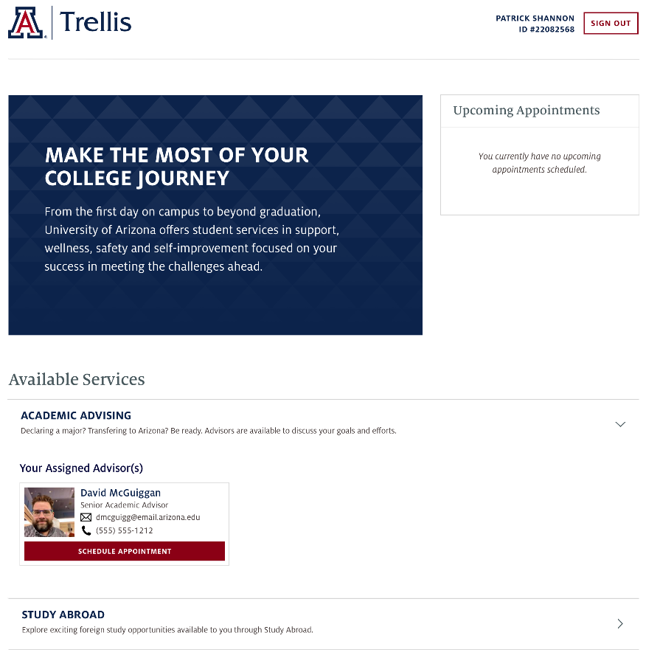

Upcoming Updates
Student Community Expansion
Expanding Trellis Advise to show additional services to students
Will add Financial Aid and other info to assist with student retention’s need to send a student to one location for assistance info
Note: This is a wireframe. Images and content subject to change.

Slide 19
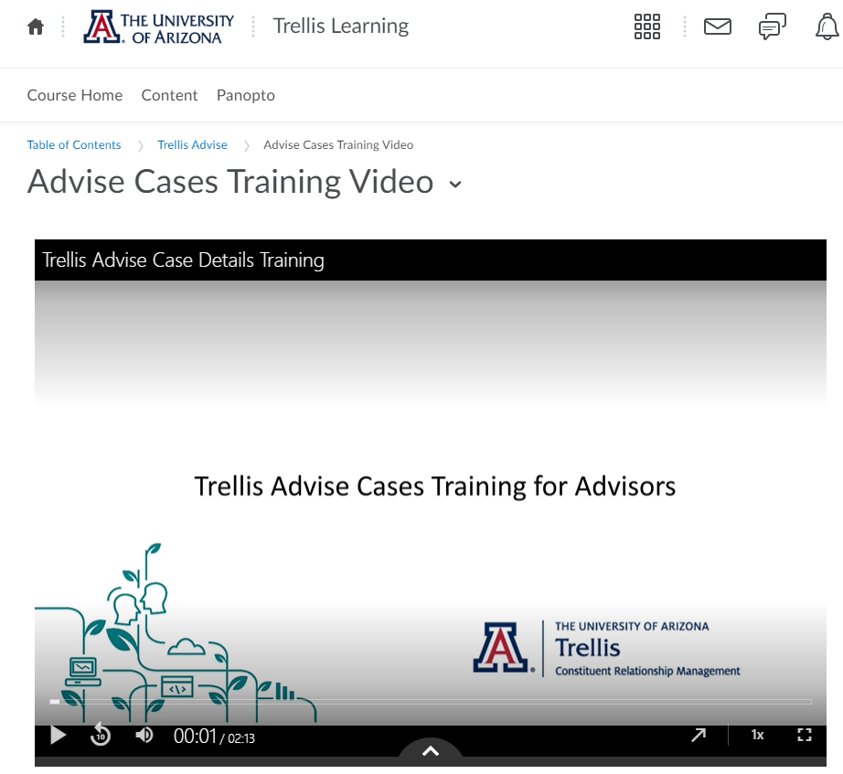
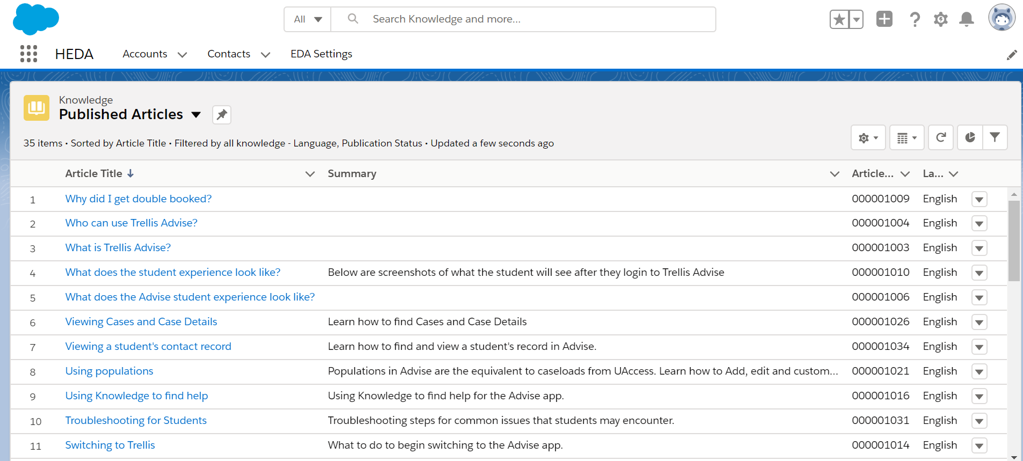
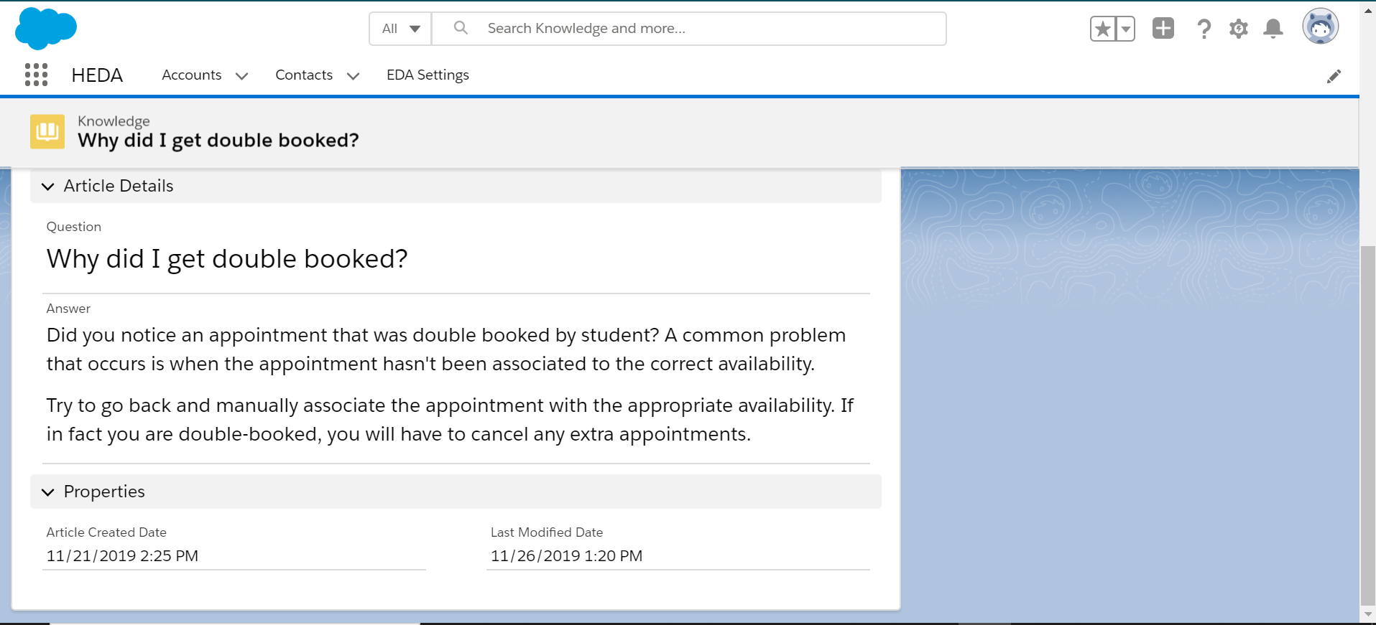
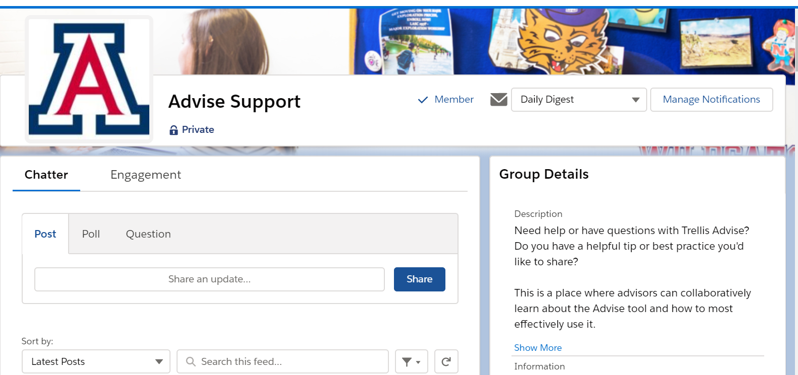
Trellis Support Resources
General
trellis.arizona.edu
Monthly newsletter
ARC newsletter content
Getting Started
UAccess Learning courses
D2L videos
New Users
D2L videos
Knowledge
Chatter: Advising
Open Labs
Improving Practices
In-app announcements
Monthly Zoomies
Knowledge
Chatter: Advising
Trellis Dashboards
Power Users
Chatter moderation: Advising
Author knowledge articles
Lead Zoomies
Birds of a Feather network

