Slide 1



Hello Future Wildcat!
Notes:
Hello future wildcat!
So, you’re interested in animal science? This introduction video will discuss important information regarding the animal science degree and some of our FAQ.
So let’s carry on.

Slide 2

4 Possible Emphases are Offered:
Industry
Equine
Science and pre-professional
Race track industry
Notes:
The first piece of information you should know is Animal Science is broken down into 4 different emphases. Don’t worry you only have to pick on to focus your college degree in.
We will go into more detail with each emphasis as we move on throughout the presentation. However these are currently the emphases you have to choose from: industry, equine, science and pre professional and RTI.

Slide 3

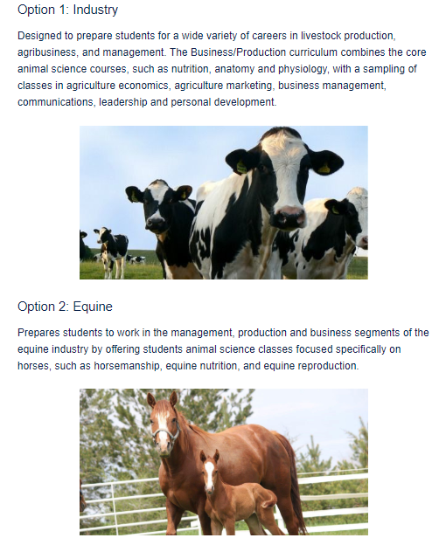

Slide 4
Courses you would take
Potential Careers
Open their own business
Grow their current business
Manager
Sales Representative
Professors/teachers
Marketing and Sales
Financial and Economic Strategies.
Meat Animal Composition
Human Resource Management
Business Law
Food Safety and Microbiology
Beef Resource Management
Accounting
Notes:
Here is a list of potential careers you can get.
And a list of example courses.

Slide 6
Courses you would take
Potential Careers
Horse Manager
Riding Instructor
Farrier
Barn Manager
Racehorse Trainer
Horse Breeder
Horse sales
Horse Nutritionist
Intro to Horse Science
Intro to horsemanship Programs
Race Track Marketing/media
Form/function of Equine Athlete
Develop and train foundation yearlings
Train and management of weanling

Slide 7
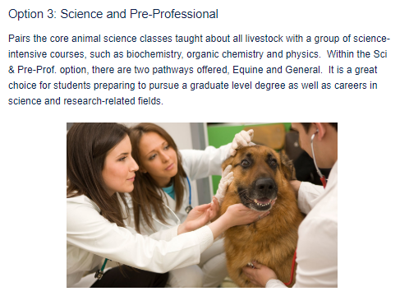

Slide 8
Courses you would take
Potential Careers
Veterinarian
Vet Tech
Animal Behaviorist
Microbiologists
Food Scientist*
Zoologist
Livestock Veterinarian
Animal Trainer/handler
Biology
Microbiology
Chemistry
Physics
Biochemistry
Animal Anatomy and Physiology
Nutritional physio. And metabolism
Notes:
This degree is similar to the Veterinary Science degree.
Other grad school options

Slide 9
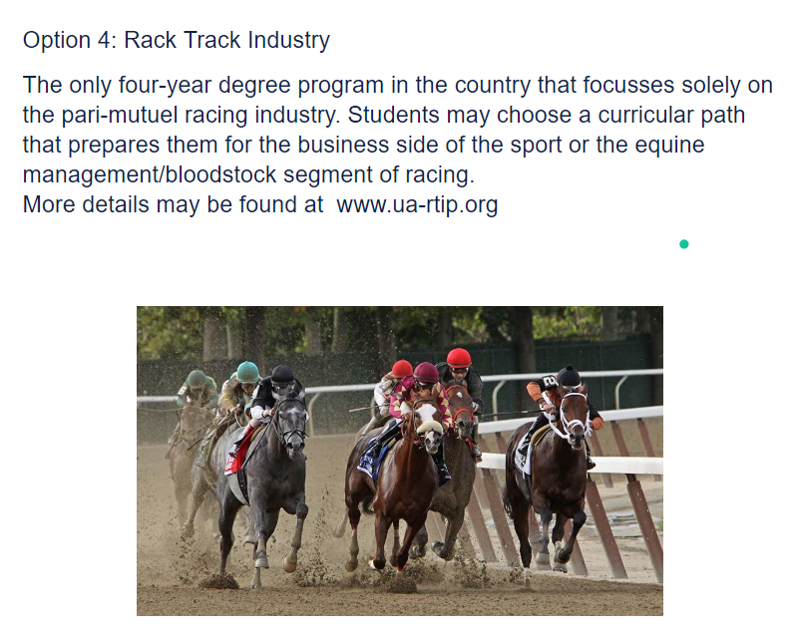

Slide 10
FAQ
I want to be a Vet. What’s the difference between Animal Science and Veterinary Science?
I’m not sure what I want to do, but I love animals. Which emphasis should I choose?
Am I allowed to switch my emphasis if I want to change it?
I’m interested in Race Track Industry, who do I contact?
Is there a minor offered?
Notes:
The main difference are the core classes. Both degrees get you into vet school. The electives are more selective for the veterinary sci degree but overall you will be taking similar course. Veterinary school is not going to decline you because you decided towards Animal Science. As long as you have the requirements , you are good to go.
Animal science is going to revolve around animals. Industry is the business side of things. So think business industry. Science and Pre professional are people who want to work in the health field so vets, doctors, dentist, nurses. Finally equine is for people who are very interested in horses specifically. You will work with other animals in your courses but if you want an equine career with more hands on courses. This is it.
If you are interested in research in food safety please consider switching to Food Safety.
Of course! Just like you can switch your major. Disclaimer though: there is a possibility that you need to stay longer to complete your course work requirements.
You can contact Wendy Davis @ wdavis@ag.arizona.edu
Yes there is! For more information on that please visit the ACBS Degree Programs website.

Slide 11
IMPORTANT INFORMATION
In order to make an appointment with the Academic Advisors the following code must be written in the comment section in WiseAdvise
“ANSREADY”
Failure to add code to the comment section will mean your appointment will be canceled because you are required to watch this video to ensure the appointment time is used effectively and efficiently. If you plan on visiting during walk-in hours, bring a screenshot/picture of this portion of the presentation.

Slide 12
Thank you for watching!
Have a wonderful day and we will see you soon!

