Slide 1


Monthly SME Network Meeting April 3rd, 2020

Slide 2

Monthly SME Network Meeting Agenda
Updates
Recent enhancements, bug fixes, and new features
In progress and planned work
Reporting
Training & Support
Q&A

Slide 3
Trellis Service – Delivered Feature Highlights
Jan
Mar
Feb
Outlook Integration Development (Ongoing)
Onboarding Study Abroad/ISS
Create busy blocks on advising calendar
Updated Case Detail workflow to retain data entered from step to step
No Show email notification to students
Student unable to cancel appointment within one hour of appt start time
COVID-19 Support banner in Trellis Advise student community
Post-advising appointment survey to students (deferring sending to students)
Resolved issue with some students not receiving appointment reminders
Remove appointment blocks from student view with Busy blocks
Scaling “Advise” to other groups
Calendar Announcement
Show Taken Appointments
Appt Reminders to Students
Accessibility Updates
Origin & Interaction Date on Case Detail
Creating Queues for advising groups
See all Case Details in one view
Major/Minor in Advisor Search
Provisioning users
Various small updates and bug fixes
CatCard swipe for Queue Check-in
Creating Queues for advising groups
Added more details on calendar popover
Refined email notifications for Outlook to reduce number of emails received
SID linked to Uaccess Student Center
Time zone selector for students on calendar
Launch IDEAS
Provisioning users
Various updates & fixes

Slide 4
Trellis Advise – In Progress/Planned Work
Now
Outlook calendar auto-sync
Expanding student experience to include other service organizations (Faculty, Dean of Students, Registrar, OSFA, 24/7)
Ex: Cases for Welfare Checks from DoS
Private appointments (for Campus Health, DRC, etc.)
Ability to restrict view of Case Details to specific groups
Next
Appointment text reminders
Availability management enhancements (recurrence)
Batch emails
Text reminders

Slide 5
Trellis Service Possible Phasing
LEARN
DATA
PERMISSIONS/ PREFERENCES
TBD
ThinkTank
Study Abroad/ISS
Registrar
Dean of Students
OSFA core team
Faculty
THRIVE (AI New Start/ASEMS/)
ThinkTank Learning Specialists
Bursar
Cultural Centers
DRC
SALT
Vets
College Wellness Counselors?
CATS
SECD
Transfer Center
College Coordinators
Online/Distance Coordinators Math Help Desk
Faculty
Library Liaisons
RHA
ASUA
SERVICE DESK
SOS
OSFA
24/7

Slide 6
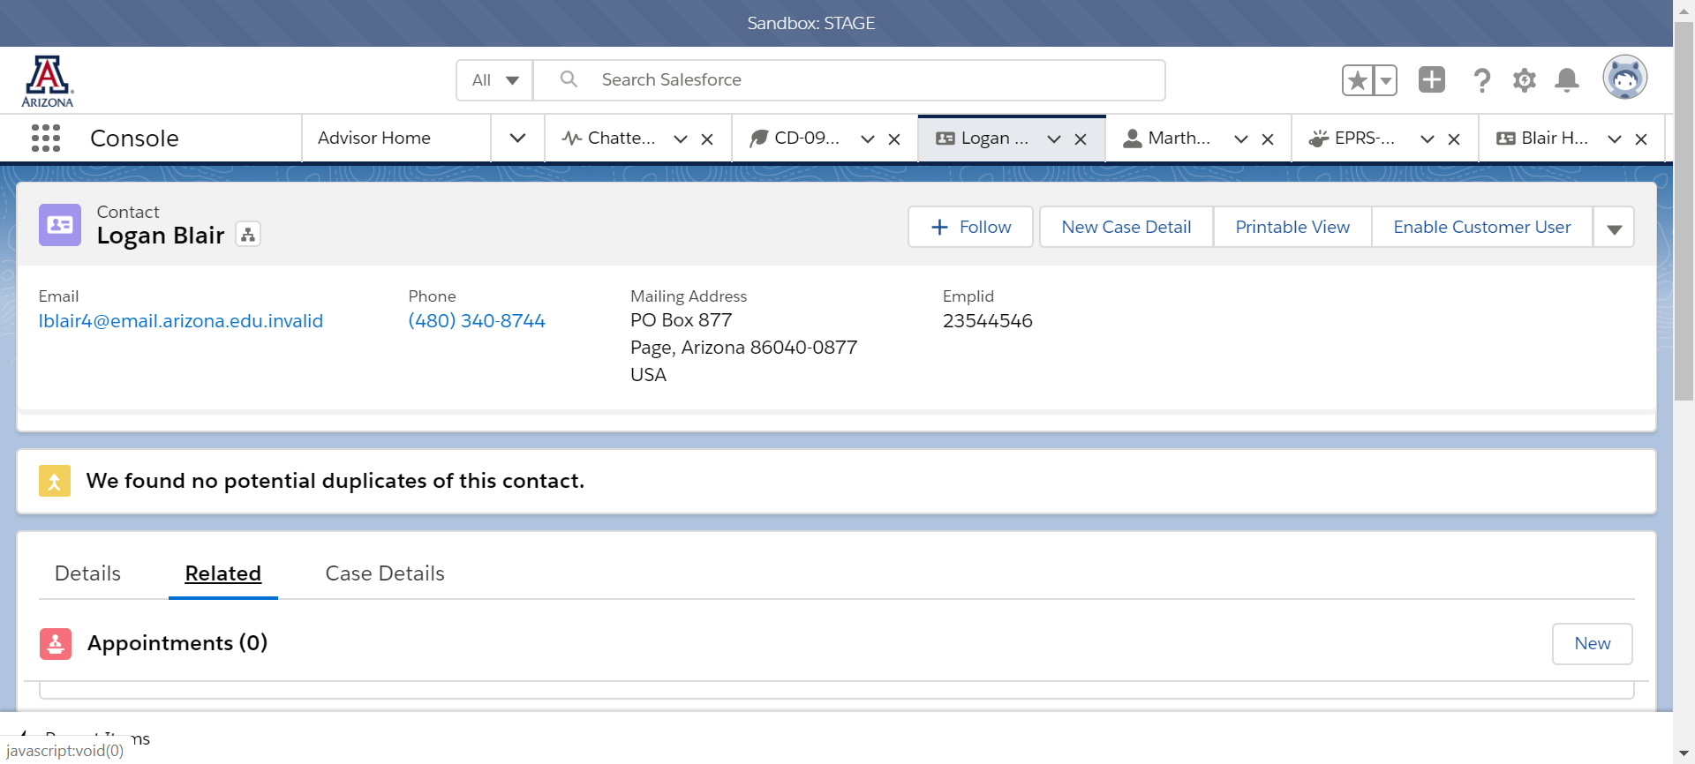
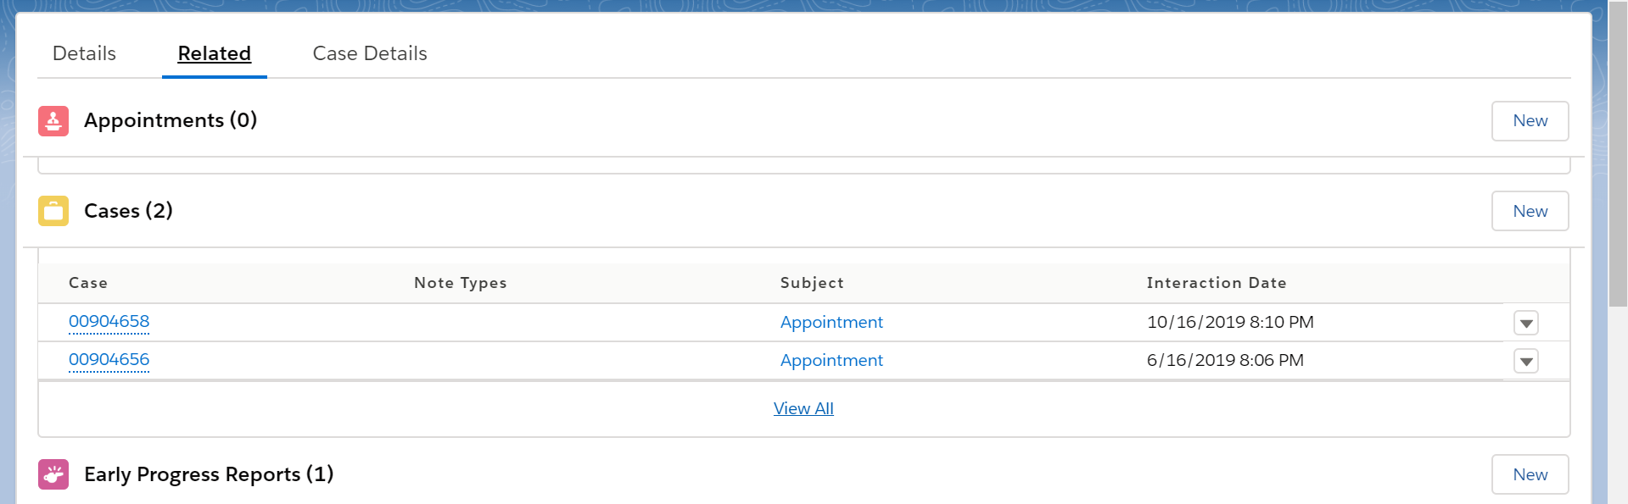
Trellis –View: Cases – With Cases Permission

Slide 7
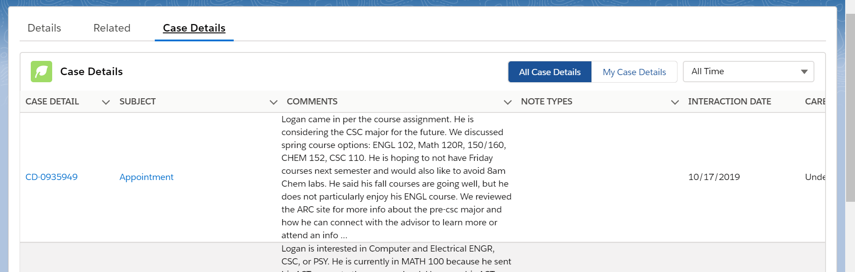
Trellis View: Case Details – How it Works

Slide 8
Analytics to Support Trellis Advise Good Practices
Reports and Dashboards in Trellis
Trellis reports/dashboard for users
User ability to generate list views and reports
Collaboration with UAIR for Dashboards
Trellis data being sent to Data Warehouse
Protype dashboard content with Trellis and build with UAIR
Advisor supervisor reports (surveys, aggregate)

Slide 9
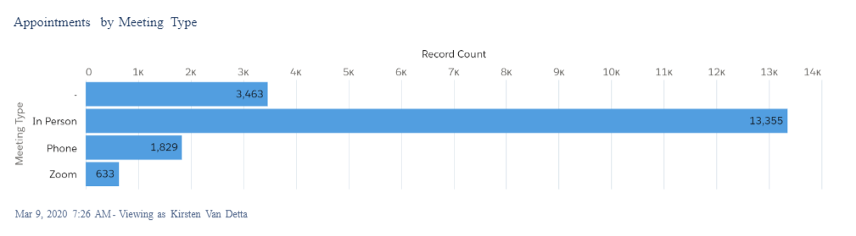
Trellis Advise Reports
Appointments by Meeting Type (All Time)

Slide 10
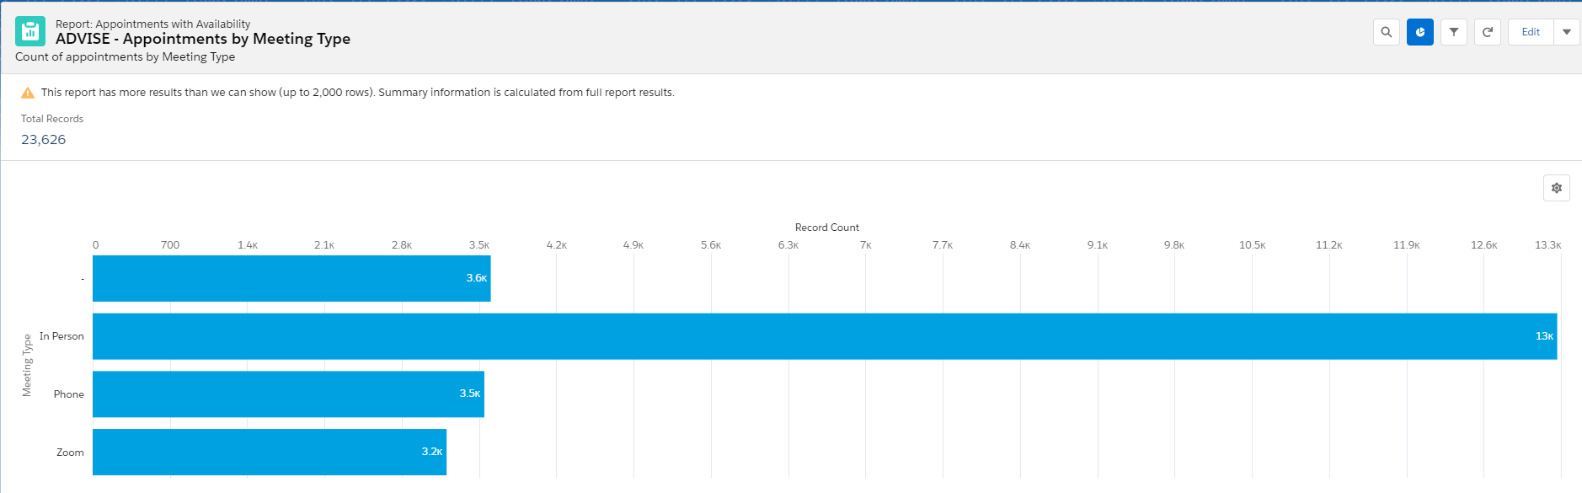
Trellis Advise Reports
Appointments by Meeting Type (All Time)

Slide 11
Where To Interact With Trellis
Bugs
Enhancements
In-App Help
24/7 assigns tickets to Trellis
Advise listserv
Knowledge
Chatter: Advise
IDEAS

Slide 12
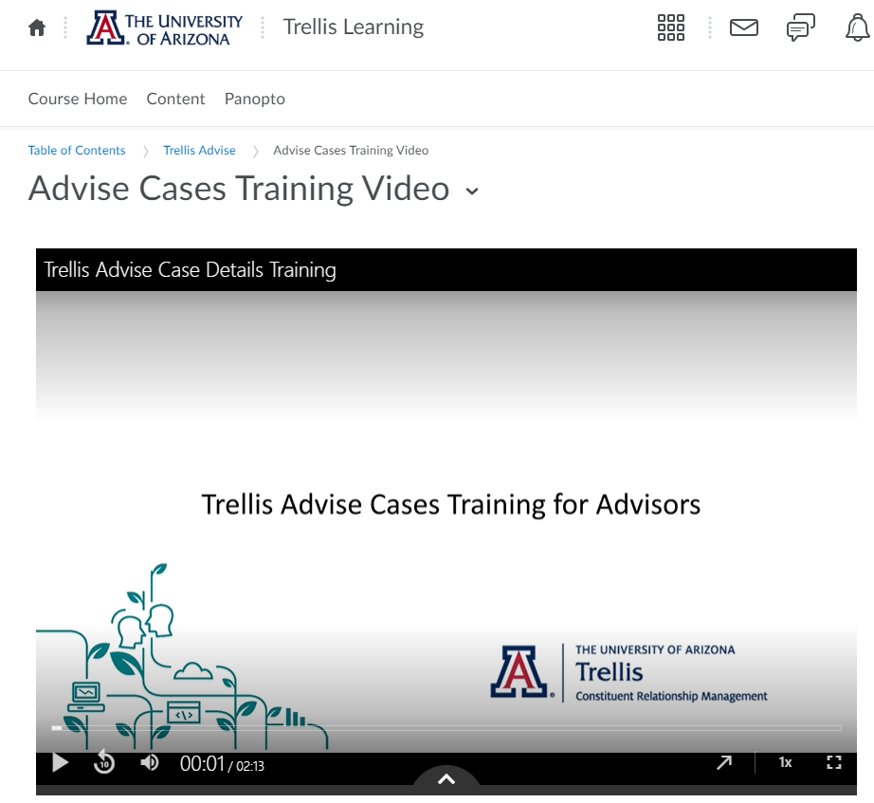
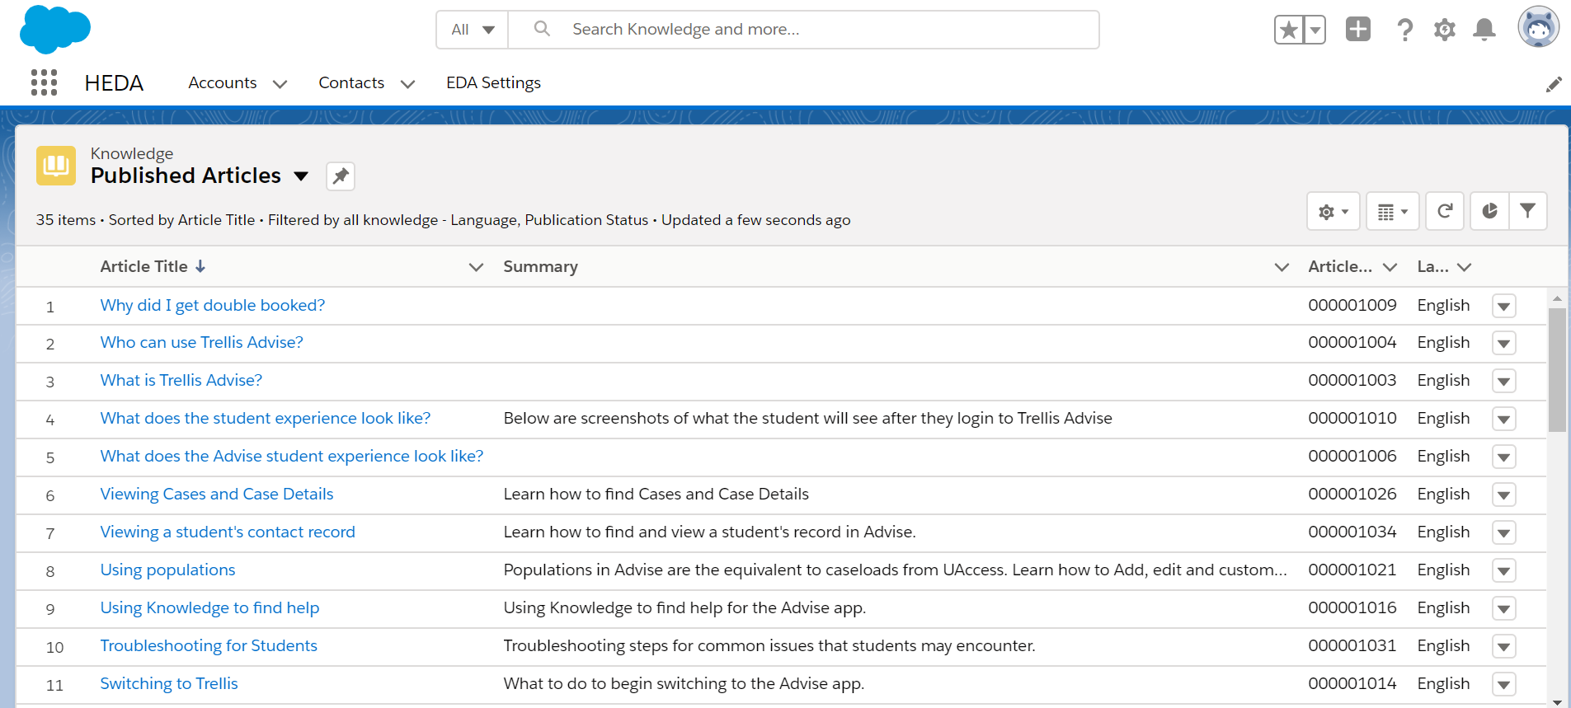
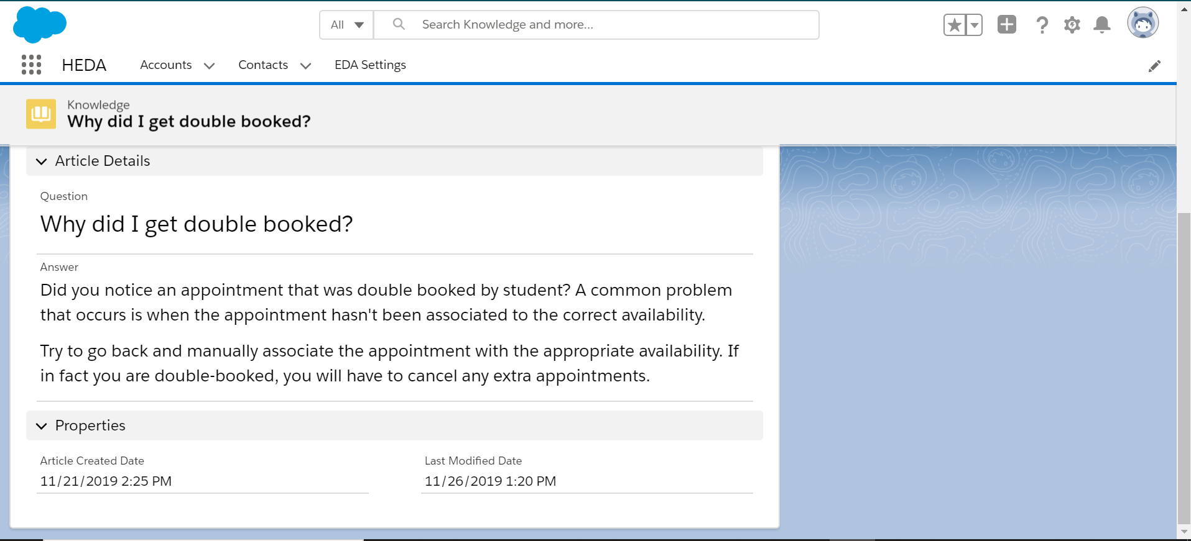
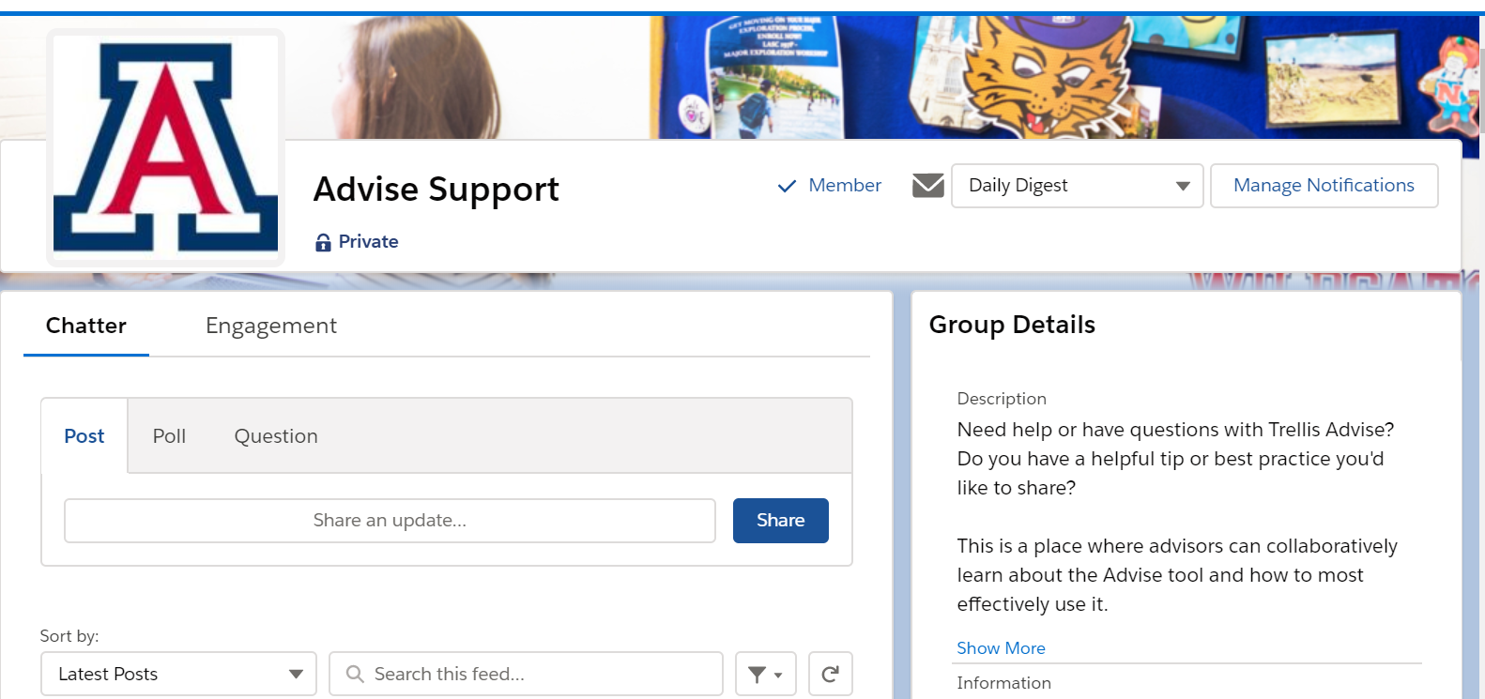
Trellis Support Resources
General
trellis.arizona.edu
Monthly newsletter
ARC newsletter content
Getting Started
UAccess Learning courses
D2L videos
New Users
D2L videos
Knowledge
Chatter: Advising
Open Labs
Improving Practices
In-app announcements
Monthly Zoomies
Knowledge
Chatter: Advising
Trellis Dashboards
Power Users
Chatter moderation: Advising
Author knowledge articles
Lead Zoomies
Birds of a Feather network

