Slide 1
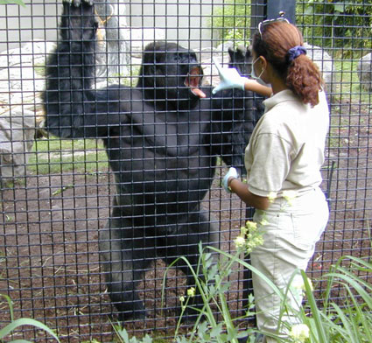
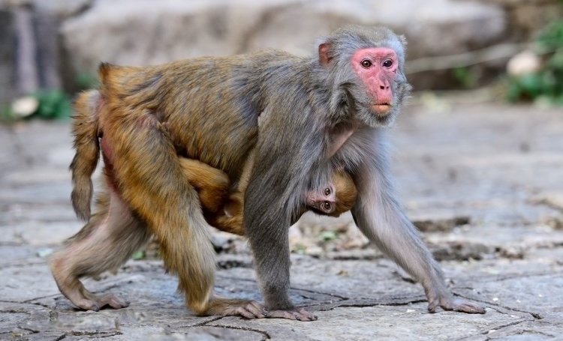

Discovery to Practice Workshop Series
ACBS 483 / 583
Principles of
Applied Primate Behavior
& Captive Management
Profs. H.Dieter & Netzin Steklis
Tu-Thu 2 - 3:15 pm
Start to build your career in primate care.
Learn how to promote welfare of monkeys and apes in zoos, sanctuaries, and research labs.

Slide 2
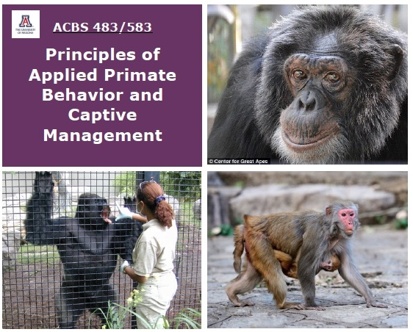

Do you want to work with Primates? Enroll today!!!
[1] ACBS 483 /583 Principles of Applied Primate Behavior and Captive Management
Fall Tu-Thu 9:30-10:15am
[2] ACBS 484 /584 Applied Captive Primate Behavior in Practice (with primate site visits)
Spring Thu 2-5pm
Applied Primate Behavior, Captive Management
and Welfare
Series
Profs Dieter & Netzin Steklis
ACBS 483/583
ACBS 484/584
Take just [1] or take [1]+[2]

