Slide 1
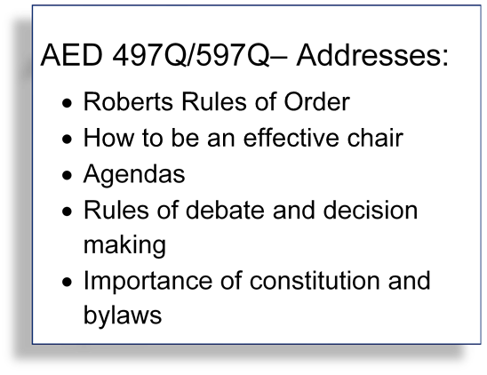



Discovery to Practice
Workshop Series
Red line indicates page edge
Step 1. Delete the CALS logo and replace it with your own logo. Delete this box when finished.
AED 497Q/597Q
Effective Meetings
Step 3. Update text with your information. Do not change the font. For UA Brand, you must use the Calibri or Milo font families.
1 Credit
Wed 12:00-12:50
Saguaro Hall Rm 104
For more information,
mattlewis@email.arizona.edu
Step 2. To replace this photo. Delete the image, and insert your new image. Click on the image and use the arrange tab to move the new image to the back. View the slide in full screen mode to check placement. Delete this box when finished.
Step 4. When complete, export the image as a jpg.

