Slide 1
General Chemistry:
Course Options & Updates

Slide 2
CHEM 100
CHEM 151
CHEM 152
Past Options
MATH 112
CHEM 151
CHEM 152
Placement
CHEM 151
CHEM 152
Placement
CHEM
161 & 163
CHEM
162 & 164

Slide 3
New Options Fall 2018
Placement
See chart
CHEM 151
Current course
CHEM
141 & 143
New course offering
CHEM
161 & 163
Honors Gen Chem

Slide 4
What is this new option?
The CHEM 140-sequence will be a new offering of General Chemistry. It’s another flavor of General Chemistry, allowing students to pick between the curriculum that they prefer. They review the same topics, and students are equally prepared for Organic Chemistry.

Slide 5
Comparison
CHEM 141 General Chemistry Lecture I: Quantitative Course Description
CHEM 141 is the first part of a two-semester lecture series introducing students to the central principles of modern chemistry using a quantitative atoms-first approach. The course is intended for students who require a strong foundation in general chemistry, rooted in a technical (mathematical) approach to the discipline. It specifically targets science and engineer­ing majors and other students interested in a systematic development of modern chemistry.
CHEM 151 General Chemistry I Course Description
CHEM 151 is the first part of a two-semester integrated lecture-lab series introducing students to fundamental ideas and ways of thinking in chemistry using relevant systems and problems (in life and medicine, material design, environmental issues) to illustrate their application. The course is intended for students who are expected to develop a deep conceptual understanding of fundamental chemistry concepts and learn how to apply them in different contexts.

Slide 6
Differences
CHEM 151 & 152
CHEM 140-Sequence
Lecture and lab offered separately
Semester-specific (no off-sequence offering)
Atoms-first approach
ACS Standard Exam
Curriculum students may be more familiar with
Integrated lab and lecture
Offered every Fall, Spring, and Summer
Chemical thinking approach
ACS Conceptual Exam
Current offering students may be more familiar with
Notes:
I don’t understand what you mean by the text in yellow.

Slide 7
Lab Comparison (First Semester)
Project-based: Development of
problem-solving skills
Development of lab techniques and skills
Distinguishing substances
  Analyzing food colorants in candies
Analyzing components
  Analyzing light sticks
Predicting Properties
  Characterizing superabsorbent polymers
Designing materials
  Build and evaluate paint formulations
Laboratory work conducted in groups or pairs
A formal lab notebook is not graded
Analytical Lab Calculations
  Basic lab skills and dimensional analysis
Preparation of Dilution Sets
  Volume measurement and prep of molar solutions
Spectrophotometry
  Absorbance spectrum and external standard calibration
Laboratory work completed individually
Formal lab notebook is part of the grade
Skills design and technical skills preparation

Slide 8
What are the differences between how the courses are taught?
CHEM 151 & 152
CHEM 140-Sequence
Traditional approach to curriculum
Level of mathematics is the same, but may be used more frequently
Taught in a traditional lecture space
Question-driven curriculum
Active learning environment
Collaborative group activities
Interactive lectures
Taught in collaborative learning spaces

Slide 9
Analogy to a Biology Course
CHEM 151
A course based on big ideas/essential questions/thematic units.
How is energy transferred and harnessed?
Photosynthesis
Cellular respiration
Food chains/webs
Types of reactions
Biological molecules
How do interactions shape environments?
Nutrient cycles
Homeostasis
Human Impact
Symbiosis
Epigenetics
CHEM 141
A more traditional micro to macro approach.
Biochemistry
Cell Structure/Function
Mitosis
Meiosis
DNA
Protein Synthesis
Genetics
Evolution
Ecology

Slide 10
How does this impact advising?
Which course should I take?
What is the difference?
Which is better?
How much math do I need for the quantitative version?

Slide 11
Implementation & Enrollment
Our department will be pre-scheduling this course during orientation for Fall 2018.
It will be pre-scheduled based upon orientation session to randomize enrollment as much as possible.
15% of the General Chemistry population will hopefully be enrolled in CHEM 141 & CHEM 143.
Transfer credits for lecture or lab only transfer can now be articulated more accurately.

Slide 12
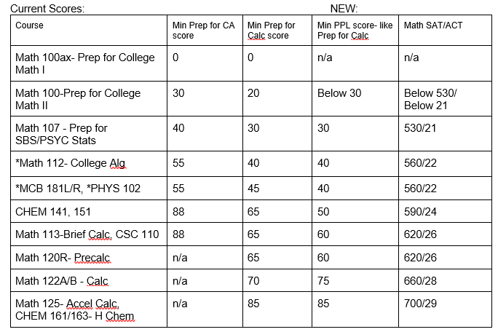
General Chemistry Math Placement Updates
The pre-requisite to CHEM 151 is still MATH 112 or placement.
Some students may be able to place into MATH 112 and CHEM 151 at the same time.
A requisite of MATH 112 is also on CHEM 152. Students enrolled concurrently must pass both to continue onto CHEM 152.

