Slide 1
Disability Resources

Slide 2
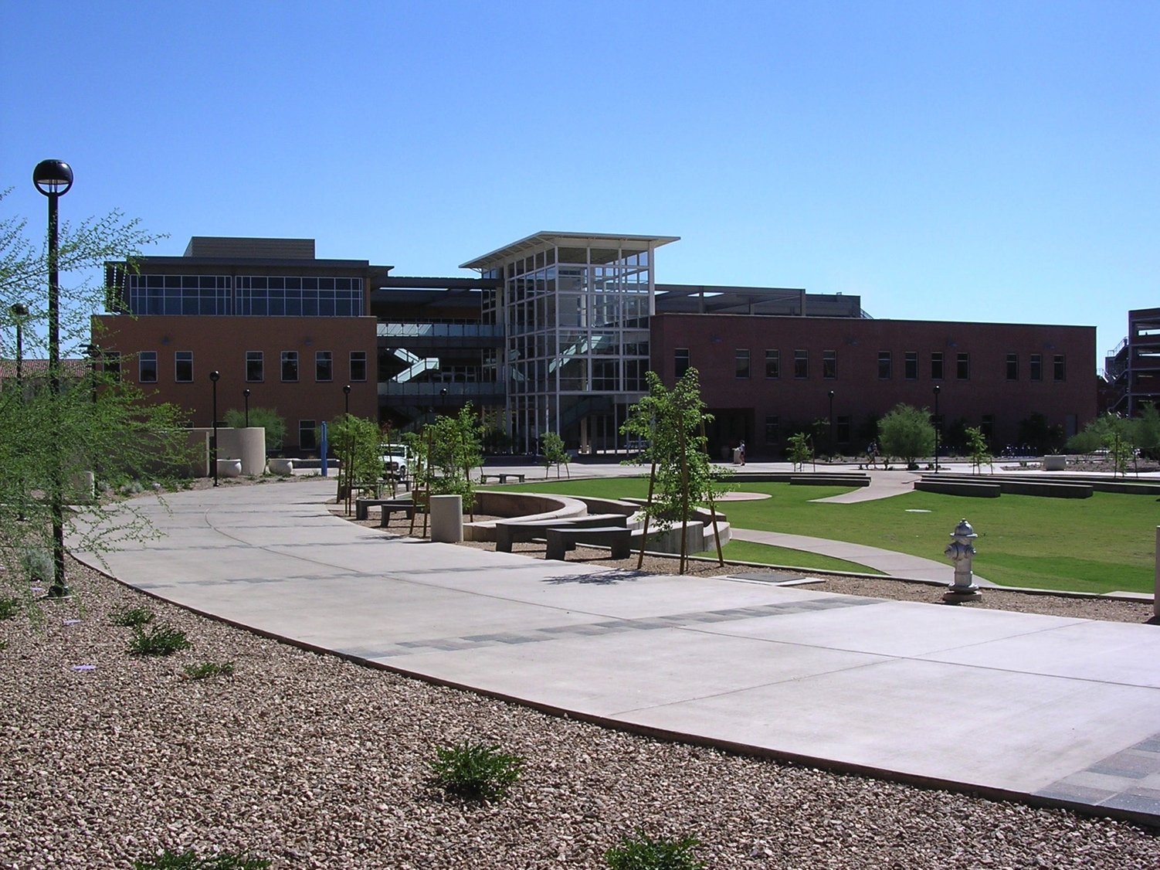
DRC –
Disability Resources
Resources for:
  Students
  Faculty
  Staff
  Campus Visitors/Community Members
Highlights:
  College wheelchair sports program
  Accessible gym
  Assistive Technology Lab
  Testing Center

Slide 3
DRC
Priorities
To facilitate access on campus
  Classroom
  Physical Space
  Technology
  Information
For disabled students, staff and faculty to have the same experiences and opportunities as non-disabled folks.
Easy, convenient processes

Slide 4
Approaches to Disability
Prevalent
Emerging
Due to physiological difference/diagnosis, injury, impairment, individual is at a deficit
“Problem” located in individual
Medical/clinical
Need to know, diagnosis
Deficit – fear, undesirable, less-than
The environment disables people with impairments through its design
Access is a right
Minimize barriers
Universal Design

Slide 5
How does the University represent values about disability?
Programming
Opportunities for involvement
Personal Interactions
Policies
Processes

Slide 6
Universal
Design
Our responsibility | Impact
Identify and remove barriers to access Incorporate access into design initially | Inclusive and welcoming environments Sustainable design Equitable, respectful experience for all
  The design of products and environments to be usable by all people, to the greatest extent possible, without the need for adaptation or specialized design.

Slide 7
Goals
Accessible
Inclusive and welcoming
Demonstrate that disability is valued
Infuse disability into content

Slide 8
Barb Borich, Access Consultant
520-621-5176 bborich@email.arizona.edu
Web: drc.arizona.edu ➔Resources for programming and events!
Main Phone: 520-621-3268
Location: Highland Commons
Main Email: drc-info@email.arizona.edu
Facebook: University of Arizona Disability Resources

