Slide 1

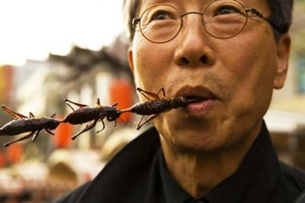
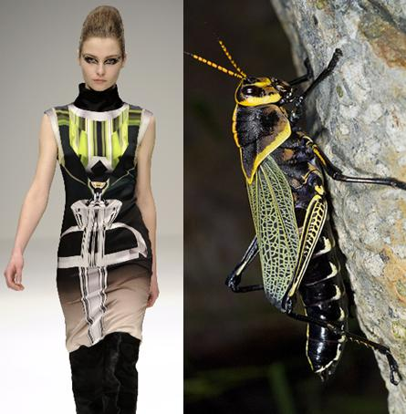
NEW SUMMER ONLINE COURSE! ENTO 160d Insects & Culture Tier 1 Traditions and Cultures
Ever wonder why the British wore redcoats? INSECTS from Mexico
Ever wonder what 80% of human cultures eat? INSECTS fried and boiled
Join us to learn how our tiny insect neighbors have shaped human art, disease, fashion, food, and war!
Contact Prof. Katy Prudic, klprudic@email.arizona.edu with any questions

