Slide 1

PeopleTools 8.55 Upgrade

Slide 2
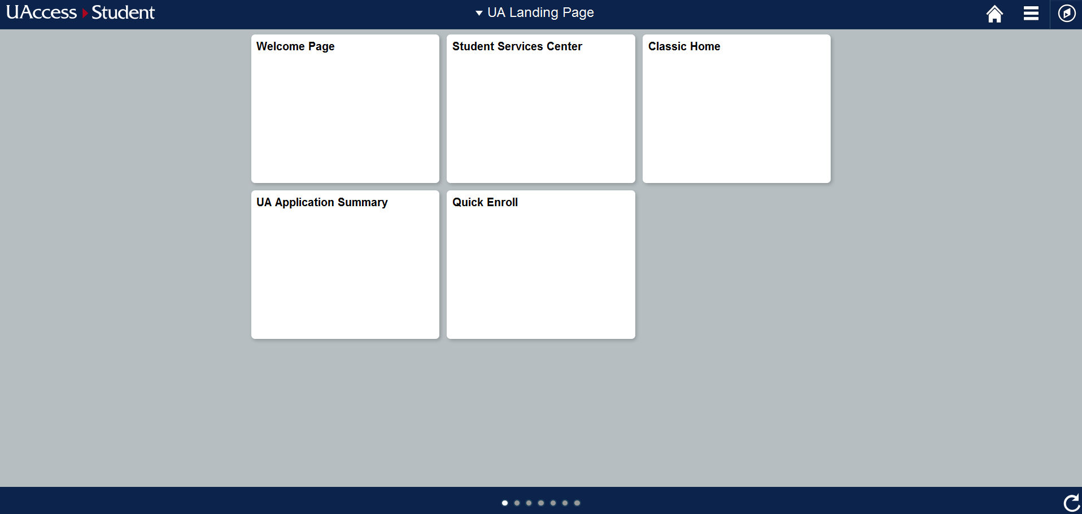
New UAccess Student Landing Page

Slide 3
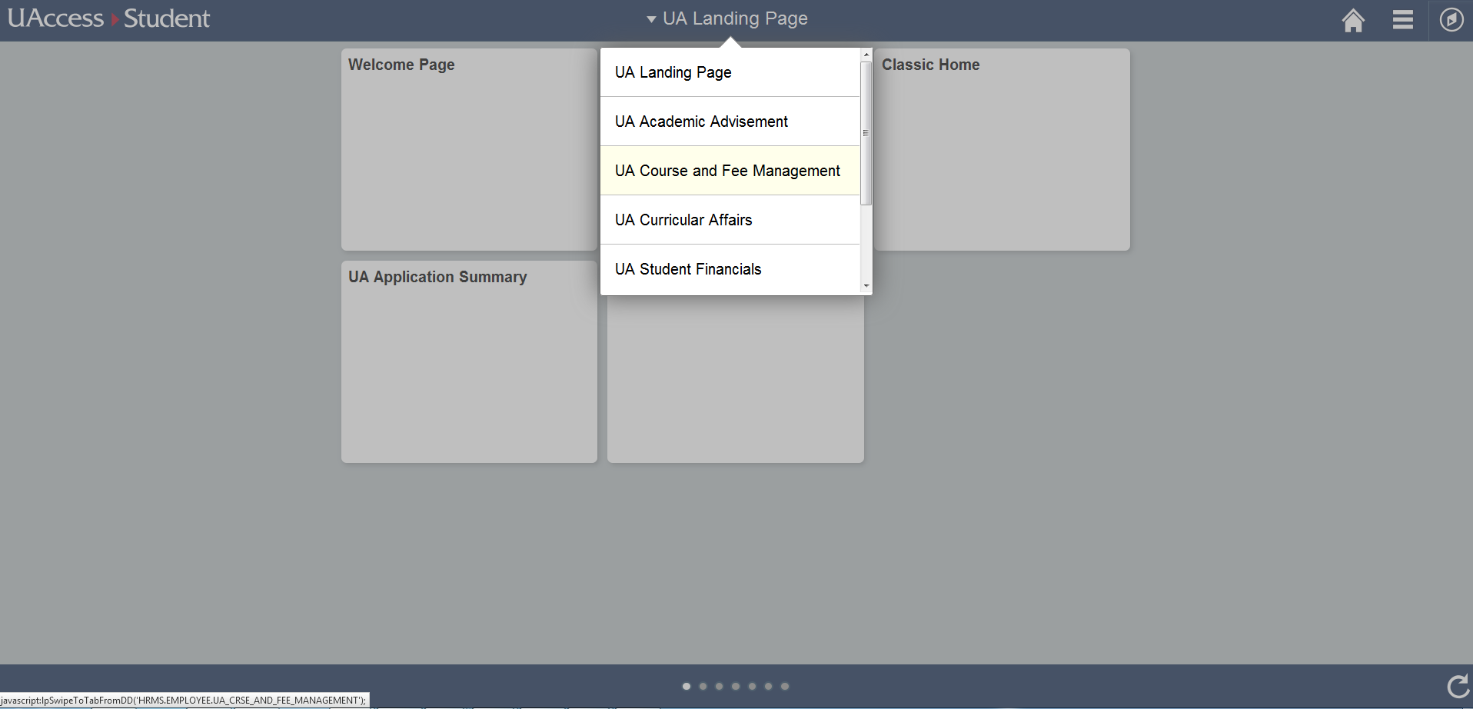
Use the drop down menu to see a list of other Landing Pages you can access.

Slide 4
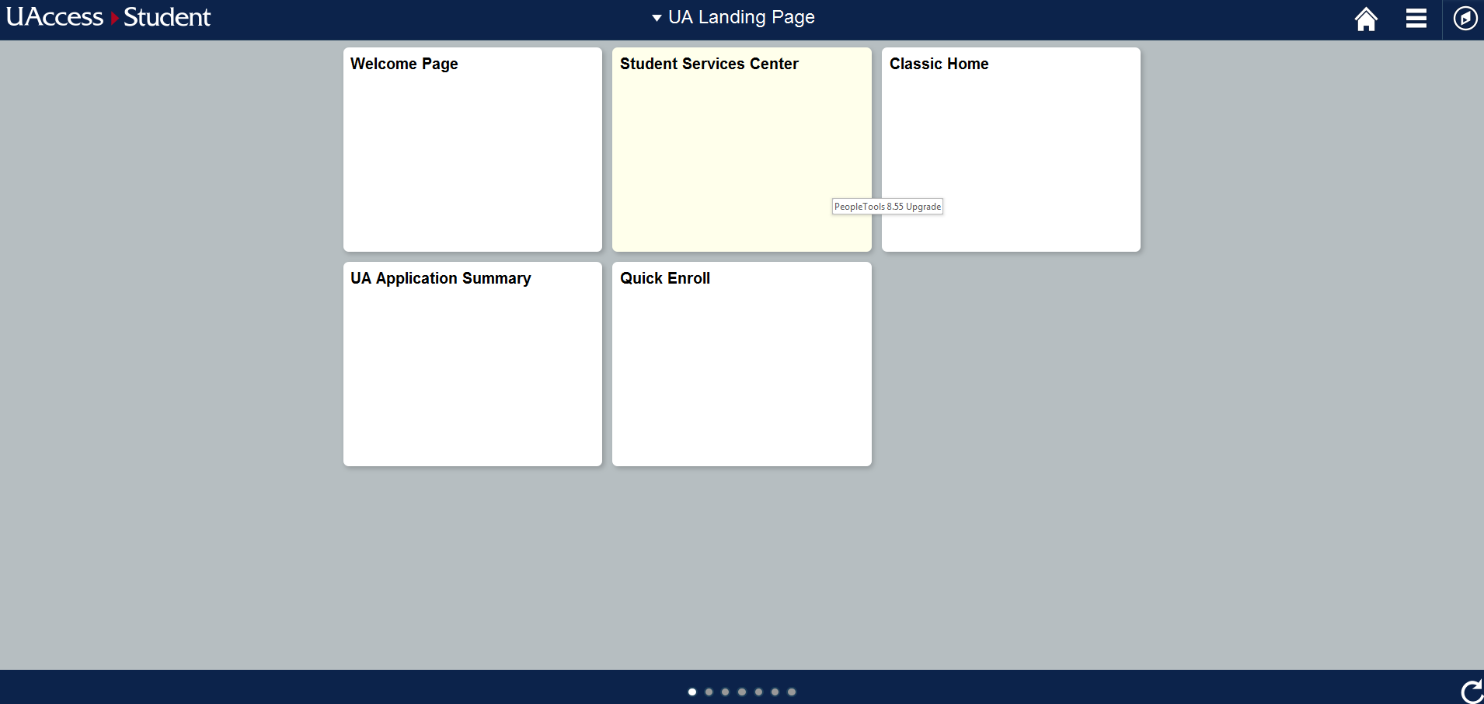
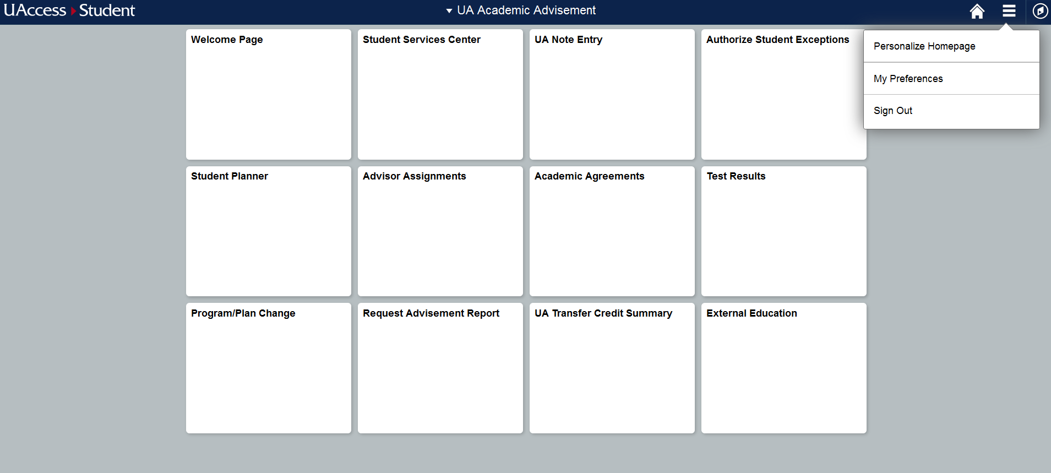
The UA Academic Advisement home page will have quick links to many of the pages Advisors use.

Slide 5
The Action List icon will allow you to personalize your homepage, change preferences, or sign out.

Slide 6
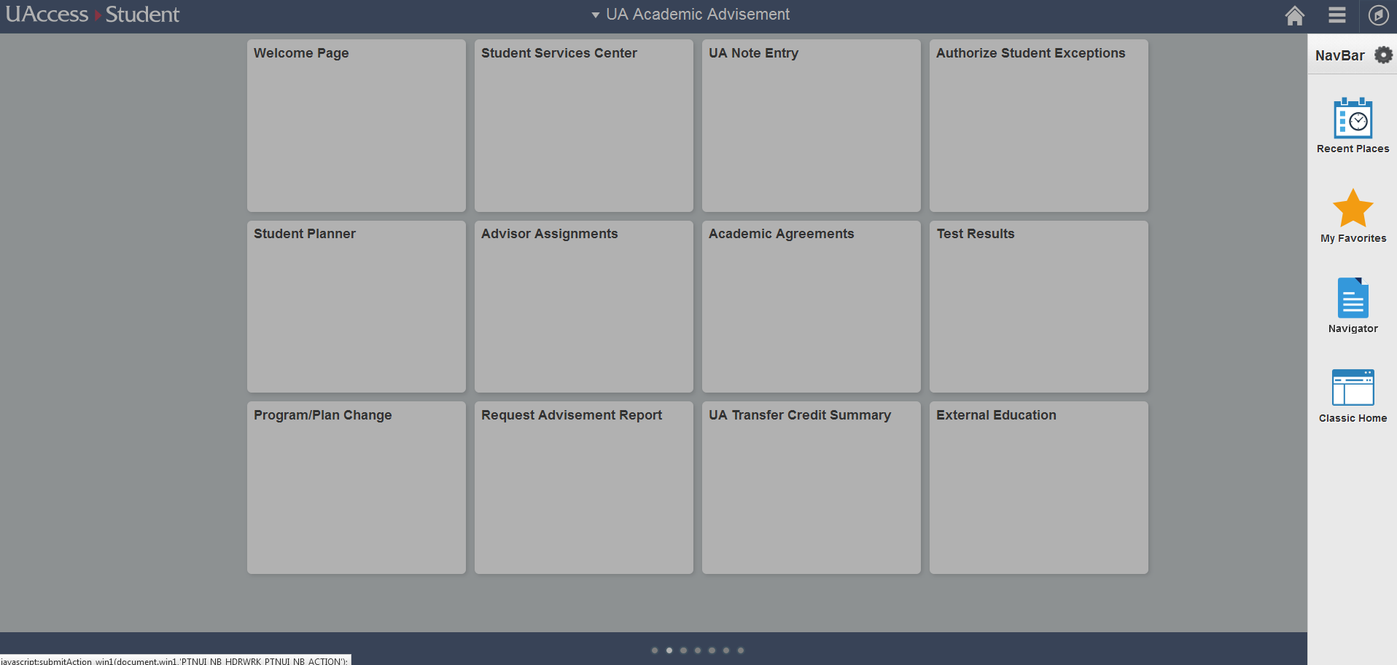
The NavBar (compass icon) will allow you to access your favorites, navigate through UAccess, or change the view to the classic home.

Slide 7
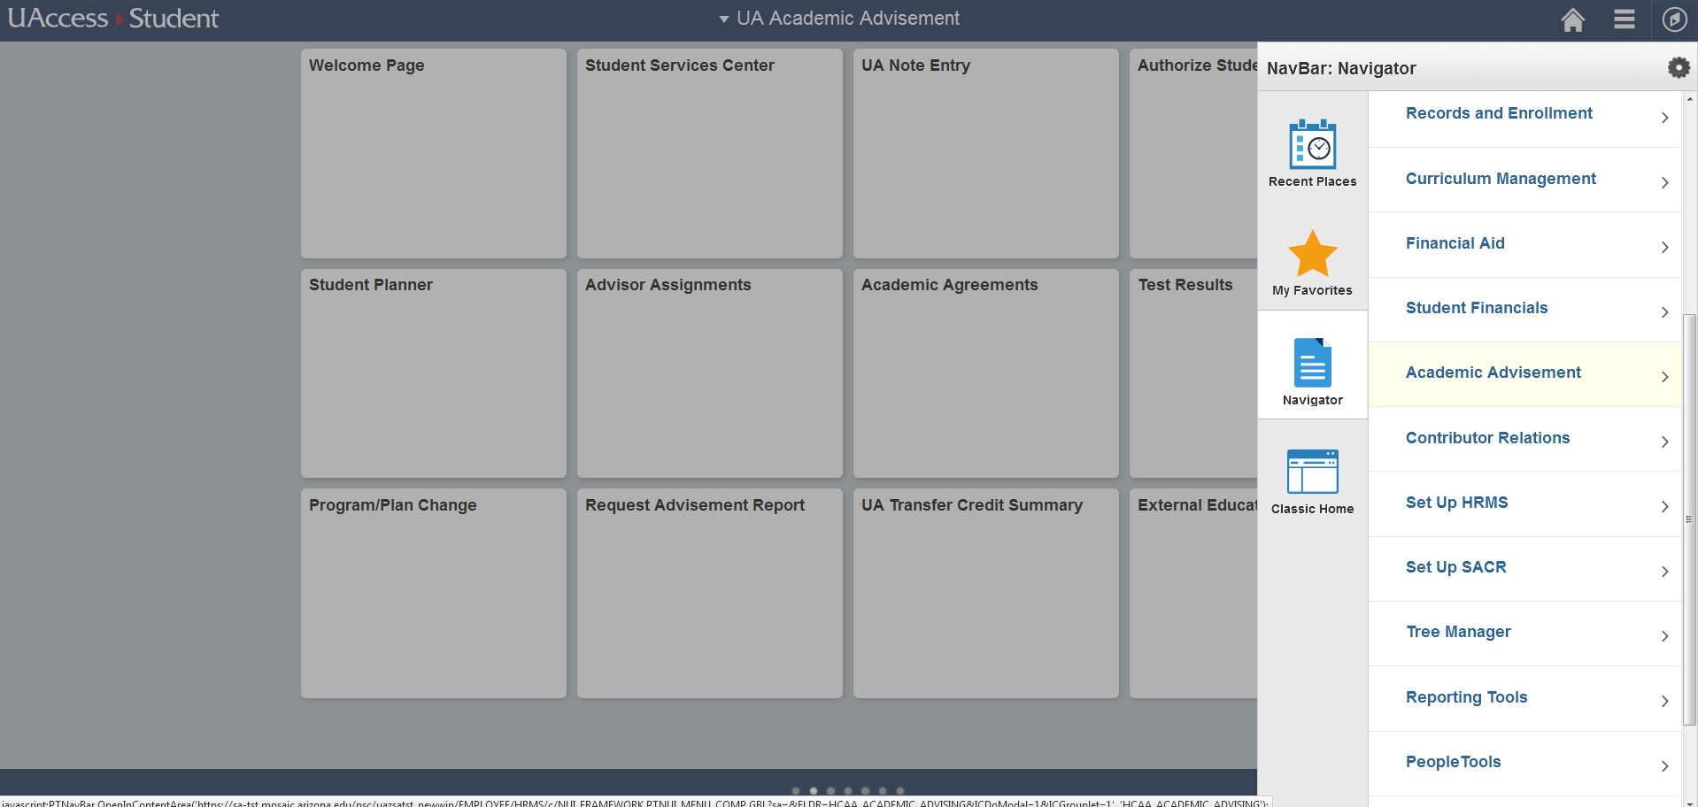
When you click “Navigator” you will see Uaccess menus appear. These are the same menus you had previously, but they appear here instead of as breadcrumbs at the top of the page. Click through them to get to the pages you need.

Slide 8
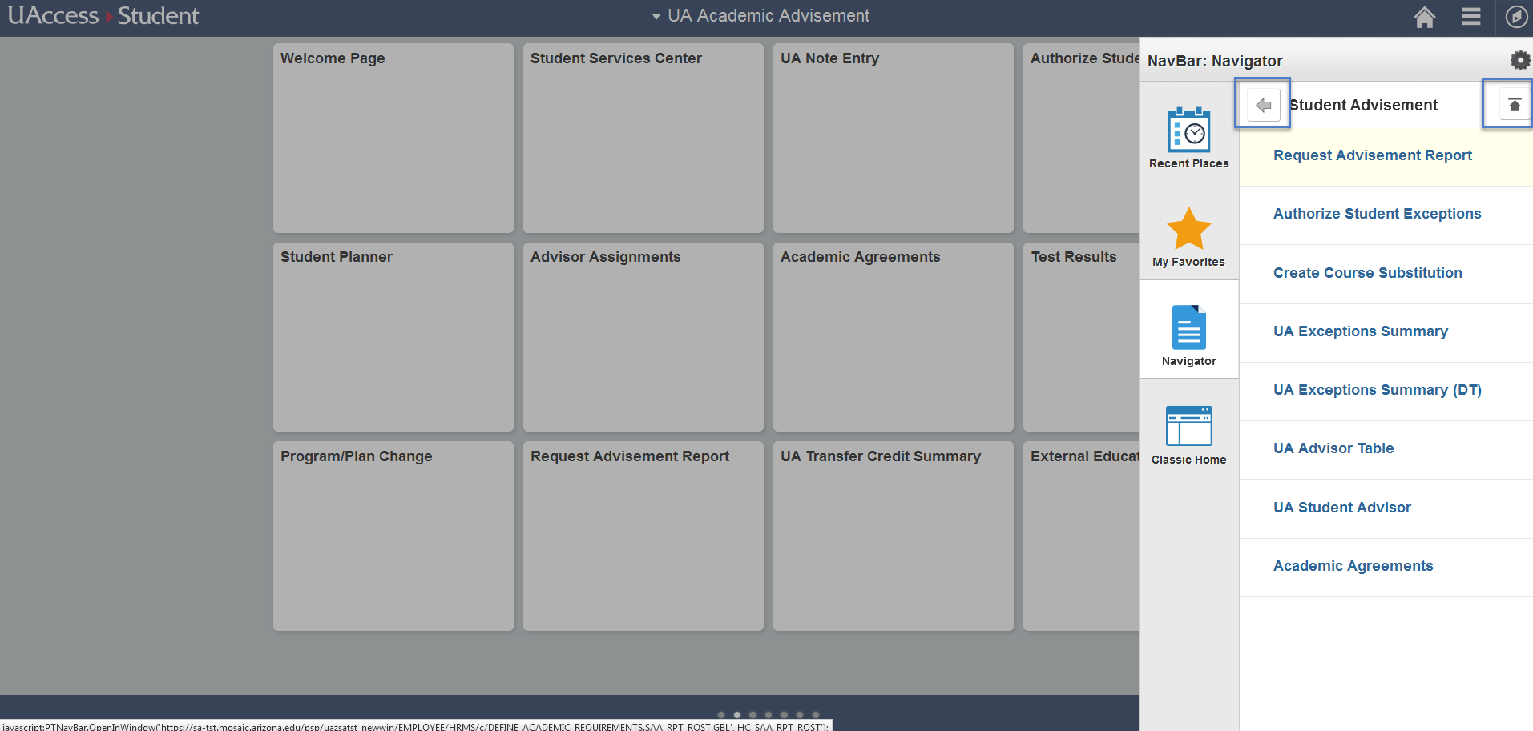
The back arrow allows to return to the previous level, and the up arrow returns you to the main menu.

Slide 9
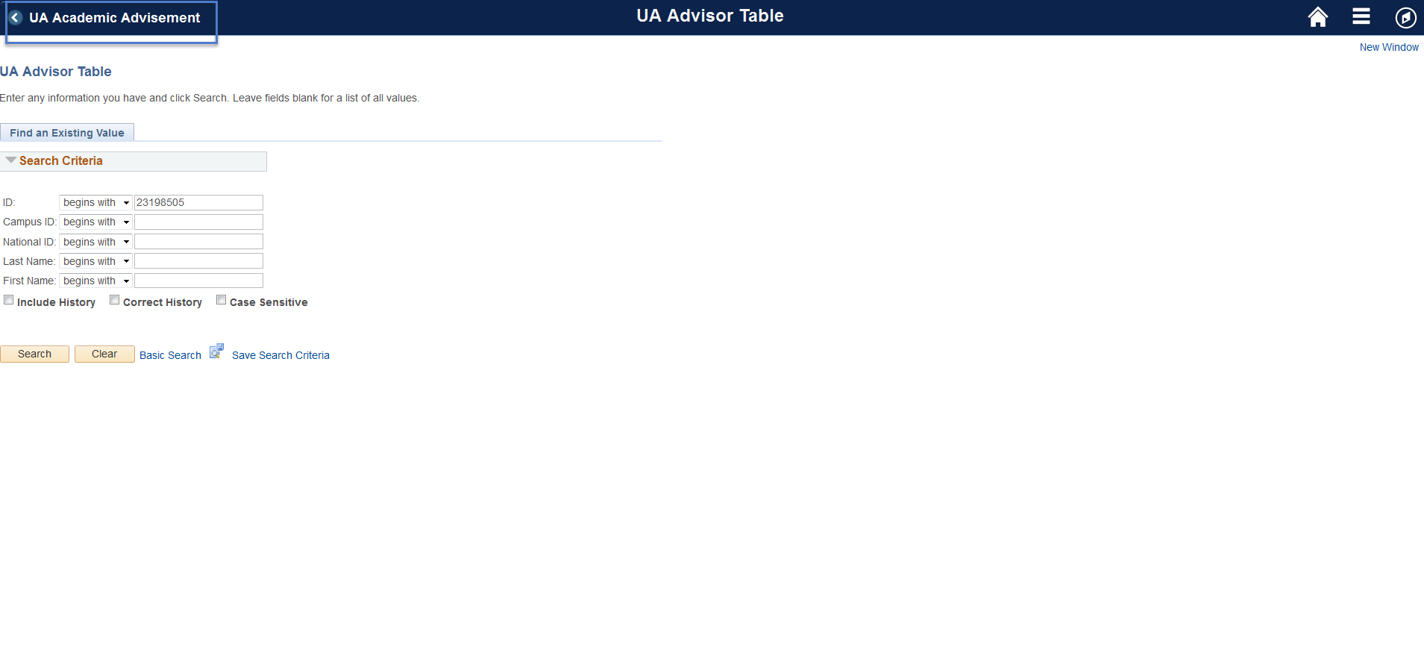
When you navigate to a page you can return to the previous screen by clicking on the button in the top left corner.

Slide 10
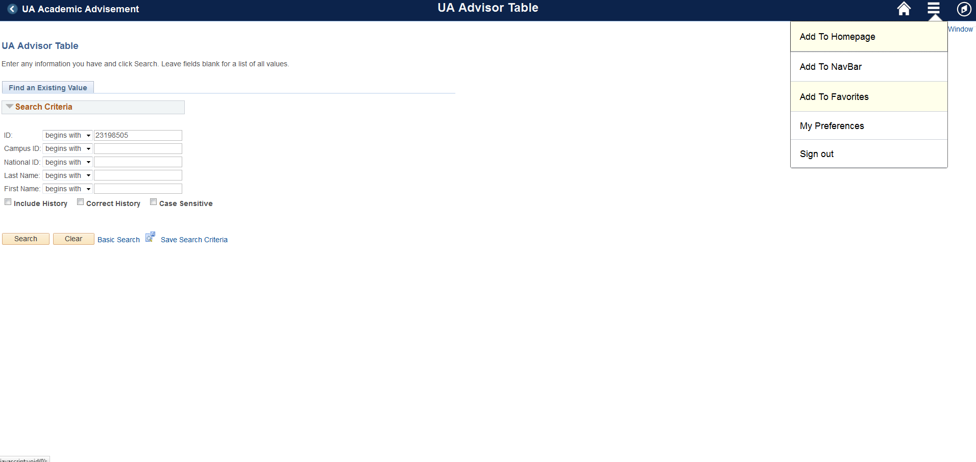
To favorite a page, go to the Action List icon and Add to Favorites or Homepage.

