Slide 1
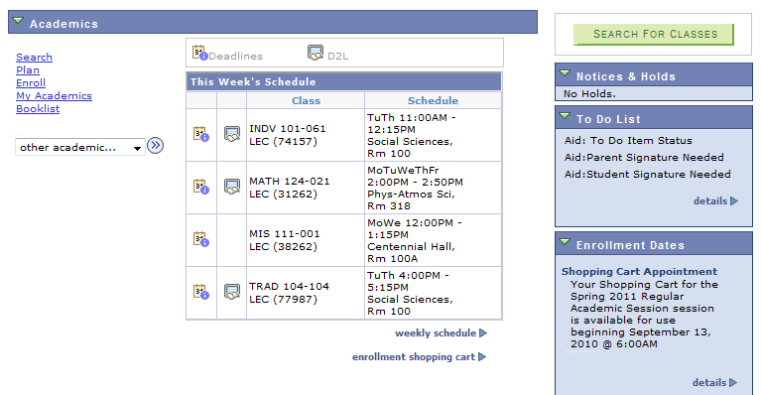
You can use CHECK ELIGIBILITY to see if the classes in your shopping cart will be successfully processed when your enrollment appointment begins and you are ready to register for classes.
From your
Student Center, choose enrollment shopping cart
22,

Slide 2
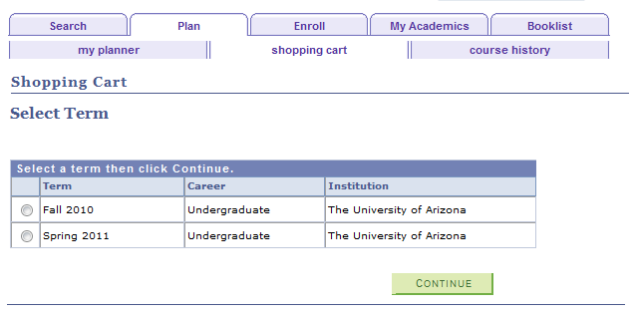
Choose Spring 2011 and then Continue

Slide 3
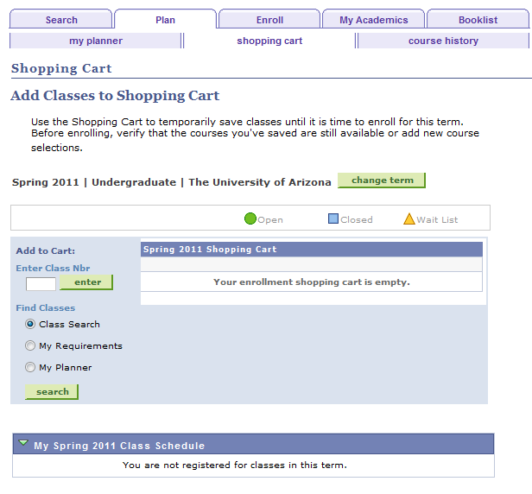
Add classes to your shopping cart by entering a Class Number or by searching

Slide 4
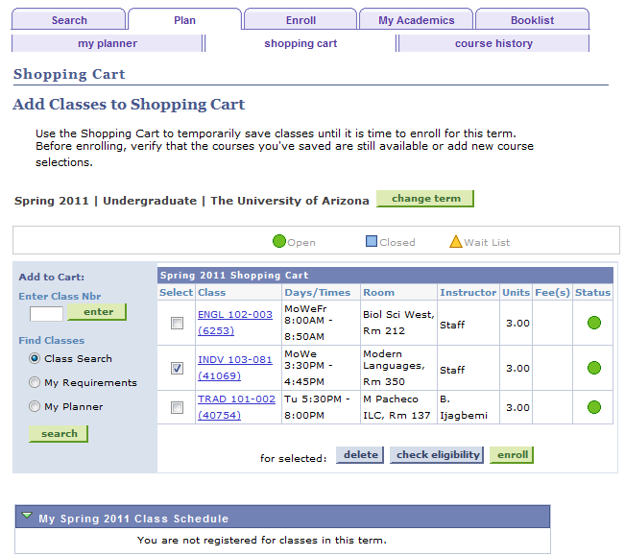
Once you have classes in your shopping cart, you can select a class and then click on the check eligibility button.

Slide 5
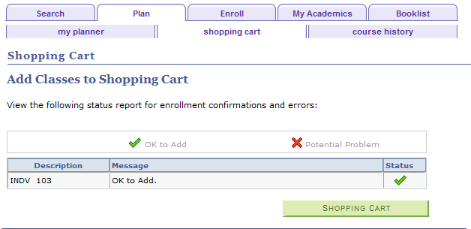
If you are eligible to enroll in this class, you will see the OK to Add message. THIS DOES NOT MEAN THAT YOU ARE NOW ENROLLED IN THE CLASS. This means that when your enrollment appointment begins, if this class has seats available and you try to enroll in this class, you will be eligible.

Slide 6
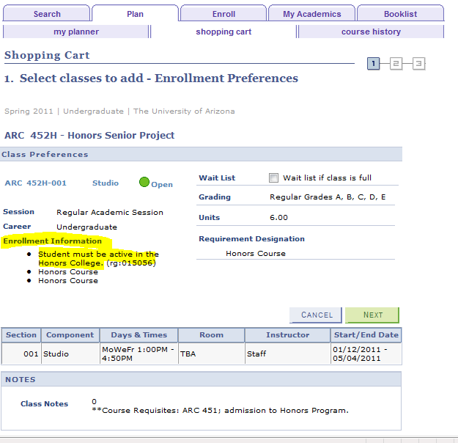
When adding classes to your shopping cart, take note of special Enrollment Information. If you don’t meet these requirements, you can still add the class to your shopping cart, but you won’t be allowed to register for the class later.

Slide 7
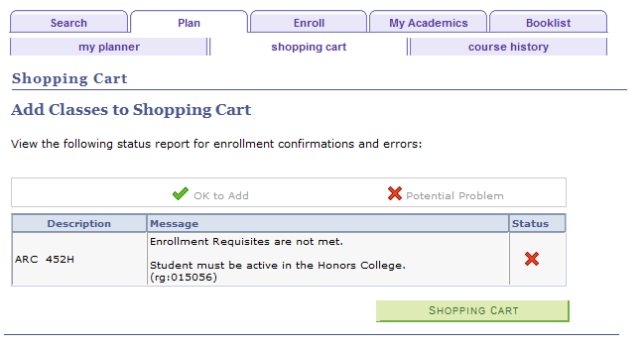
In this example, an honors class was added to the shopping cart, but when the student used check eligibility, they discovered that they don’t meet the requirement of being active in the Honors College.

Slide 8
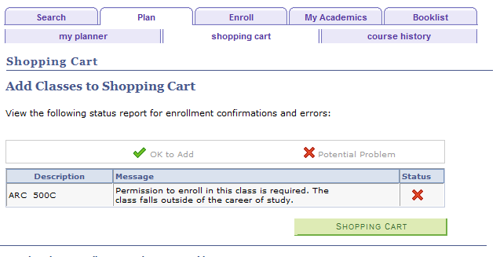
CHECK ELIGIBILITY will tell you if the class falls outside of your career. In the example below the student is an undergraduate and had a graduate level class in their shopping cart.

Slide 9
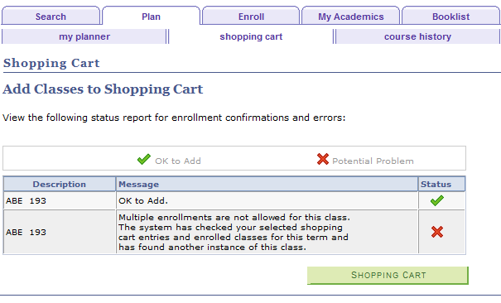
CHECK ELIGIBILITY will tell you if you can’t add the same class twice. In the example below the student had an internship class added twice. This course is not set-up to allow this, so an error is received on the second class.

Slide 10
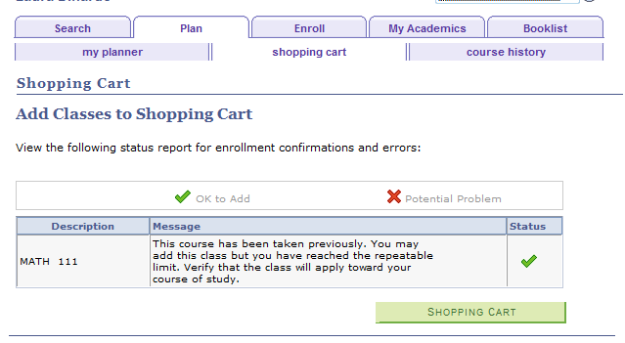
CHECK ELIGIBILITY will tell you if the class is being repeated. In the example below the student already took Math 111 but didn’t earn an A or B, so they are eligible to repeat the class a second time. The student receives a warning to make sure that this class can be used towards degree requirements. The student will be able to enroll in this class when registration begins, but they will receive this warning message again.

Slide 11
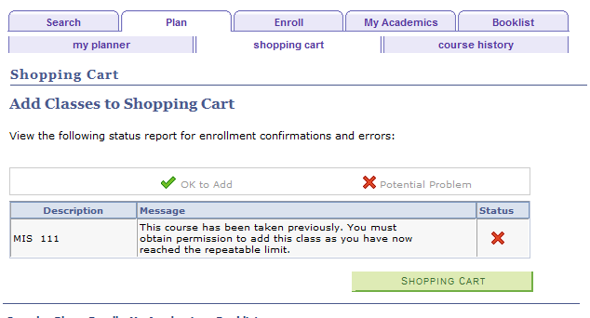
CHECK ELIGIBILITY will tell you if the class cannot be repeated. In the example below the student has already taken MIS 111 and earned a B grade, so they are not eligible to repeat this course.

