Slide 1

Supporting Transgender &
Non-Binary Students
Revised: Summer 2015

Slide 2
We were raised in a society that constructs and reinforces false binaries.

Slide 3
  Societal Expectations
At birth if you are assigned Male…
It is expected that you will be a Man…
As a man, society expects you to be Masculine…
And men are expected to be attracted to women = Heterosexual & Heteroromantic
Male
Masculine
Heterosexual
Man
Heteroromantic
Female
Feminine
Heterosexual
Woman
Heteroromantic
At birth if you are assigned Female…
It is expected that you will be a Woman…
As a woman, society expects you to be Feminine…
And women are expected to be attracted to men = Heterosexual
& Heteroromantic
However, not everyone meets society’s expectations…

Slide 4
Sex
Gender
Identity
Gender
Expression
Female
Intersex
Male
Transgender, Non-Binary
Woman
Man
Gender non-conforming
Feminine
Androgynous
Masculine

Slide 5
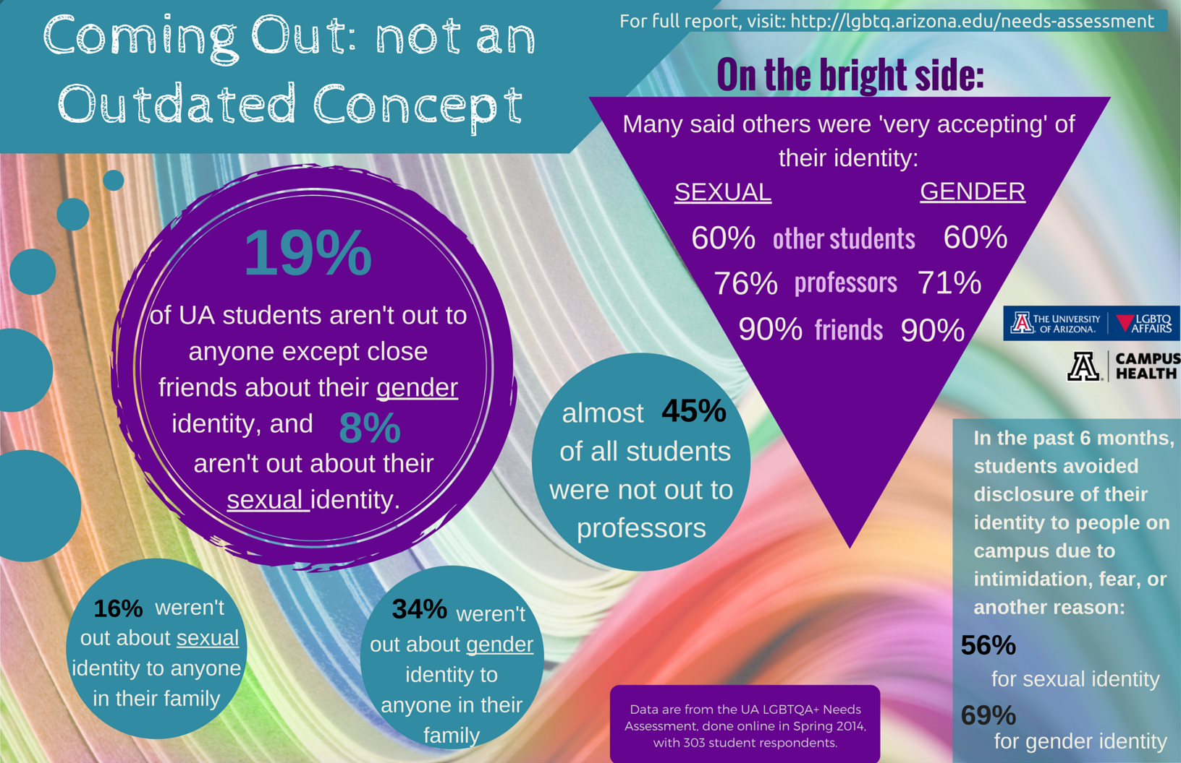
Notes:
The LGBTQA+ Needs Assessment was administered to students, faculty, staff and community members in spring 2014.
Students, Faculty/Staff and Community Members were invited to participate, Total sample size = 589 (303 students, 191 who identify as LGBTQ+)
Students were asked “which other people know about your sexual or gender identity?”
Options were Friends, Other Students, Professors, and Family
Students were asked “how accepting have other people been about your sexual or gender identity?”
Options were Friends, Other Students, Professors, and Family
Dealing with being out is not a thing of the past – students are still not out in many aspects of their lives
Not just a function of age and development – for example, 7% of grad students said none of their friends knew about their sexual identity, compared with 1% of undergraduates
Significant numbers of students were not out to/or accepted by their families
Students of color reported being less out in most spheres and reported being slightly less accepted (except among friends)
Trans students reported alarmingly lower levels of outness and acceptance, especially among family

Slide 6
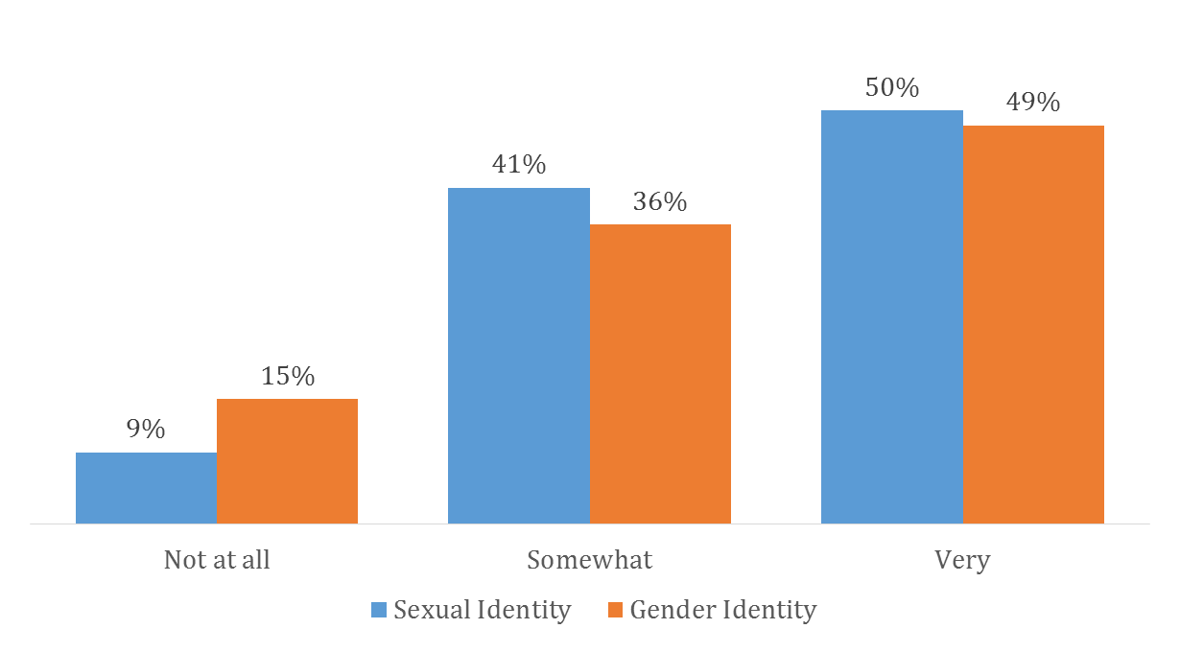
Acceptance: Family (n=190)
% student ratings of acceptance of their sexual identity or gender identity by their family
Notes:
Trans students reported alarmingly lower levels of outness and acceptance, especially among family
Dealing with being out is not a thing of the past – students are still not out in many aspects of their lives
Not just a function of age and development – for example, 7% of grad students said none of their friends knew about their sexual identity, compared with 1% of undergraduates
Significant numbers of students were not out to/or accepted by their families
Students of color reported being less out in most spheres and reported being slightly less accepted (except among friends)
Trans students reported alarmingly lower levels of outness and acceptance, especially among family

Slide 7
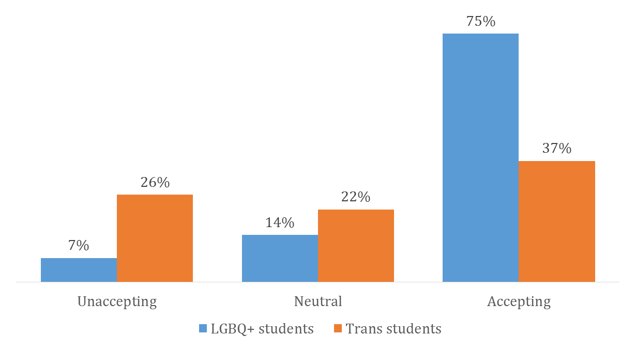
How would you describe the overall campus climate for LGBTQ+ students? (n=190)
*student respondents only
Notes:
Responses from LGBTQA+ students ONLY

Slide 8
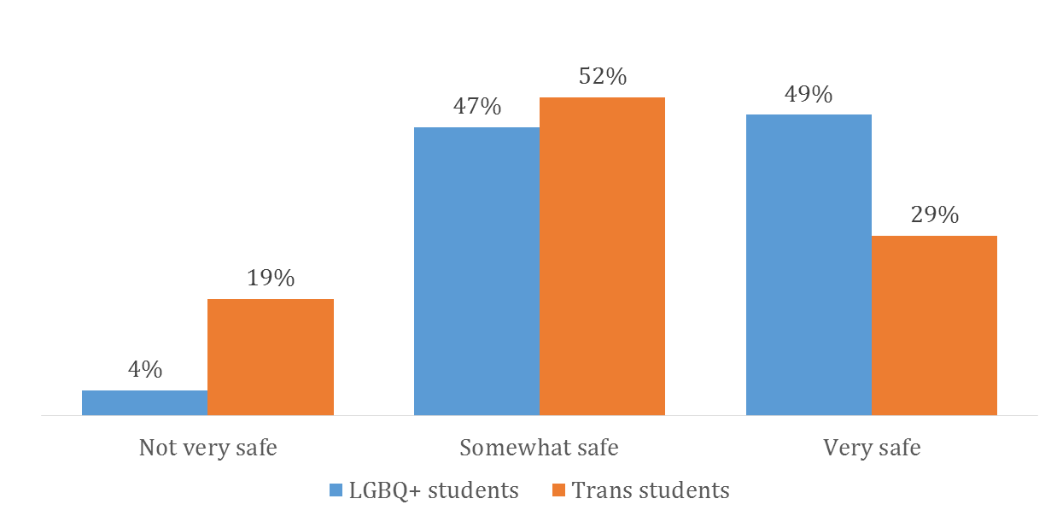
Feeling Safe on Campus (n=190)
% student ratings of feeling safe on campus, by LGBQ+ and Trans
Notes:
Responses from LGBTQA+ students ONLY

Slide 9
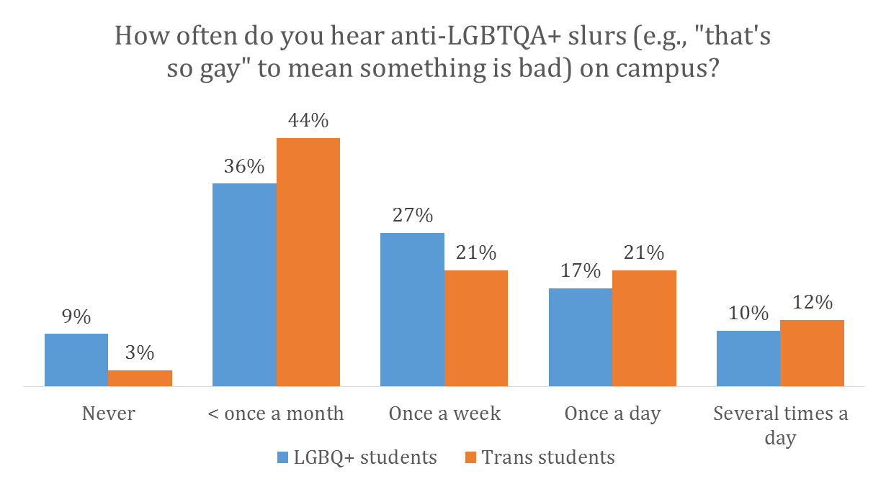
A majority of LGBTQA+ students experienced derogatory language at least once a week (n = 190)
How often do you hear anti-LGBTQA+ slurs (e.g., “that’s so gay” to mean something is bad) on campus?
54% of Transgender students
54% of LGBQ+ students
Notes:
Responses from LGBTQA+ students ONLY

Slide 10
Disproportionate numbers of transgender students avoided going to class because of discrimination (n = 190)
Notes:
Responses from LGBTQA+ students ONLY

Slide 11
Additionally, disproportionate numbers of transgender students felt left out while working in groups
(n = 190)
Notes:
Responses from LGBTQA+ students ONLY

Slide 12
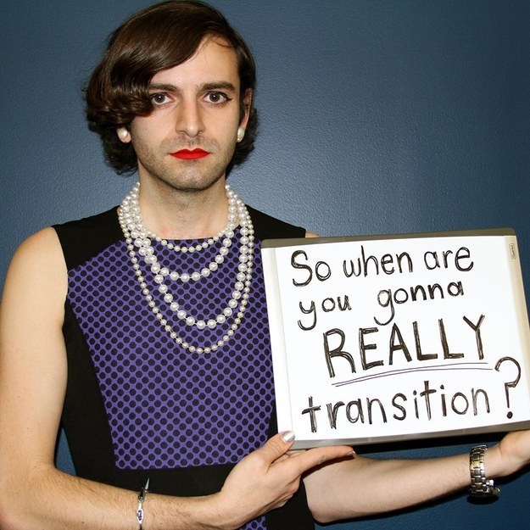
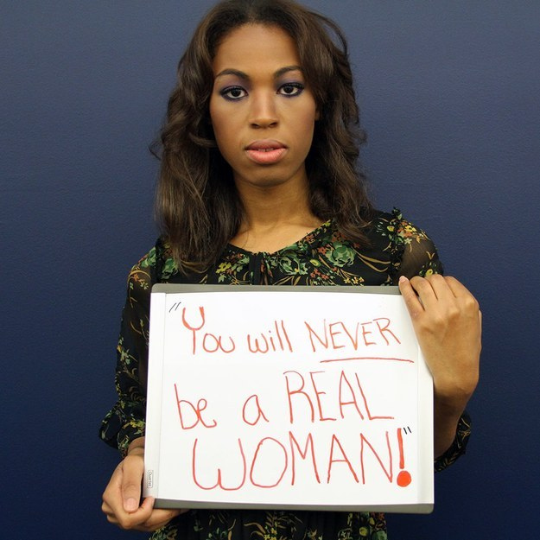
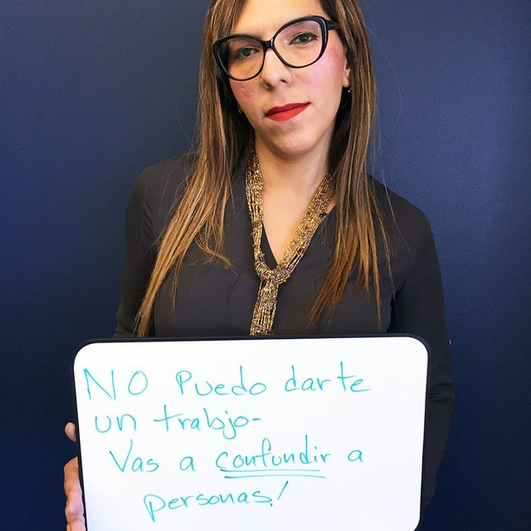
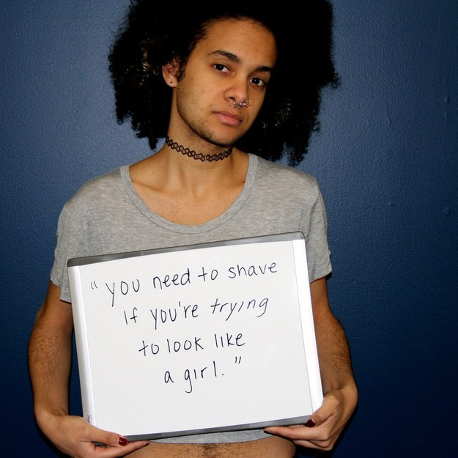
Transgender and non-binary students face myriad microaggressions in their everyday lives, especially on college campuses.
Notes:
Microaggressions: brief, commonplace verbal, behavioral, or environmental indignities that communicate hostile, derogatory, or negative insults. They may not always be intentional, they reinforce a power dynamic through casual degradation of folks from non-dominant groups…

Slide 13
Microaggressions that Non-Binary Students face on the UA campus
People being generally rude and not taking you seriously until they figure out “which gender you are”
Not asking for pronouns/not respecting pronouns once they are shared
Misgendering based off of appearance
“Male and female” bathrooms and feeling uncomfortable/unsafe using them/which will be less dangerous?
Assuming that non-binary people have to look a certain way/ change their gender expression to identify as non-binary
Using language that assumes a binary (ex: “both genders”, “brothers and sisters”), both in conversation and on official forms (ex: check “male or female”)
Referring to legal name as “real name”/ refusing to use someone’s chosen name
Suggesting that non-binary identities aren’t “real”
Whispering and giggling once others think I am out of ear shot (including from staff/advisors)
Notes:
Microaggressions: brief, commonplace verbal, behavioral, or environmental indignities that communicate hostile, derogatory, or negative insults. They may not always be intentional, they reinforce a power dynamic through casual degradation of folks from non-dominant groups…

Slide 14
(If you find yourself feeling uncomfortable)
Allow your discomfort to lead to reflection.
Take responsibility for the way you treat transgender and non-binary students.
Notes:
These issues are bigger than any one department, or even our campus as a whole, it happens everywhere—but we have to do what we can.
We all serve transgender and non-binary students.
Whatever discomfort you are feeling is your responsibility to understand.
It’s your job to explore your discomfort, question it, and allow it to lead to reflection
We all have a sex, gender identity, gender expression.
If someone’s identities or expression makes you uncomfortable, use that as a motivation to self-reflect.
Think, “why does another person’s identity offend you or seem like a joke?”

Slide 15
How you can support transgender & non-binary students…
Don’t assume another person’s gender. Ask them what pronouns they use and make sure you use them. Additionally, use the name that they wish to be addressed as (not a name that may exist on their legal record).
Reflect and challenge your own perceptions of gender. Recognize that there are more than two genders.
Use language that’s inclusive of ALL genders.
Don’t stare or laugh at folks whose expression doesn’t match your expectations.
Examine your office’s policy’s to see if there are any forms/procedures/language that are not fully gender inclusive. If there are, lobby for it to be changed or change it yourself.

Slide 16

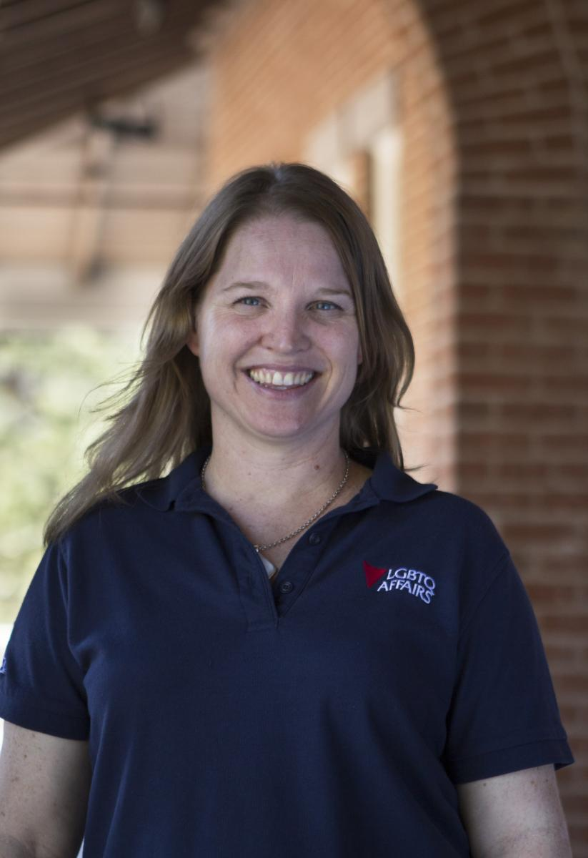
Jen Hoefle Olson
Program Director
LGBTQ Resource Center
Student Union, Rm 404-O jhoefle@email.arizona.edu
(520) 626-1996 lgbtq.arizona.edu

