Slide 1
APPLICATION FOR GRADUATION
The New Online Process

Slide 2
PROCESS OVERVIEW
Give student access to apply for graduation
Notify student of eligibility to apply
Create two checklist items
Student submits application
Instruct student to contact their advisor
Advisor meets with student, creates Degree Audit Worksheet, and submits it to Graduation Services
Graduation Services reviews, posts degree

Slide 3
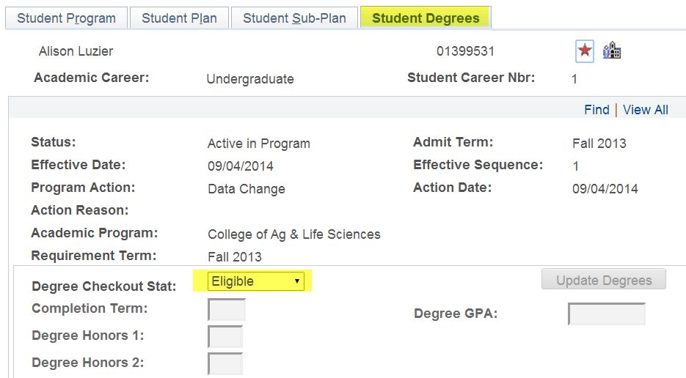
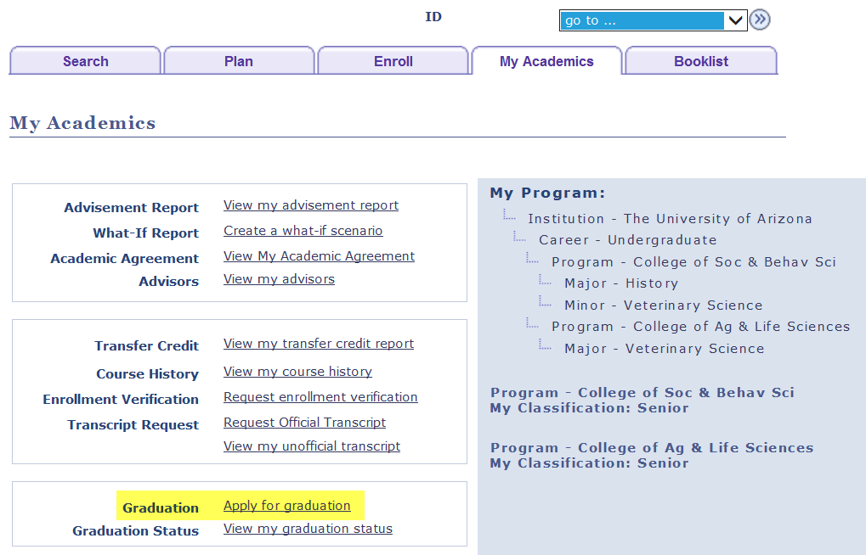
ACCESS TO APPLY FOR GRADUATION
REGISTRAR’S OFFICE
Runs a process which sets the student’s Degree Checkout Status to “Eligible.” This enables the display of the “Apply for Graduation” link in the Student Center.
Student must have 90 earned units, valid major(s), and admit term earlier than Fall 2014.

Slide 4
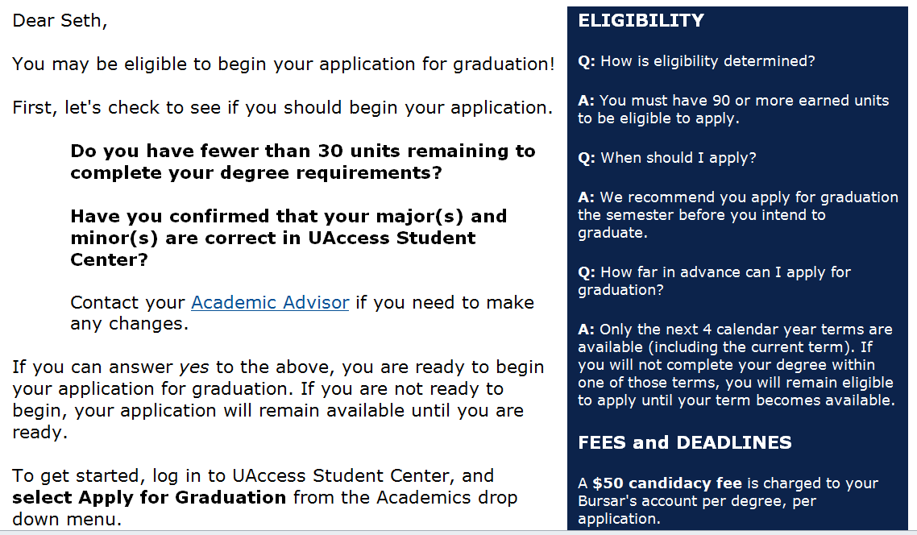
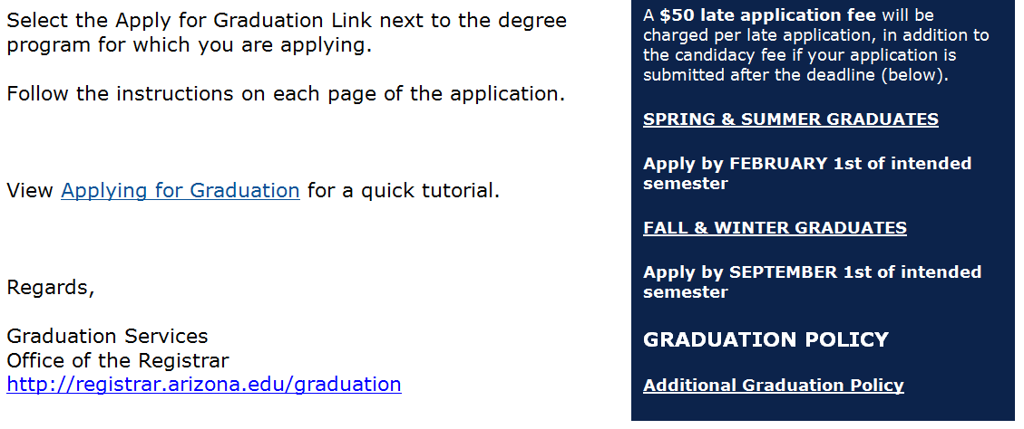
NOTIFY STUDENT OF ELIGIBILITY TO APPLY

Slide 5
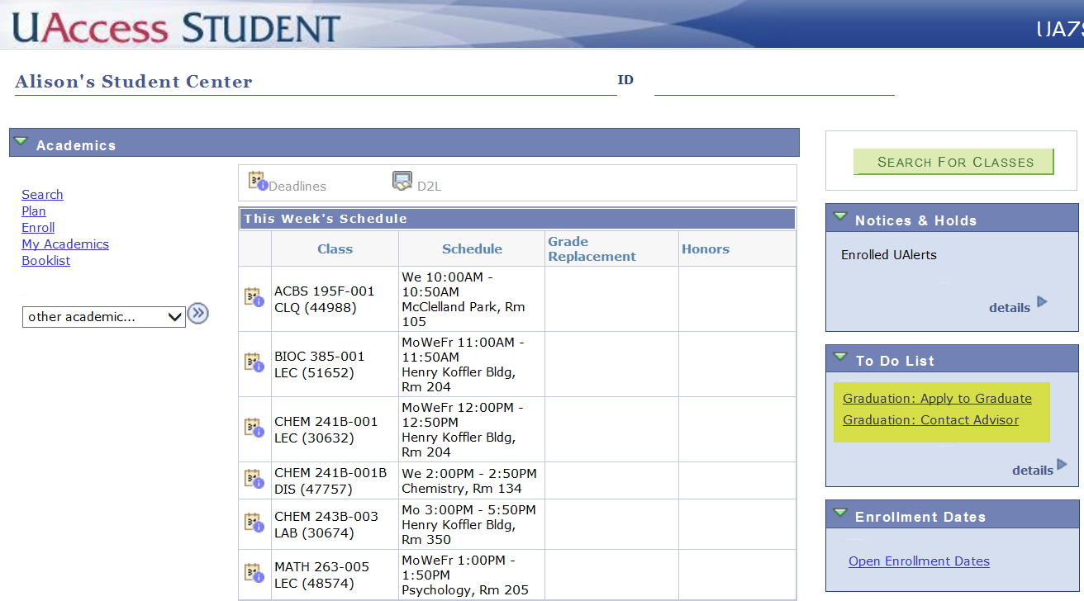
CREATE TWO CHECKLIST ITEMS
STUDENT CENTER TO DO LIST

Slide 6
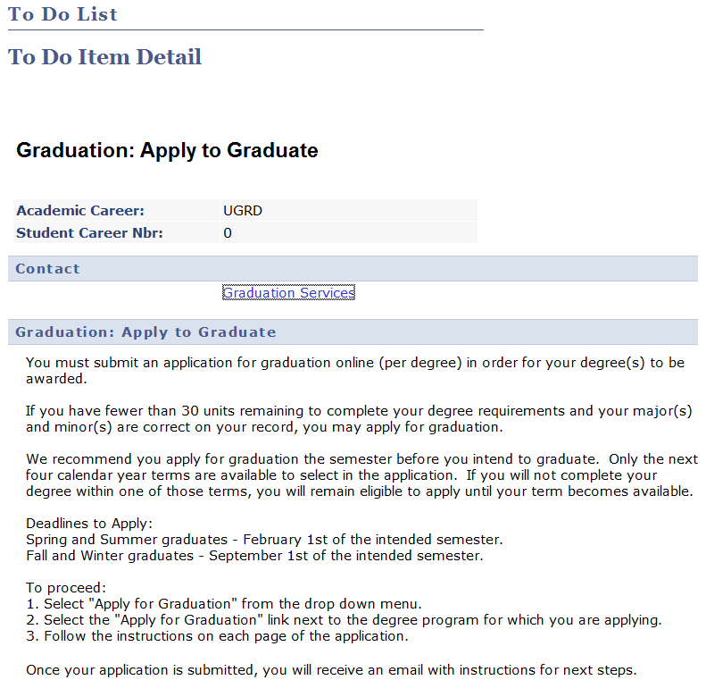
CHECKLIST ITEM DETAIL
APPLY TO GRADUATE

Slide 7
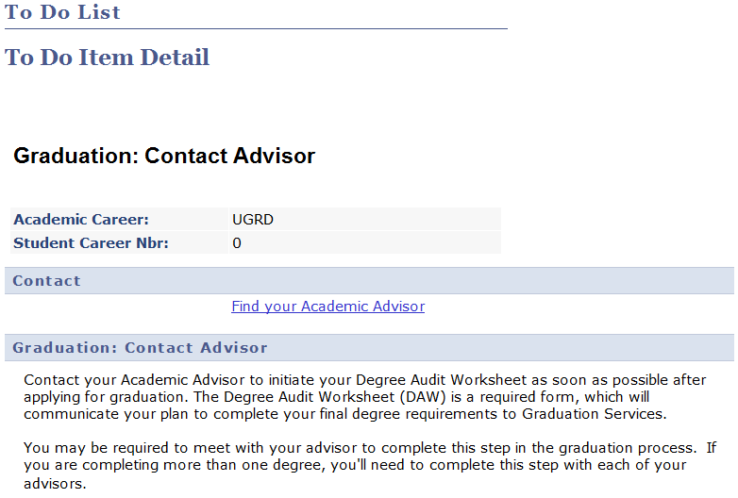
CHECKLIST ITEM DETAIL
CONTACT ADVISOR

Slide 8
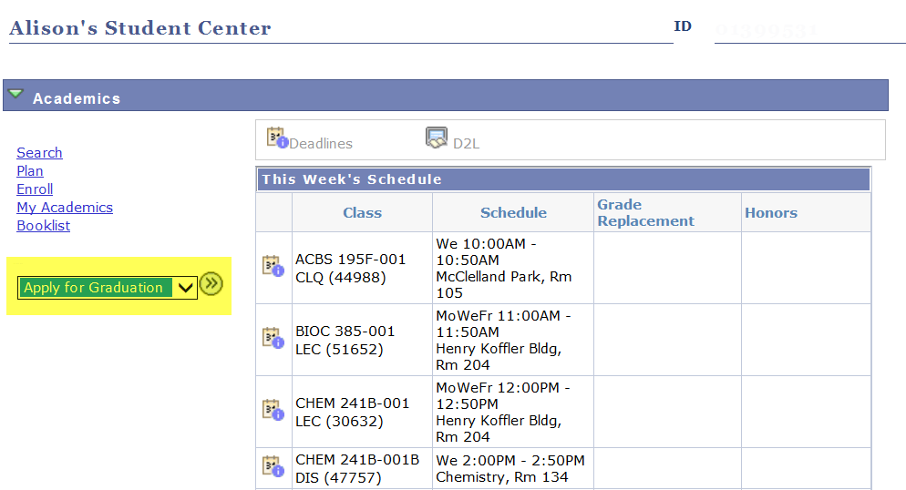
STUDENT APPLIES FOR GRADUATION
SELECT “APPLY FOR GRADUATION” FROM THE DROP DOWN

Slide 9
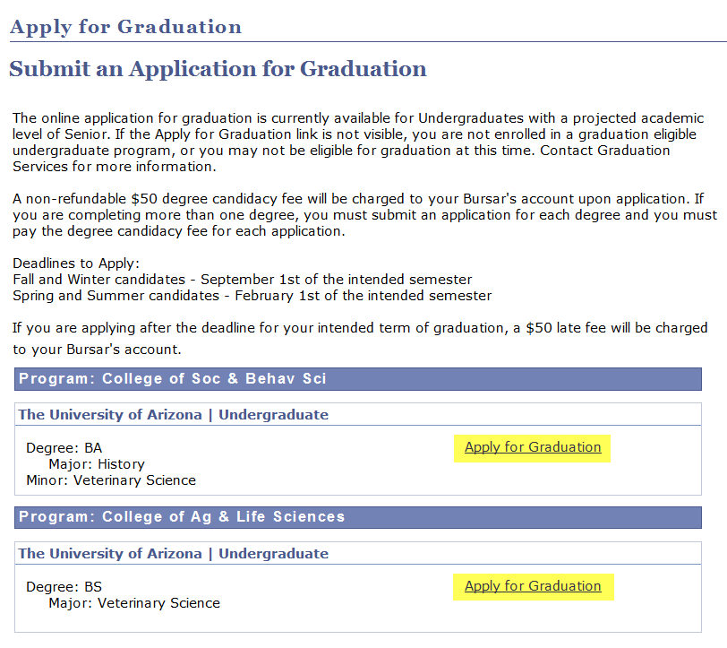
STUDENT APPLIES FOR GRADUATION
INSTRUCTIONS AND INFORMATION DISPLAY

Slide 10
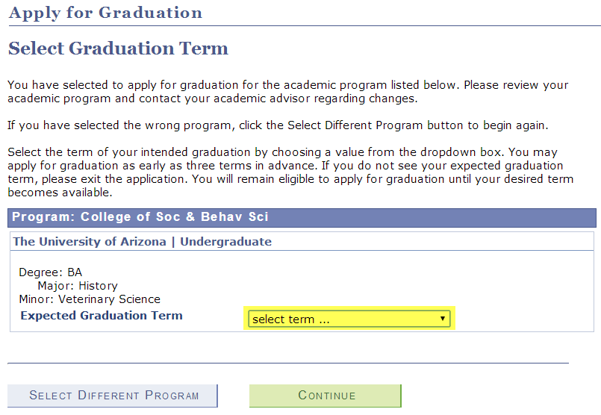
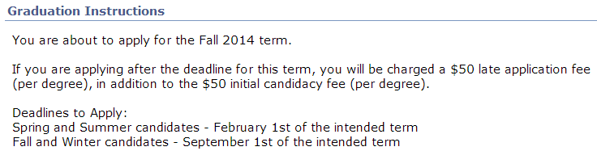
STUDENT APPLIES FOR GRADUATION
SELECT THE TERM OF EXPECTED GRADUATION

Slide 11
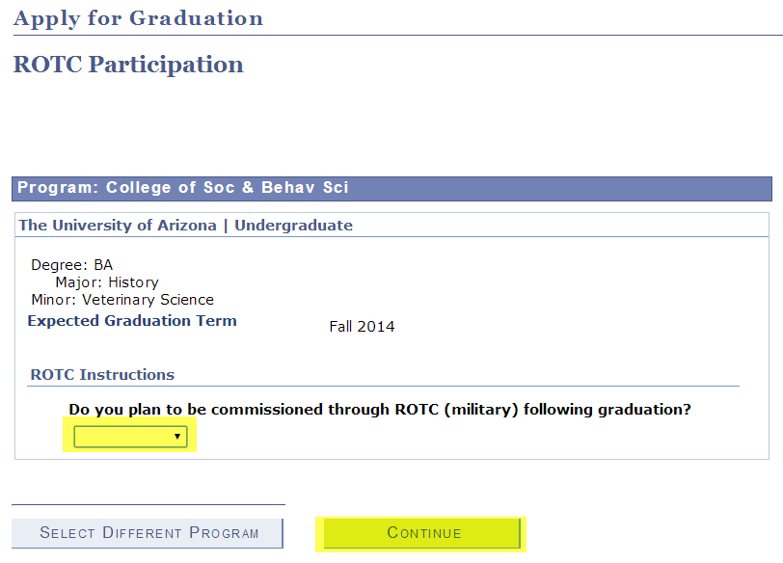
STUDENT APPLIES FOR GRADUATION
ROTC INSTRUCTIONS

Slide 12
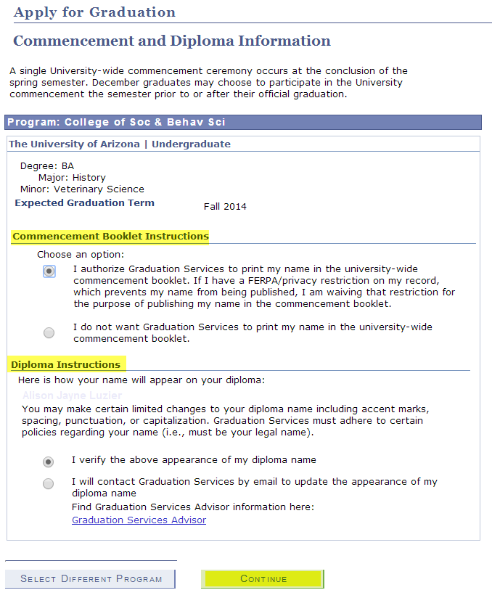
STUDENT APPLIES FOR GRADUATION

Slide 13
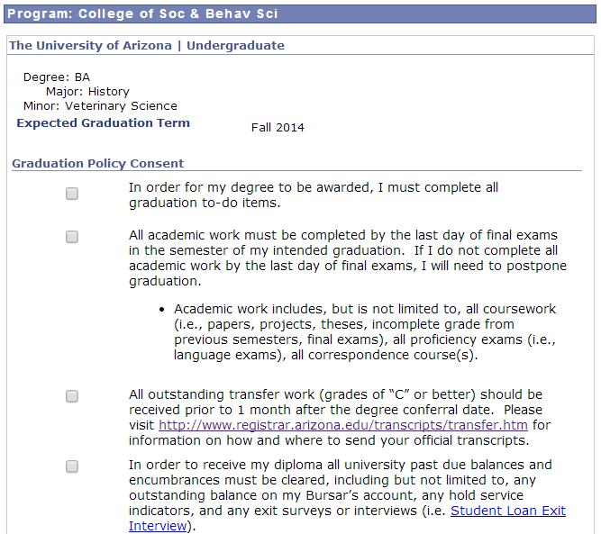
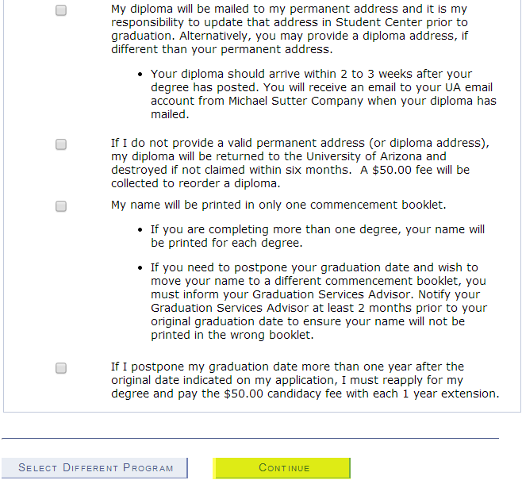
STUDENT APPLIES FOR GRADUATION
GRADUATION POLICY CONSENT

Slide 14
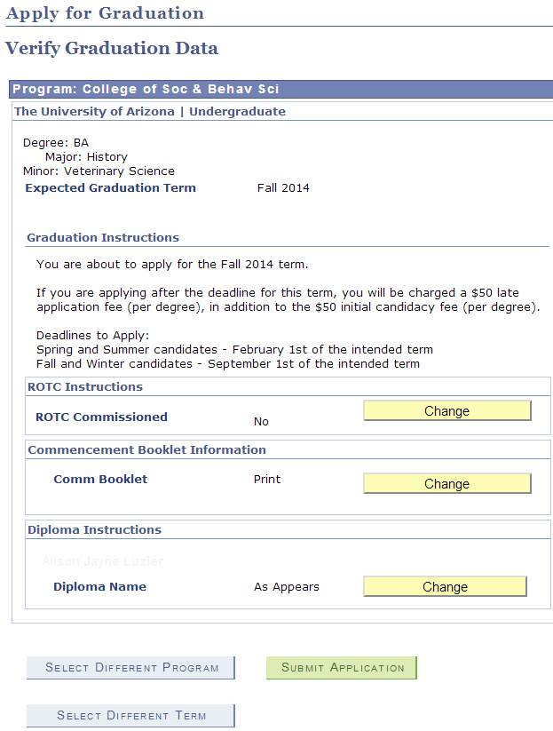
STUDENT APPLIES FOR GRADUATION

Slide 15
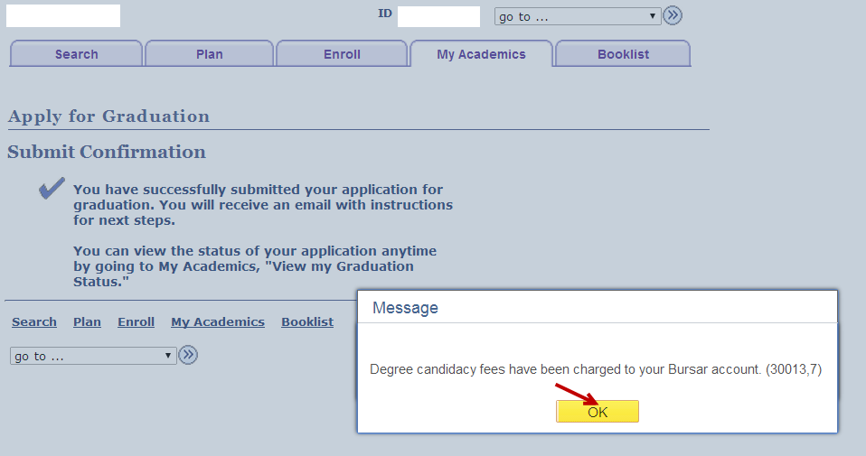
STUDENT APPLIES FOR GRADUATION
CANDIDACY FEES ARE CHARGED

Slide 16
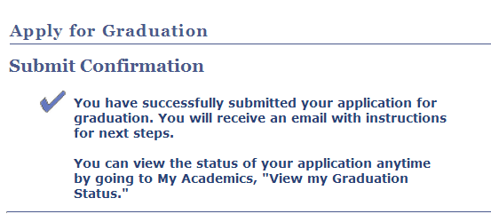
STUDENT APPLIES FOR GRADUATION
SUBMIT CONFIRMATION

Slide 17
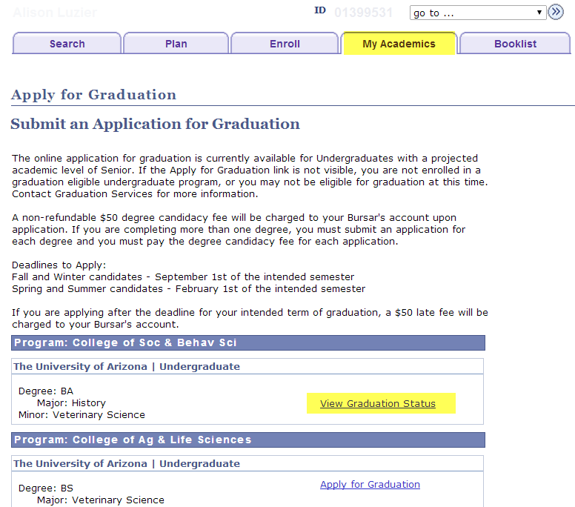
STUDENTS CAN VIEW THEIR GRADUATION STATUS

Slide 18
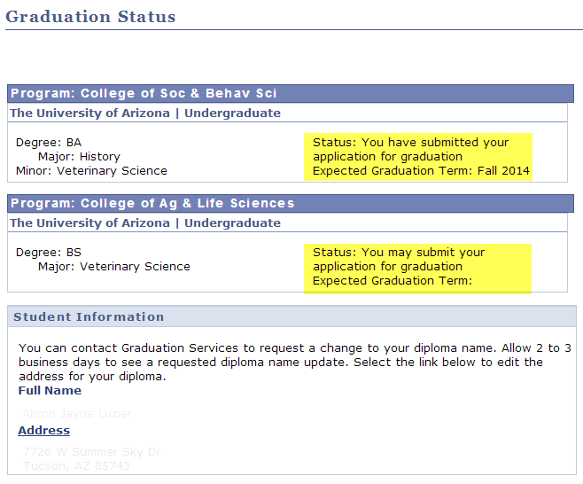
STUDENTS CAN VIEW THEIR GRADUATION STATUS
THEY’LL ALSO VERIFY THEIR DIPLOMA NAME AND ADDRESS

Slide 19
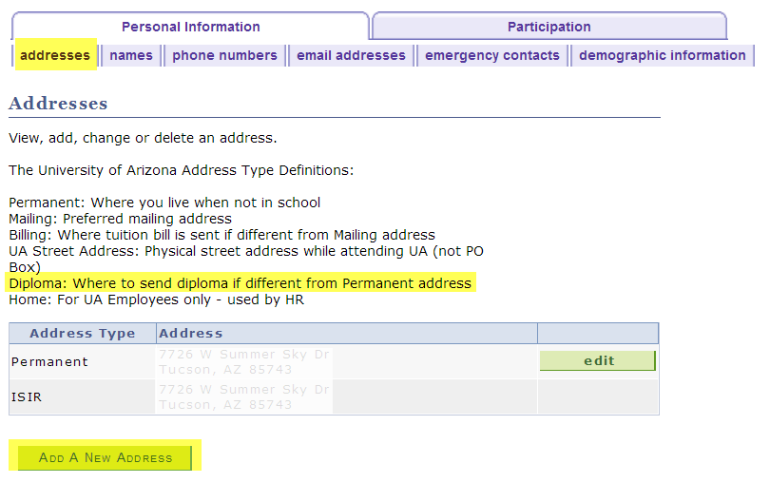
STUDENTS CAN UPDATE THEIR ADDRESS
THEY CAN ALSO CREATE A NEW ADDRESS FOR DIPLOMA MAILING

Slide 20
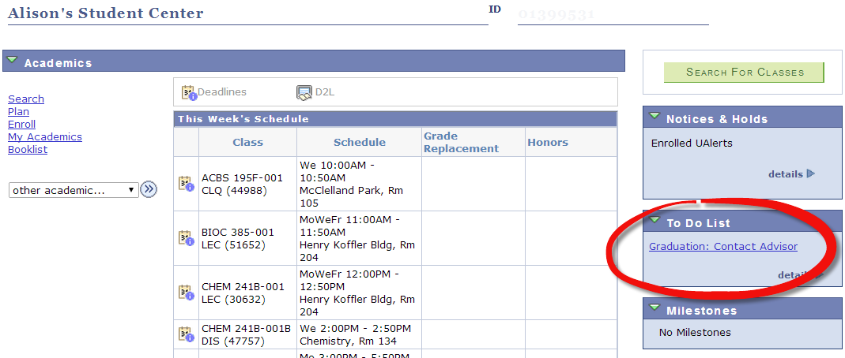
CHECKLIST ITEM COMPLETES
“GRADUATION: APPLY FOR GRADUATION” TO DO ITEM IS REMOVED

Slide 21
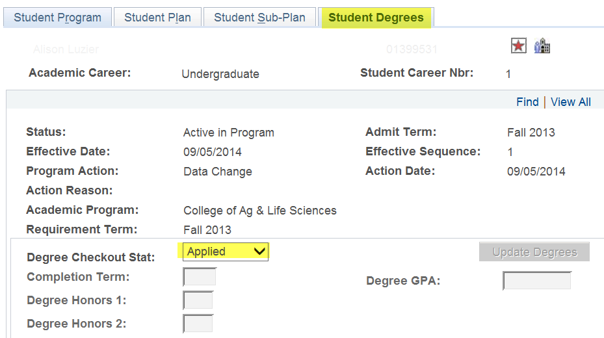
DEGREE CHECKOUT STATUS IS UPDATED
DEGREE CHECKOUT STATUS IS UPDATED TO “APPLIED”

Slide 22
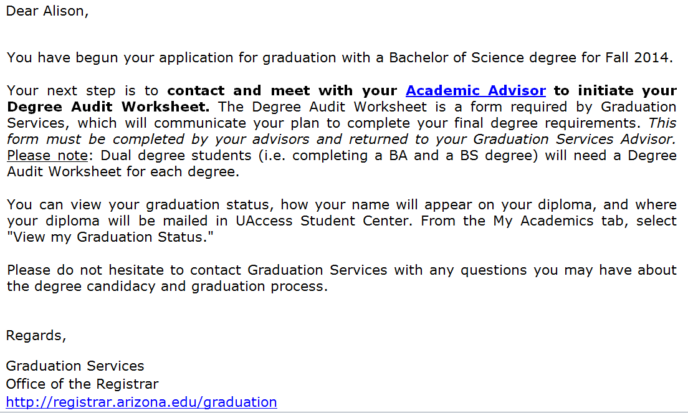
INSTRUCT STUDENT TO CONTACT THEIR ADVISOR
“APPLIED” EMAIL

Slide 23
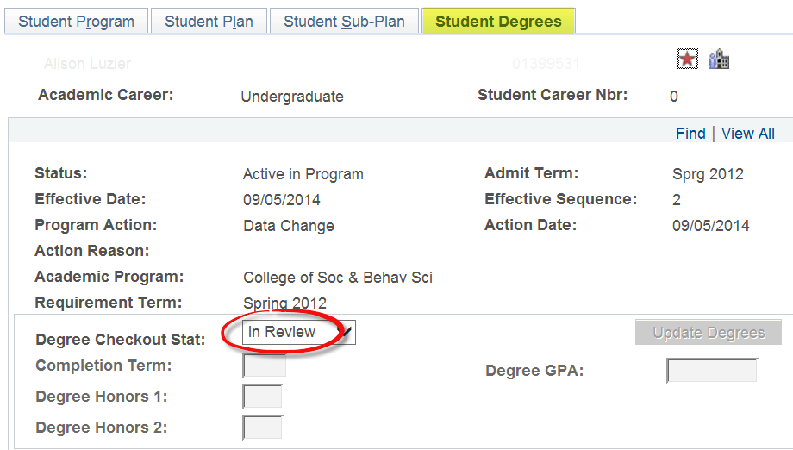
ADVISOR MEETS WITH STUDENT, CREATES DEGREE AUDIT WORKSHEET, AND SUBMITS IT TO GRADUATION SERVICES
GRADUATION SERVICES MANUALLY UPDATES THE DEGREE CHECKOUT STATUS TO “IN REVIEW”

Slide 24
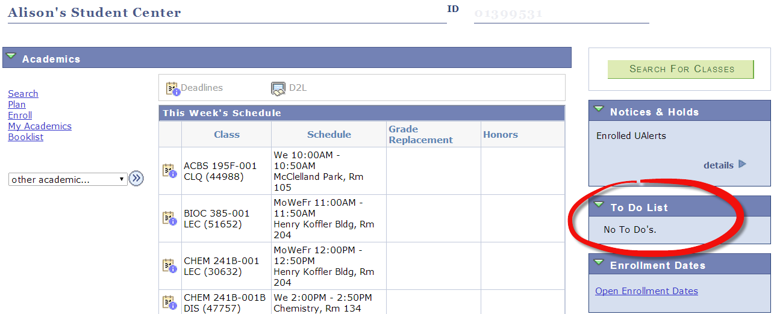
CHECKLIST ITEM COMPLETES
“GRADUATION: CONTACT ADVISOR” TO DO ITEM IS REMOVED

Slide 25

GRADUATION SERVICES REVIEWS THE DEGREE AUDIT WORKSHEET AND POSTS THE DEGREE

Slide 26
A FEW ADDITIONAL COMMENTS
Advisors will have a report which shows who has applied for graduation
Phase II of the project will incorporate:
  better triggers to determine who is eligible to apply for graduation
  an electronic version of the Degree Audit Worksheet
  an exit interview

