Slide 1
APPLYING FOR GRADUATION
Starting the graduation process just got a little easier!

Slide 2
ELIGIBLE TO APPLY FOR GRADUATION
In order to access the application, you must…
Be an undergraduate senior.
Be in an eligible degree program.
Students in a pre major or in no major selected will need to contact their academic advisor for additional information.
Have 90 or more earned units.

Slide 3
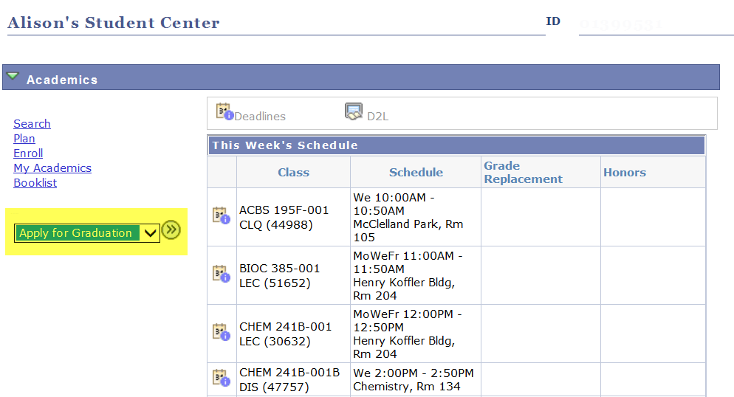
ACCESS THE APPLICATION FOR GRADUATION
SELECT “APPLY FOR GRADUATION” FROM THE DROP DOWN

Slide 4
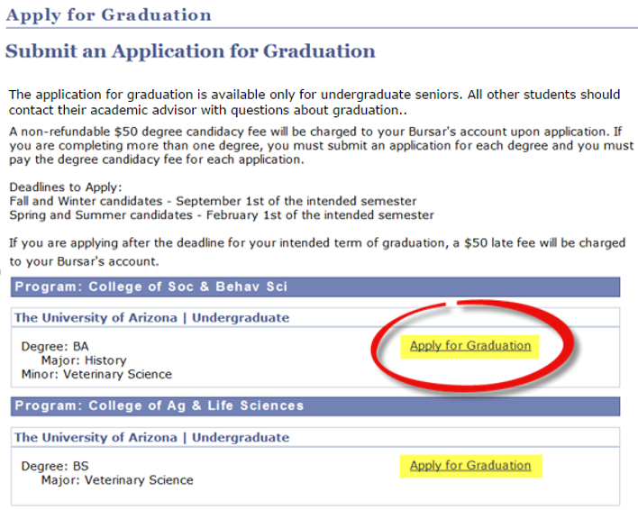
APPLY FOR GRADUATION
Submit one application per degree program.
If you are completing your degrees at different times, you can submit your applications at different times.
REVIEW YOUR DEGREE PROGRAMS

Slide 5
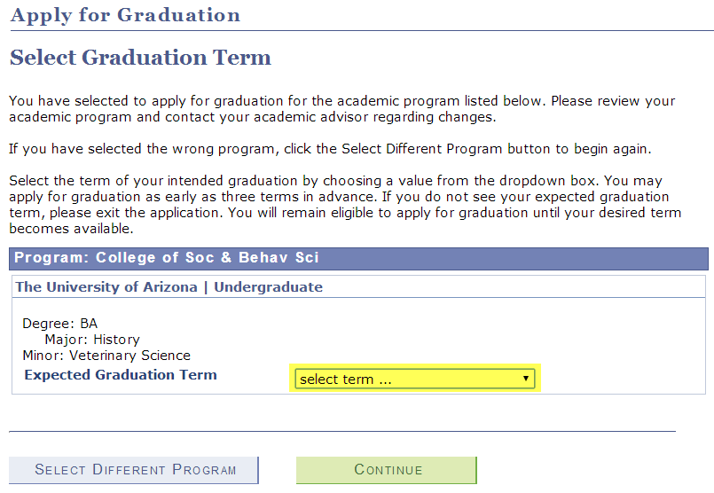
APPLY FOR GRADUATION
You should select the term you expect to finish your final courses for degree completion.
UA Commencement Ceremony information, including RSVP, is available at UA Commencement.
SELECT THE TERM YOU EXPECT TO GRADUATE

Slide 6
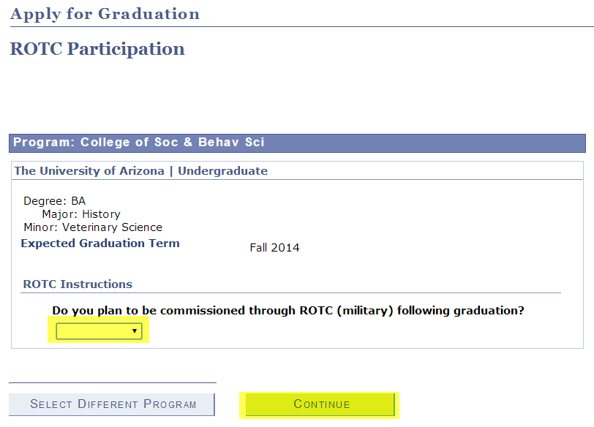
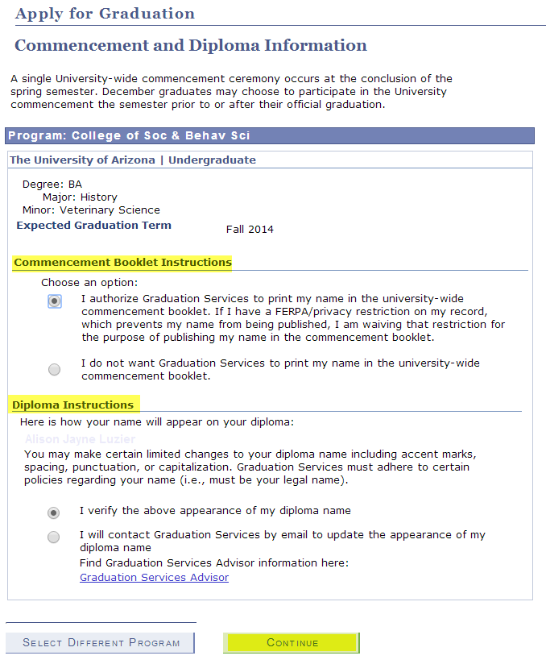
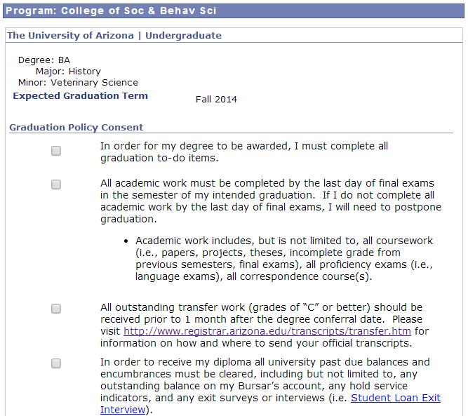
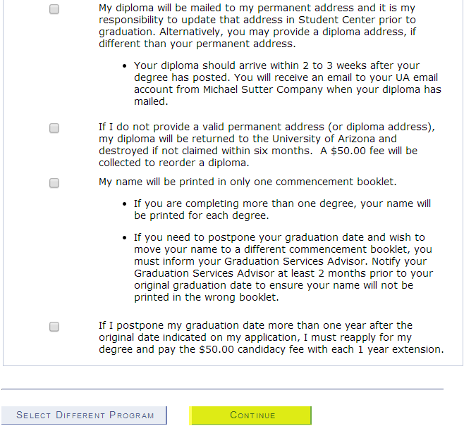
APPLY FOR GRADUATION
ROTC PARTICIPATION
COMMENCEMENT AND DIPLOMA
GRADUATION POLICY CONSENT

Slide 7
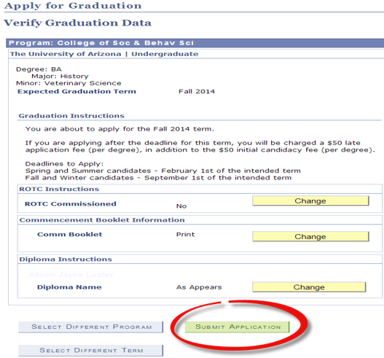
APPLY FOR GRADUATION
Make any necessary changes prior to submitting your application.
REVIEW YOUR SELECTIONS AND SUBMIT YOUR APPLICATION

Slide 8
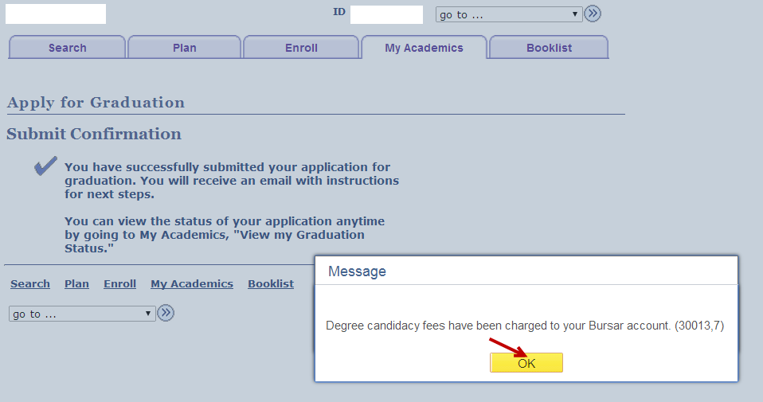
APPLY FOR GRADUATION
CANDIDACY FEES ARE CHARGED (INCLUDING LATE FEE, IF APPLICABLE)

Slide 9
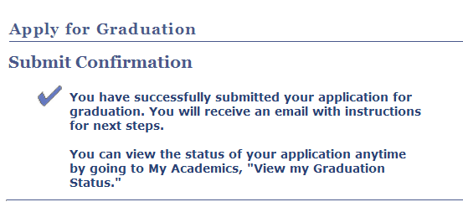
APPLY FOR GRADUATION
While you wait for your email from Graduation Services, visit your graduation status page.
YOU HAVE SUCCESSFULLY SUBMITTED YOUR APPLICATION FOR GRADUATION!

Slide 10
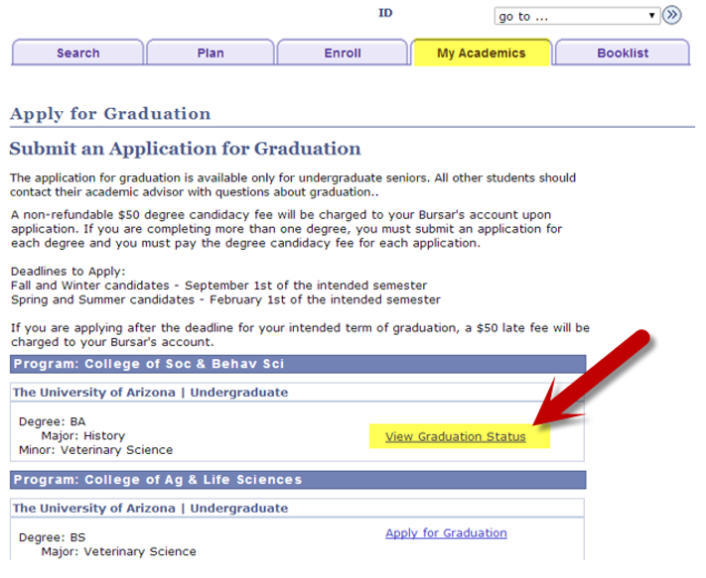
VIEW YOUR GRADUATION STATUS
SELECT VIEW GRADUATION STATUS

Slide 11
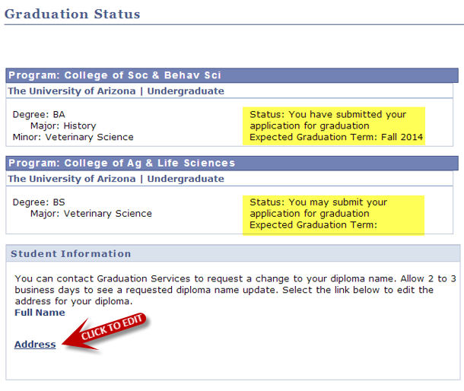
VIEW YOUR GRADUATION STATUS
Your status will update as you move through the graduation process.
VERIFY YOUR DIPLOMA NAME AND ADDRESS

Slide 12
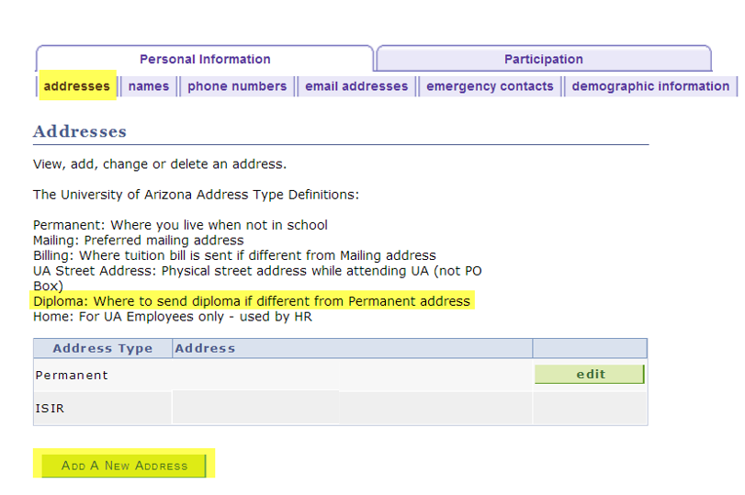
UPDATE YOUR ADDRESS
YOU CAN CREATE A NEW ADDRESS SPECIFICALLY FOR DIPLOMA MAILING

Slide 13
GRADUATION SERVICES
Please do not hesitate to contact your Graduation Services Advisor with any questions you may have about the graduation process.

