Slide 2
Wildcat Academy is an innovative program for new students during their freshman year.
smaller classes
structured programming
supportive peer mentors
Wildcat Academy gives you an individually tailored schedule built to foster your successful transition to the University of Arizona.
Your career as a successful Wildcat begins now.

Slide 3
What is Wildcat Academy?
You have exclusive access to…
A dedicated advisor
Specifically designed first-semester course schedule
A trained peer mentor
MAP-Works
Mid-semester grade checks
Support throughout the first year experience

Slide 4
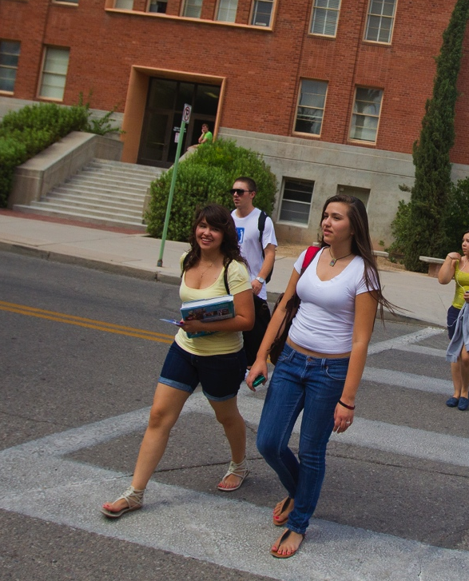

All About You
YOU are the perfect candidate
Your Wildcat Academy team:
Your Academic Advisors
Faculty
The Office of Academic Success and Achievement
You are more likely to graduate on time
We’re excited to have you in the program!

Slide 5
First Semester Courses
English 3-4
General Education course 3
General Education course 3
LASC 197M 1
LASC 100X 2

Slide 6
Questions about Wildcat Academy can be directed to:
Daniel J. Gonzales, M.Ed.
Wildcat Academy Coordinator
CLAS Academic Advising Center
(520) 621-7763
dgonzales@email.arizona.edu

Slide 7


Slide 8

Let’s meet someone new!
Notes:
Pair and share
Introduce yourself to the person (or two) who are near to you where you’re from and answer the following question:

Slide 9

What can a college education do for you?
Notes:
The question that I want you to ask your new friend(s) is
5 volunteers: Share something that resonated with you that your Friend said.
Grow more self sufficient and self confident
Establish & strengthen your personal identity
Understand more about the global world around you
Become more open minded
Become a more involved citizen in social and political issues
Learn to manage your emotions and reactions more effectively
Manager you personal resources such as time and money
Become more proficient at written oral and nonverbal communication
Grow more understanding and accepting of different cultures
Become financially independent.
Enter a career field that you enjoy

Slide 10
The Basic Truths about College Success
Notes:
We have heard some great and lofty goals for a college education right!
Let’s talk about some of the basic truths…
We want you to that the inside track.

Slide 11
Basic Truth 1
Success is about…
Notes:
Success is about choices, sacrifices and making intelligent transitions\
Life is as series of choices. Hard Choices. Easy Choices. Right choices. Wrong Choices. Nevertheless, the quality of your life is determined by the choices you make and your willingness to evaluate your life and determine if changes are in order.

Slide 12
Basic Truth 2
Your education is…
Notes:
The first thing you will notice about Higher education is that it is a two-way street. Not only do you have expectations of your institution and instructors, but your institution and instructors have expectations, great expectations of you.
To be successful you will need to accept substantially more responsibility for your education.

Slide 13
Basic Truth 3
You’re in charge here…
Notes:
It’s all about your responsibility and ganas (desire) for your own success
Higher education is not about others doing the work but rather about you finding internal motivation and accepting responsibility for your actions, your decisions, your choices, and yourself.
This is your education and no one else will be responsible for acquiring the knowledge and skills you will need to thrive and reach your fullest potential.

Slide 14
Basic Truth 4
The keys to your success…
Notes:
This major transition coming your way involves the workload for your courses and the choices you will need to make regarding your schedule and time.

