Slide 1

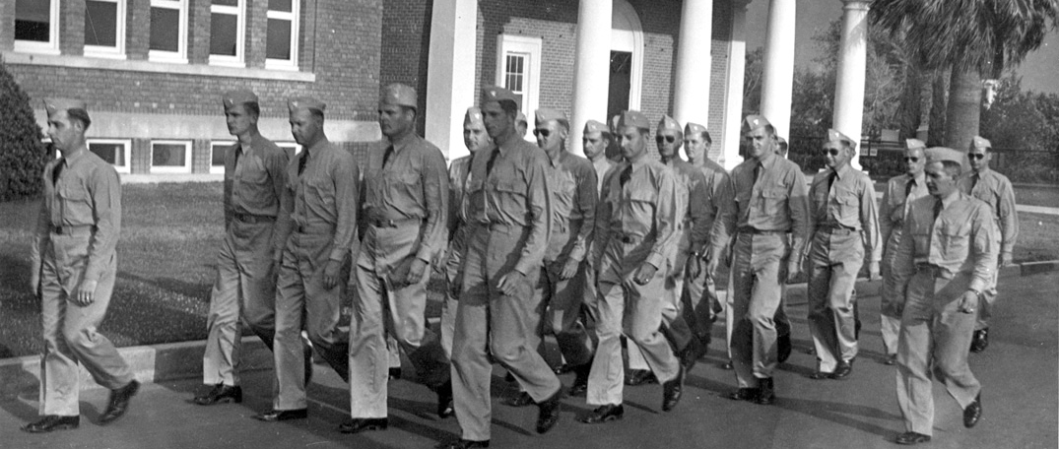
Veterans Academic Certification
Naval flight instructors in the CAA war training service leave their "barracks" in Yavapai Hall
--July 1943

Slide 2
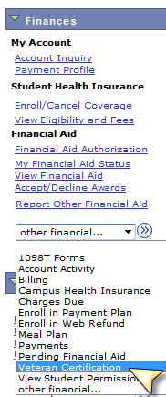
Student Center Request for VA Certification
Finances
Veteran Certification
Six Simple Steps
Benefit Transfer
Term Selection
Attributes and Benefit
Yellow Ribbon
Course Selection
Disclaimer

Slide 3
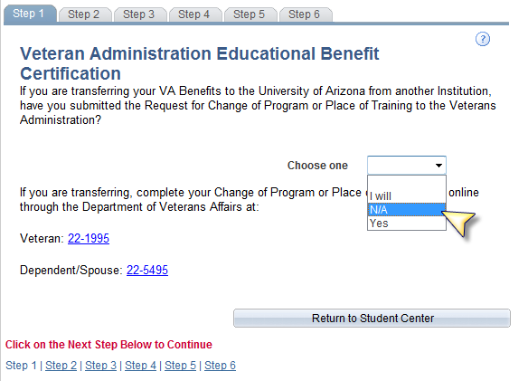
How We Customized Student Center
Step 1
Change of Program or Place of Training
Asked for every certification
Links to Veterans Affairs website

Slide 4
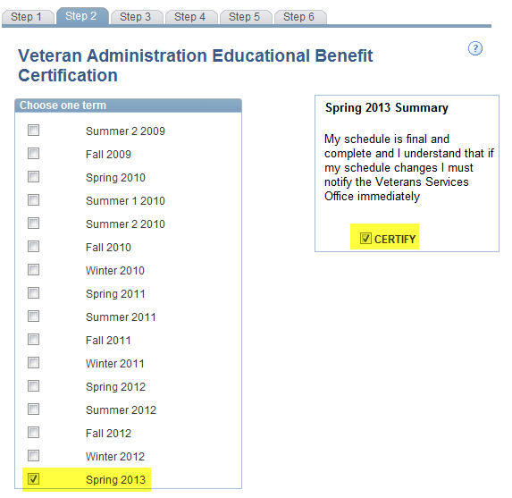
How We Customized Student Center
Step 2
Choose a term
Choose to certify
Understand your enrollment must be complete

Slide 5
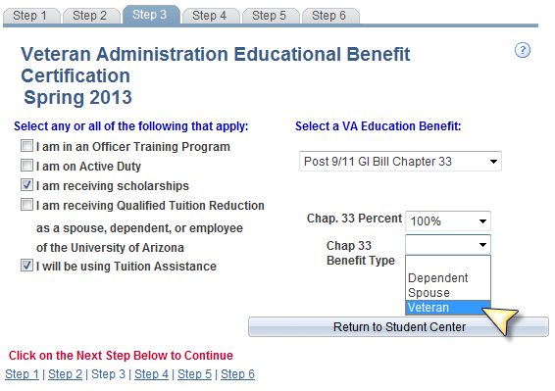
How We Customized Student Center
Step 3
Student attributes
Benefit selection

Slide 6
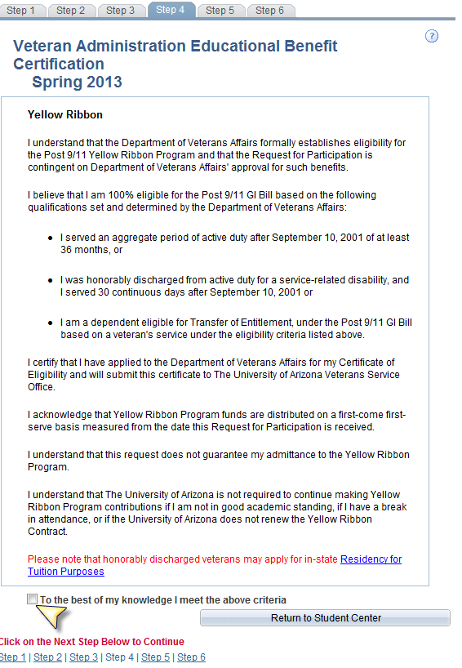
How We Customized Student Center
Step 4
Yellow Ribbon agreement

Slide 7
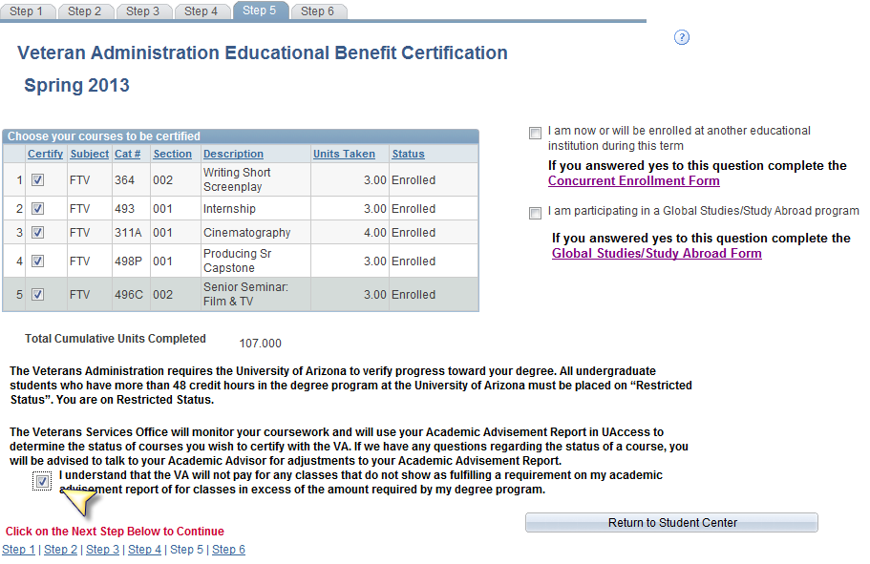
How We Customized Student Center
Step 5
Class selection
Restricted Status
Concurrent Enrollment
Global Studies

Slide 8
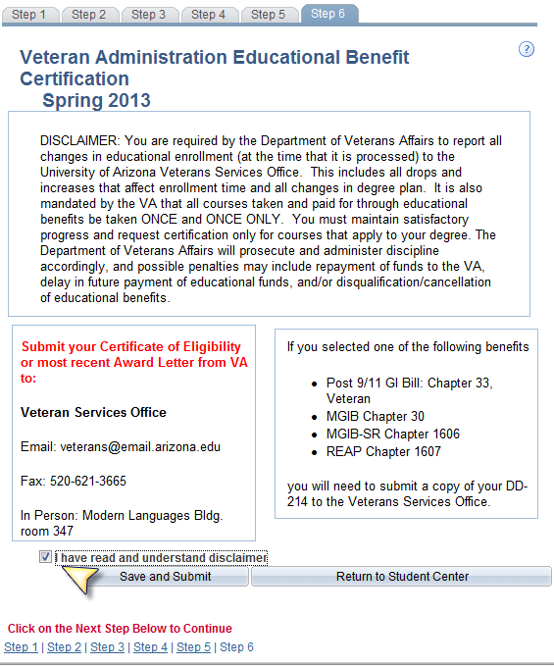
How We Customized Student Center
Step 6
Disclaimer
Contact info
Submit

Slide 9
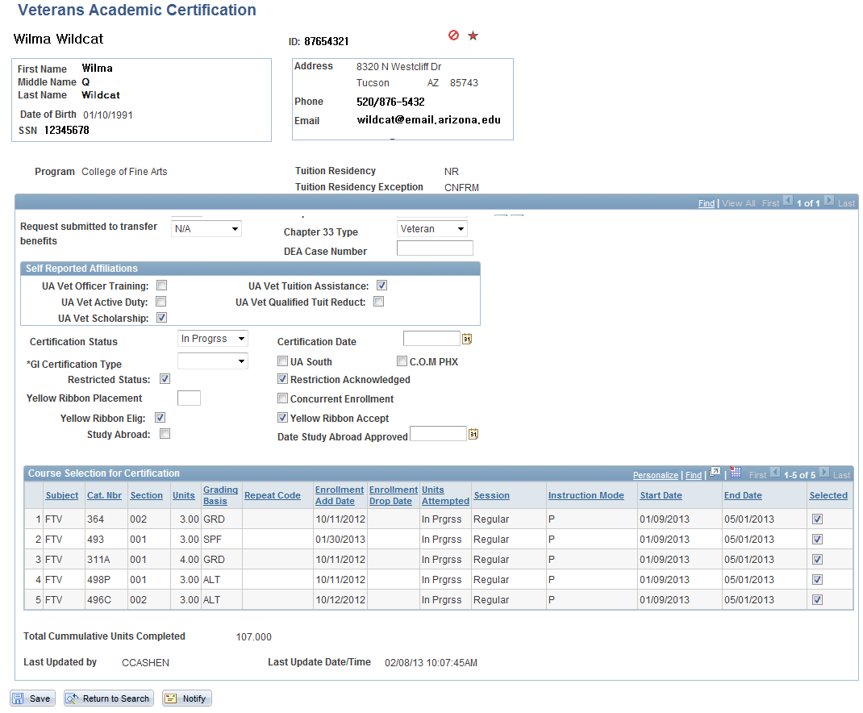
Administrative Veteran Academic Certification

Slide 10
What We Need From Advising
Only courses that satisfy requirements outlined by the curriculum guide or graduation evaluation form can be certified for VA purposes
Classes not satisfying requirements cannot be certified

Slide 11
What We Need From Advising
Approval stating class meets a degree requirement
Repeated enrollment for better grade as required for degree
Enrollment required for admission to next level of course
Remedial enrollment required to correct a deficiency
Enrollment approved as a substitution—documented in the advisement report

Slide 12
What We Need From Advising
What if we get it wrong?
The student must reimburse the VA for tuition and fees associated with the enrollment, or
The University of Arizona must allow the erroneously pre-approved enrollment to meet a degree requirement
The student may take longer to graduate
Veterans who have been wronged make the news

