Slide 1

University Professional Advising Council
February 12, 2014
“Although the University of Arizona may not be as progressive as neighboring campuses in California, it does represent the most LGBT-friendly campus in the state and one of the best choices in the Southwest.”
- The Advocate: College Guide for LGBT Students
Notes:
It is good to know that The University of Arizona sets the bar for LGBTQ inclusion within the state of Arizona, which is something we can all take pride in. According to Campus Pride’s LGBT-Friendly Campus Climate Index, the University of Arizona has earned 4.5 out of 5 stars for LGBT inclusion, whereas our counterparts at Arizona State University have only earned 2.5 stars.
(Campus Pride is the only national nonprofit organization for student leaders and campus groups working to create a safer college environment for LGBT students, their primary objective is to develop necessary resources, programs and services to support LGBT and ally students on college campuses across the United States.)

Slide 2

Notes:
At the UA, LGBTQ students comprise an estimated 1,900 to 3,800 students (5-10%), who are an important part of our campus community.
We don’t have exact numbers because it is not a demographic that we track.
To better serve students who identify as LGBTQ, the UA established the Office of LGBTQ Affairs in 2007

Slide 3
The mission for the Office of Lesbian, Gay, Bisexual, Transgender, Questioning (LGBTQ) Affairs is to build, sustain and strengthen a safe, inclusive, and open environment for faculty, staff, appointed professionals, students, alumni, parents, and guests of all gender identities and sexual orientations.
Notes:
The decision to create the Office of LGBTQ Affairs was brought about after nearly twenty years of advocacy by LGBT students, faculty and staff—People who devoted hour-upon-hour to promote equity in University policies and practices and build an inclusive campus climate. (I am aware that I stand on their shoulders in the work I do on campus).
In recognition of the significant needs of this marginalized community, the President’s LGBT Advisory Council recommended that President Shelton hire a Director of LGBTQ Affairs, which he did in 2007. The council did this for 2 primary reasons:
1. For students, the council recognized the significant needs of this marginalized community--Sadly we know that LGBTQ students as a group are at a higher risk of isolation, depression, substance abuse, and even suicide
2. For faculty and staff, the council recognized that to achieve our goal of becoming a top ten public research institution, we need to be able to retain world class faculty and staff, and therefore we must be inclusive of LGBTQ colleagues.
I am proud to report this position brings the University of Arizona in line with over 160 other college campuses across the country that have professional staff to serve the LGBTQ campus community (National Consortium of Directors of Lesbian Gay Bisexual and Transgender Resources in Higher Education 2010Annual Report).
I am also proud to share that the UA was the first in AZ to create a position like this.
MISSION:
Every college student has the right to a safe learning environment where she or he can learn, grow and succeed. Every staff and faculty member has the right to feel protected and valued. By building, sustaining, and strengthening a visible LGBTQ campus community, the University of Arizona ensures all students, staff, and faculty can attain the University’s mission—to discover, educate, serve and inspire.

Slide 4
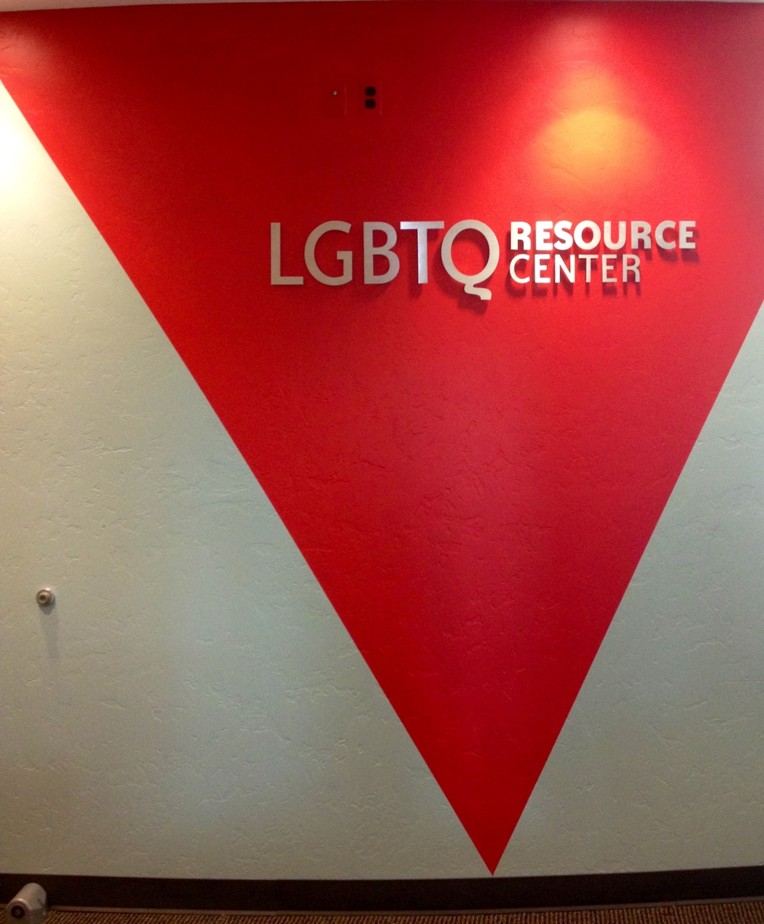
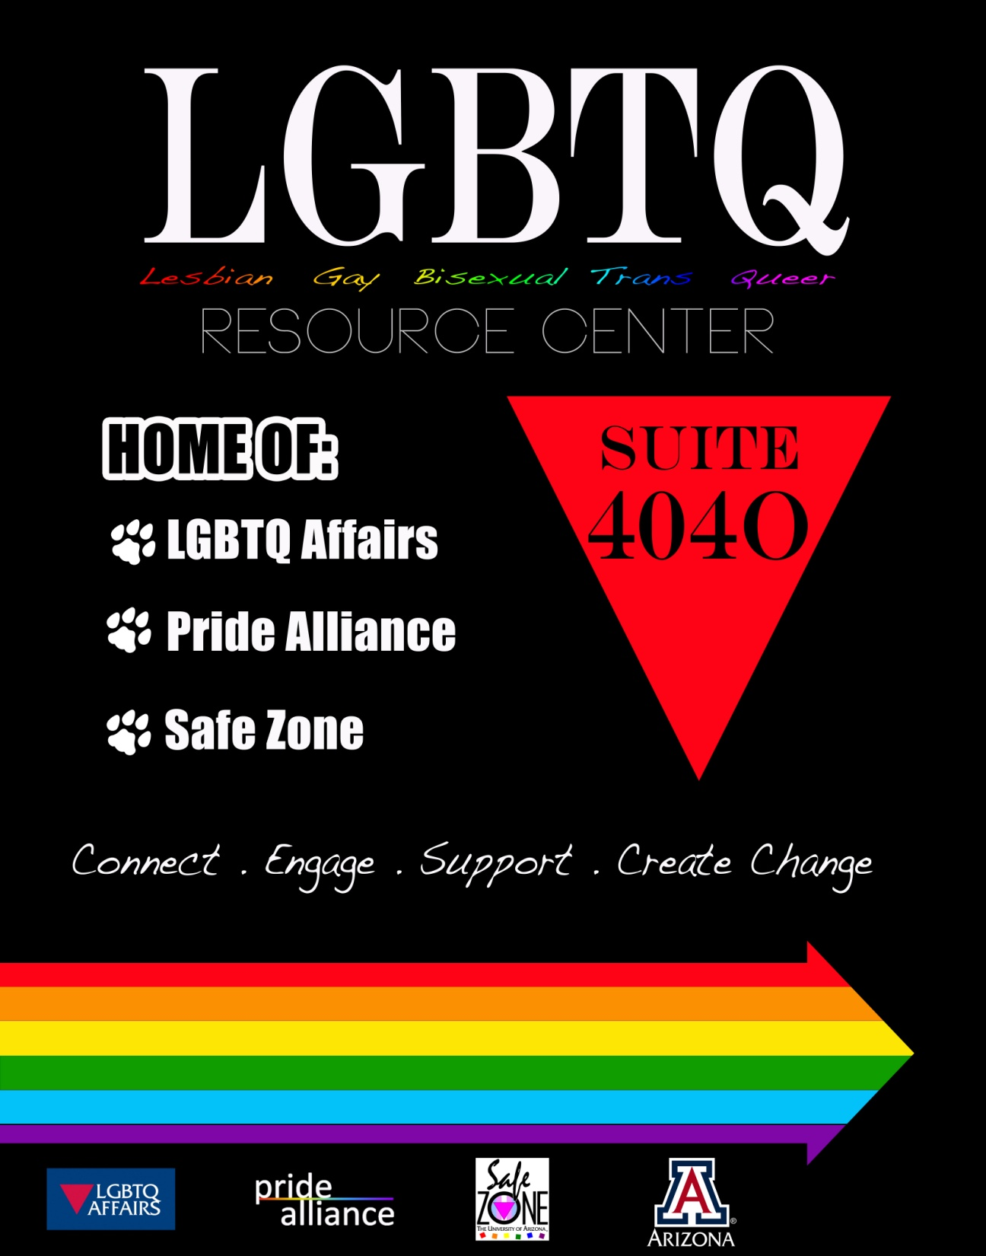
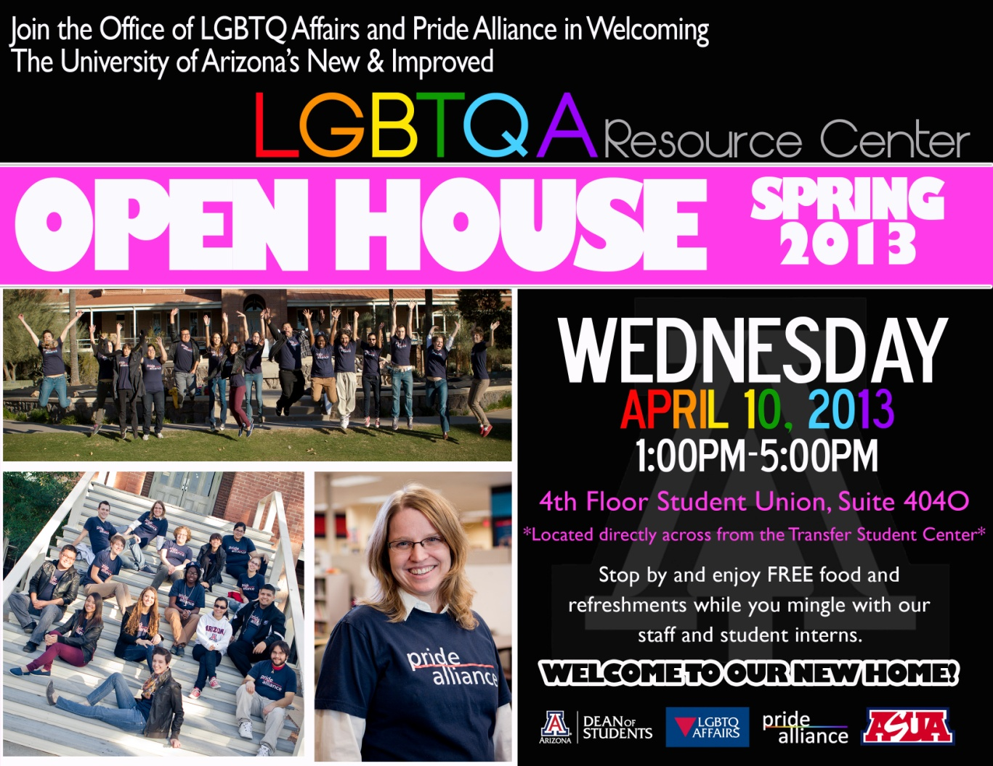
Notes:
Just this past spring we moved into the LGBTQ Resource Center inside the Student Union—Room 404-O
Space Usage
Formerly Pride Alliance maintained a 15 x 20 ft. drop-in space inside the Center for Student Involvement and Leadership
Last fall our Center was visited by over 200 unique students who came in over 1,400 times.
It is their home away from home…

Slide 5
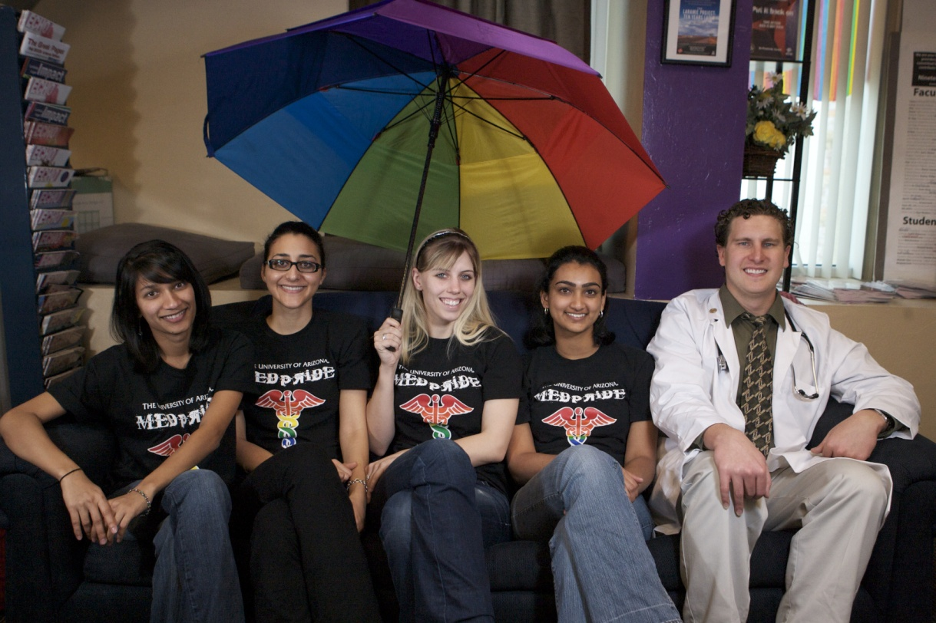
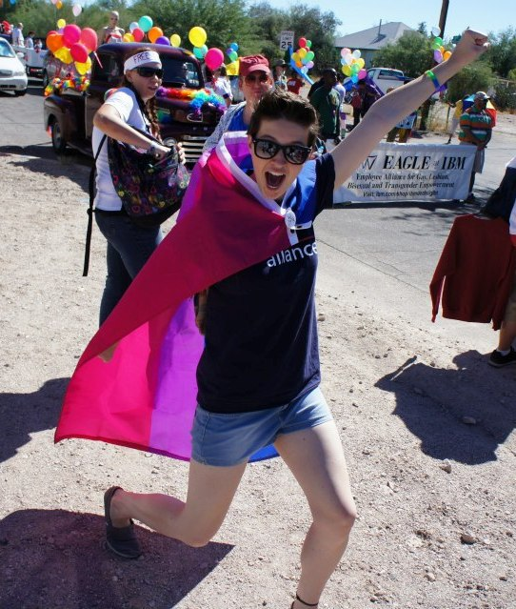
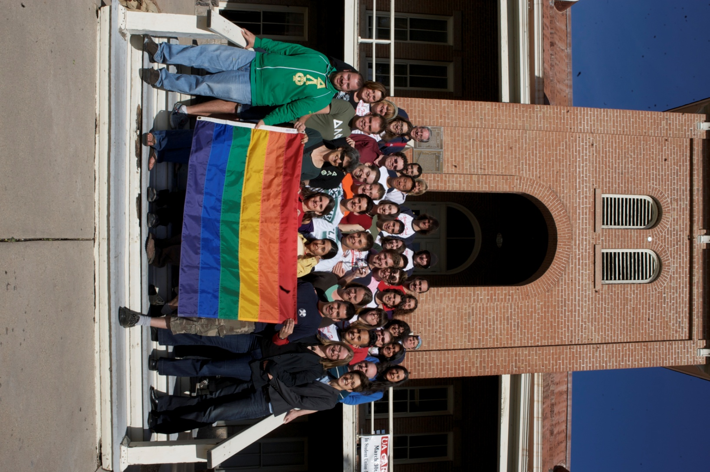
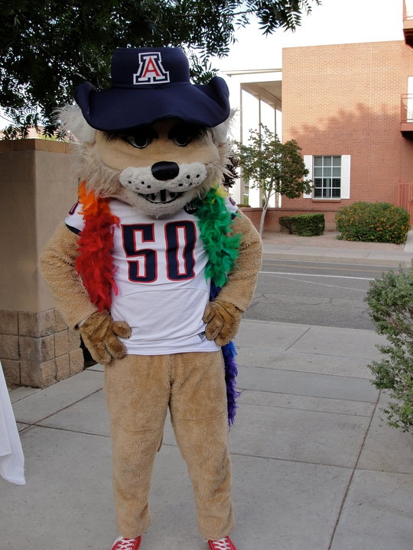
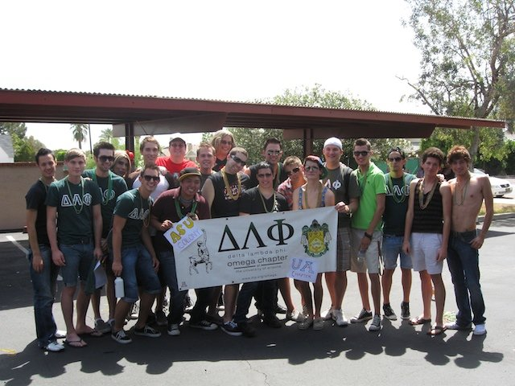

A hub for LGBTQ Work on Campus
Notes:
As the Program Director for LGBTQ Affairs, I serve as hub for LGBTQ work happening at UA, which equips the institution to better serve our LGBTQ students…and after all, serving students is why we are all here.
We support our 4 recognized LGBTQ student groups on campus—I directly advise Pride Alliance, our largest LGBTQ student org; I also work closely with DLP, MedPRIDE & Pride Law. And I work with a variety of other student organizations across campus.
We work with the Institute for LGBT Studies, Out Reach and serve on the President’s LGBTQ Advisory Board.
We are part of Tucson’s Queer Strategic Partnership—where we work closely with the leading LGBTQ community organizations like Wingspan, SAAF, PFLAG, TIHAN, Alliance Fund, Chamber of Commerce, City Commission, Tucson pride and others!
We have 3 major areas of focus: Providing support (Support Groups), Building a Healthy Community (Events/Intern Program), and Educating the Campus (Safe Zone and Panels)
A little bit about the programs we offer…

Slide 6
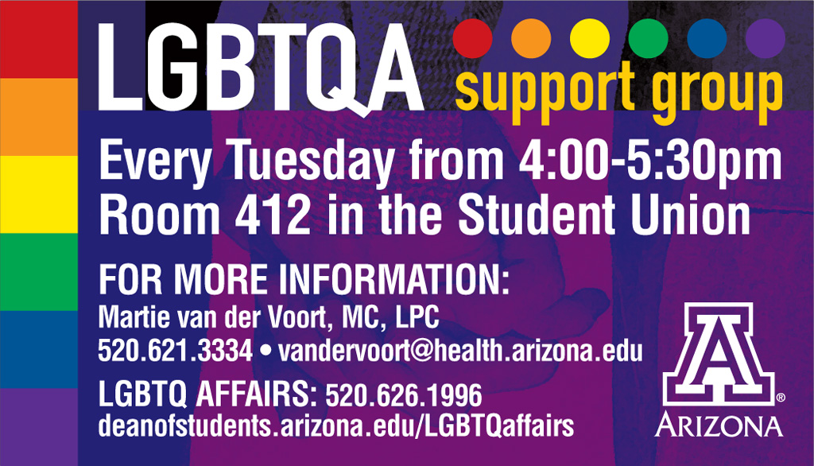
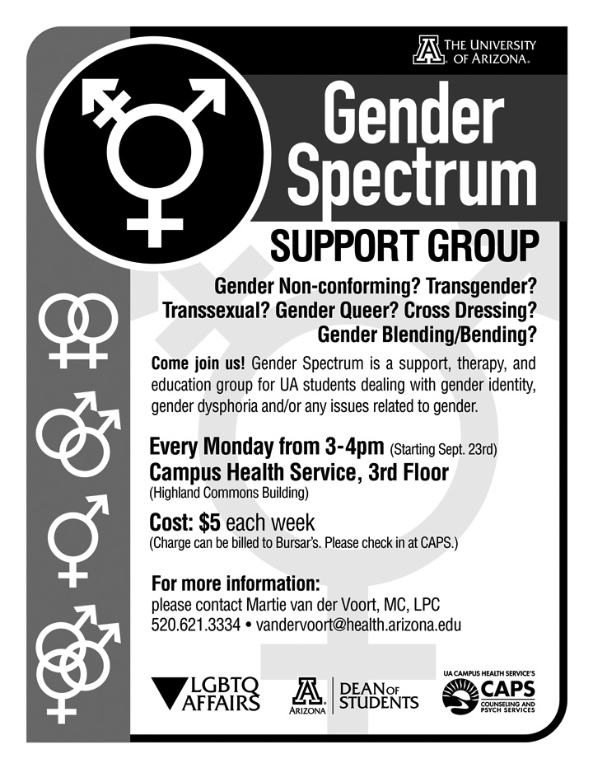
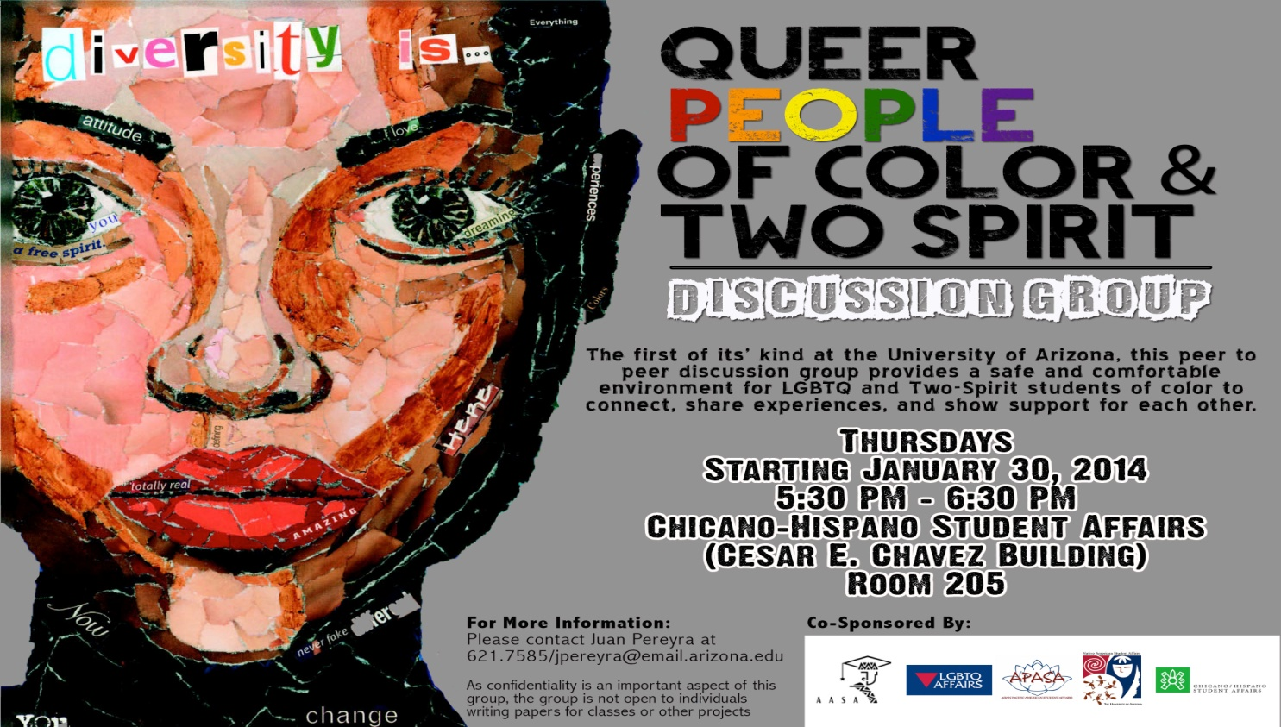
Notes:
Providing support
-I meet one on one with students
And we have 3 groups:
1. LGBTQ SUPPORT GROUP
This is a collaborative program with Counseling and Psychological Services through Campus Health. This group is a safe place for UA students, faculty and staff to talk in an open and supportive environment about issues impacting their lives and the LGBTQ and Allied community. Group topics originate from participants, examples include: coming out, family dynamics, relationships, gender-identity/transitioning, sexual assault, coping strategies for unsupportive families and friends, how to develop positive self-esteem, and media representations.
2. QPOC
3: Gender Spectrum Support Group

Slide 7

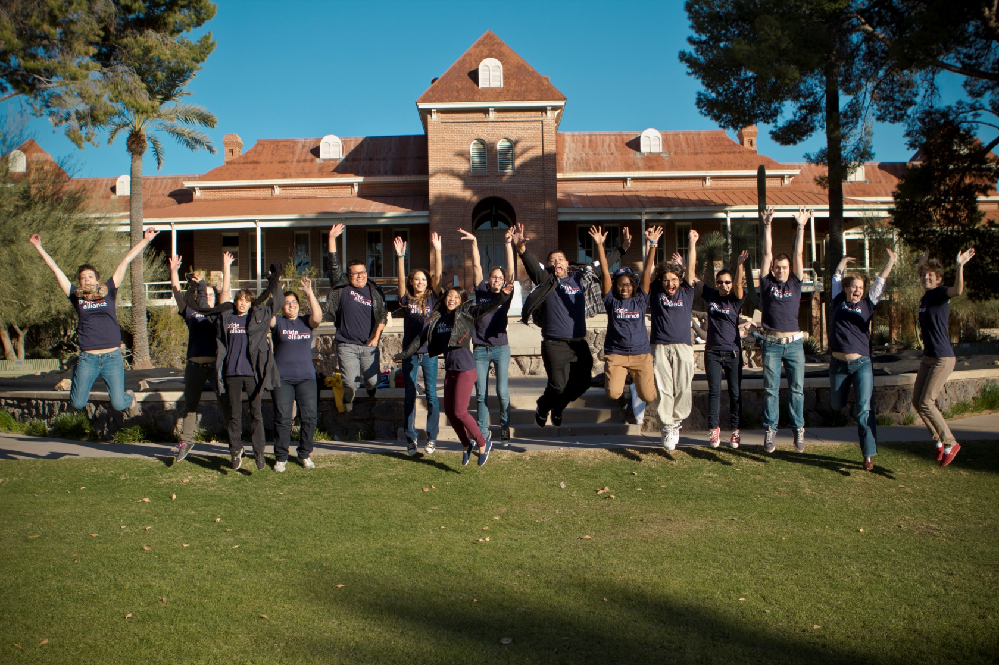
Pride Alliance Intern Team
Notes:
Building a Healthy Community (Events/Intern Program),
PRIDE ALLIANCE Internship Program
We started an internship program with Pride Alliance in spring of 2010 with 6 student interns. At this point we have doubled in size to a team of 12 interns, graduate student volunteers and the Pride Alliance co-directors.
Interns are responsible for planning events, overseeing the resource center and conducting outreach.

Slide 8
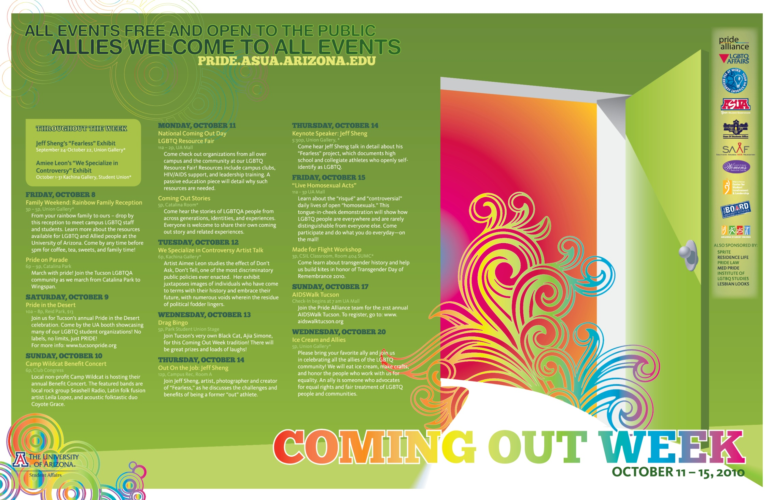

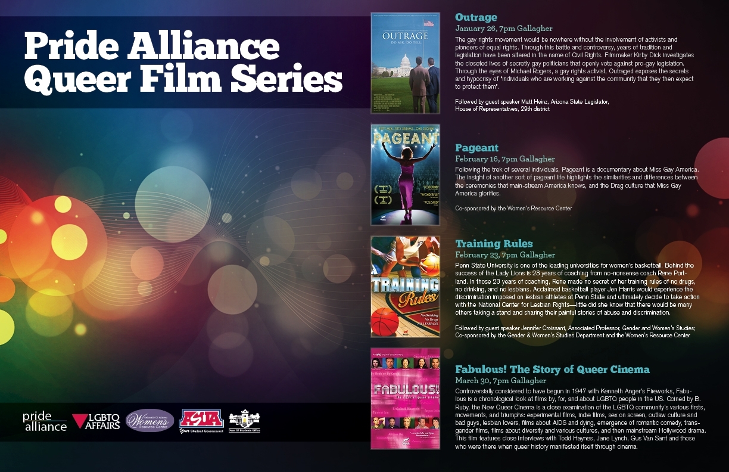
We offer events throughout the year!
Notes:
The interns take a lead on organizing all the events we put on. Last year we put on between 50-60 annual events, with over 4,000 people in attendance. Some highlights include:
Welcome Week Events
Coming Out Week
Transgender Awareness Week
Day of Silence
Second Chance Prom
Rainbow Graduation
Films, lectures and much more!

Slide 9
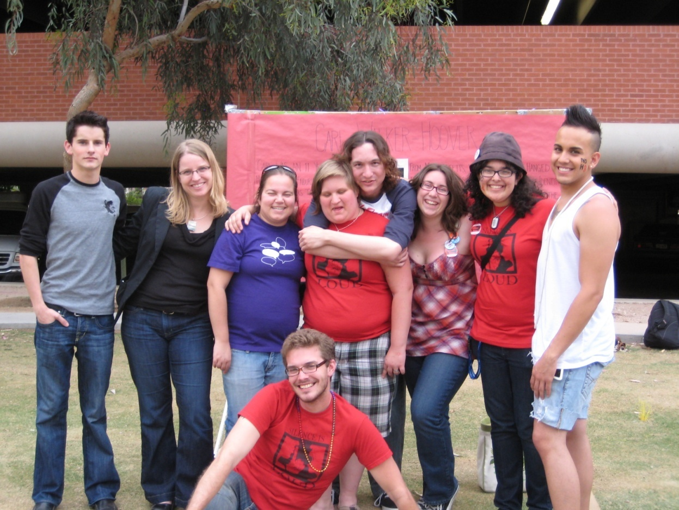
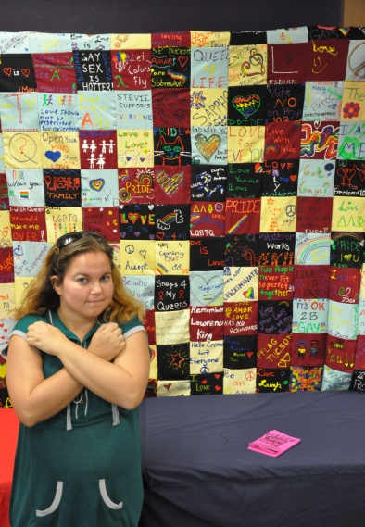
Impact of the Intern Program
The most important thing I learned is that leadership is not about giving orders, it’s about taking a group of people who all have different strengths and guiding them to a common goal, while they learn from and work with each other. A good leader uses everyone’s strengths to make the vision come alive. There is not one thing I would change about my experience as an intern, I learned so much about myself and about the real world.
-Arthur Vinuelas, Sophomore, Business Major
I started the semester refusing to label myself an activist, but throughout the semester I have learned to be proud of the time I committed and all we accomplished. I am a proud ALLY. I learned I shouldn’t be quiet and ashamed about it. I am starting to understand what the work is really about. It’s about not staying in the background; it’s about doing something and reminding yourself why you fight the fight. I ended the semester feeling like I had walked into a room of strangers and was leaving knowing they were family.
-Patty Putman, Sophomore, English Major
Notes:
In the words of our students

Slide 10

Next training:
Saturday February 22, 2014
Sabino Room , Student Union
11:00am-1:30pm, General Education Training
2:00pm-4:00pm, Ally Development Training
Register online at UA LGBTQ Affairs website
Campus-wide program committed to making UA a safer, more welcoming, and inclusive environment for LGBTQ people
The complete Safe Zone training consists of two sessions, including a General Education and an Ally Development workshop
Participants receive a Safe Zone placard to display indicating support and nurturance for LGBTQ students, staff, and faculty on our campus
We also provide speakers, panels, and lecturers upon request
Notes:
Educating the Campus (Safe Zone and Panels)
SAFE ZONE TRAINING & ALLY DEVELOPMENT
Safe Zone is a campus-wide training program that prepares members of the campus to be effective allies to LGBTQ people. It consists of two 2-hour workshops.
[this is the program that Michael will be primarily responsible for]
Since 2010 over 2,600 participants have attended Safe Zone Workshops:
Workshop participants are comprised of 60% students and 40% staff/faculty.
*90% of participants agree that as a result of the Safe Zone training they feel a greater sense of commitment to serving as an ally to the LGBTQ community and are prepared to do so.
* I worked with an MPH graduate student in 2011 to conduct an assessment of the Impact of Safe Zone on the campus and we found that in terms of Campus Climate, 90% of LGBTQ respondents said that Safe Zone helps them feel better about the campus climate toward LGBTQ people—so we know that the visibility that Safe Zone brings about is having a positive impact on how safe LGBTQ students feel on campus. (200 survey respondents)
In fact, 73.58% of respondents agreed or strongly agreed that Safe Zone made them feel safer on campus (22.64% neither agree nor disagree)
*This program has been awarded a grant from the Alliance Fund for 4 years in a row, including the Leos-McCall award for exemplary grant proposals.
We also do presentations and panels in classes across campus. Last year we went to 15 classes with over 700 students in attendance. Panel topics range from coming out, to transgender identities, to issues faced by LGBTQ adolescents.

Slide 11

Impact of Safe Zone Program
  I have a Safe Zone placard on my wall, and in my position working and mentoring students I have had clear and open communication with LGBTQ students regarding their personal struggles and relationships. I think the placard was the key that let the students know they could open up to me about all of the challenges they were facing in their lives.
-UA Staff, from Impact of Safe Zone Survey, spring 2011
I consider the UA Safe Zone workshops to be the best, most directly applicable workshops I have ever attended on the UA campus. LGBTQ leadership is outstanding here at the U, and a source of great pride for me and many of my classmates.
-UA Student, from Impact of Safe Zone Survey, spring 2011
Notes:
Read Quotes

Slide 12
Best ways Advisors can Support LGBTQ Students

Slide 13
Top 5 Ways You Can Support LGBTQ Students
1. Educate Yourself
  Know general terms & learn about LGBTQ issues in your field
  Don’t rely on students to educate you, do the work yourself
  Take advantage of Safe Zone Trainings
  Break down your own biases & recognize your privileges
2. Be a Visible Source of Support
  Include LGBTQ themed flyers, posters and publications in your office
  Display your support (Safe Zone Sign)
3. Don’t Make Assumptions
  Don’t assume a student is heterosexual
  Remember that you only know someone’s sexual orientation or gender identity if they tell you what it is

Slide 14
Top 5 Ways You Can Support LGBTQ Students
4. Be Inclusive in Language & Practice
  Use gender-neutral terms (i.e. partner or significant other rather than gender specific terms like girlfriend or boyfriend)
  Respect preferred pronouns
  Use LGBTQ instead of "homosexual”
  Don’t let tension around sexual orientation/gender identity continue to be unaddressed because you’re not sure what to do.
5. Speak Up
  Talk to your students and your colleagues
  Support other allies
  Confront comments that are heterosexist or gender identity biased

Slide 15
How you can support our office
Know you are serving LGBTQ Students
Become a Safe Zone
Know our Campus Resources
Refer Students to our Office
Notes:
Know that you are serving LGBTQ Students—we all are, they are all of our students & it takes a village
Become a Safe Zone--We train people (not spaces) to provide a network of support—Safe Zone allies are bridges who link people who need help to the resources they need—it allows us to extend the reach beyond the grasp of the LGBTQ Affairs Office. People exit the training with a skill set, prepared to be effective members of the network of support.
Know our Campus Resources—thank you for inviting me in to share with you what we do
Refer students to us—LGBTQ students do deal with a lot of stress. Not all, but many. One example that sticks out is a student that Renee referred to me. She was concerned about a student who is in the midst of Coming Out and with that student’s permission, she was able to connect me to her. I never would have been able to connect to that student otherwise…but that referral allowed me to meet with and support that student at a crucial time in her life. We depend on the network of support and referral because we are a small office…

Slide 16
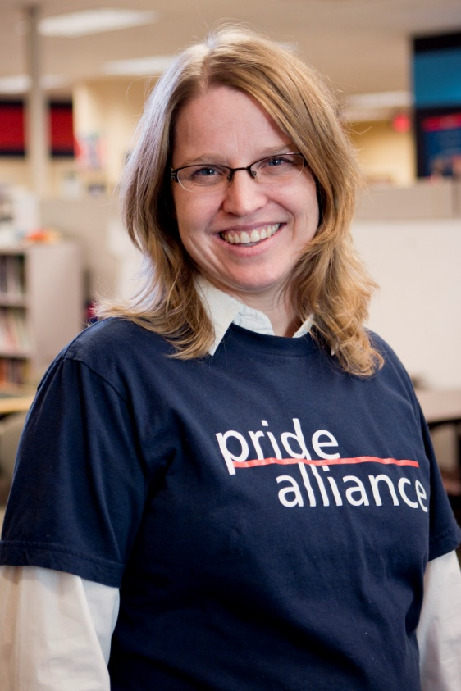
Need Advice?
Need to Refer a Student?
Jennifer Hoefle Olson,
Program Director jhoefle@email.arizona.edu
(520) 626-1996
Student Union, Rm 404-O

