Slide 1
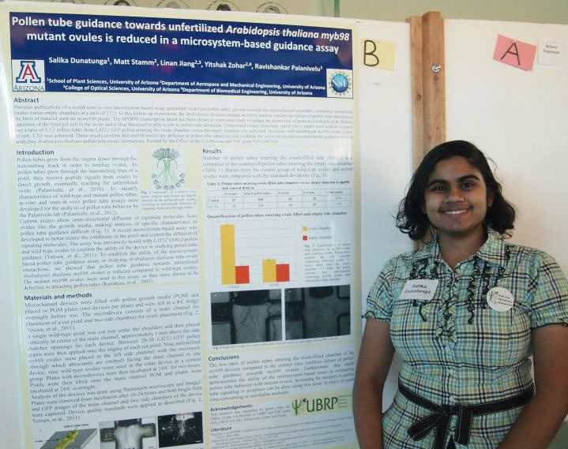
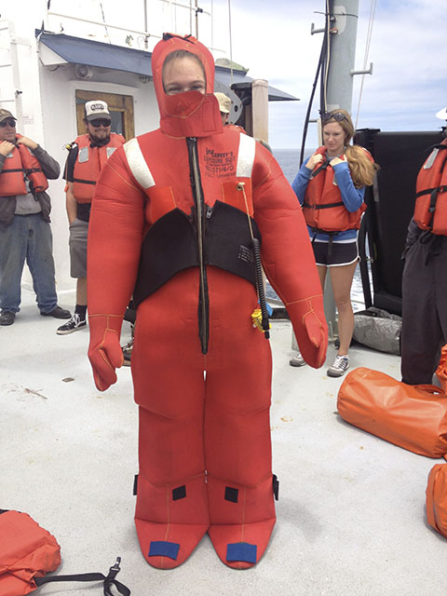
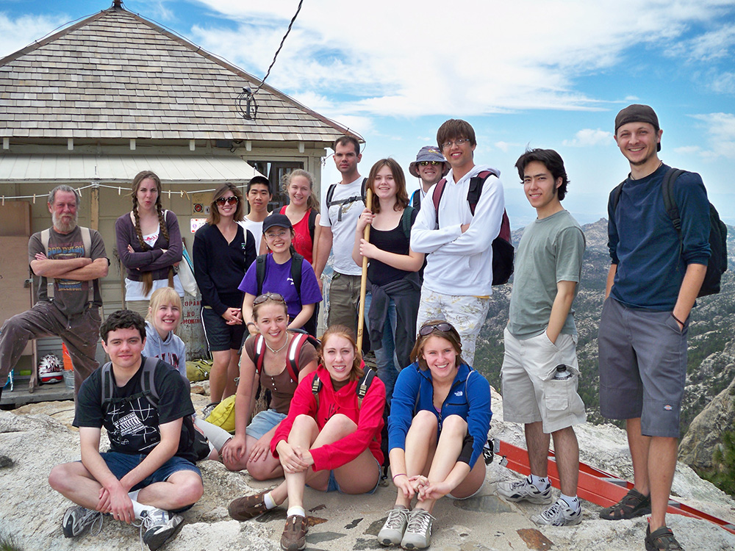
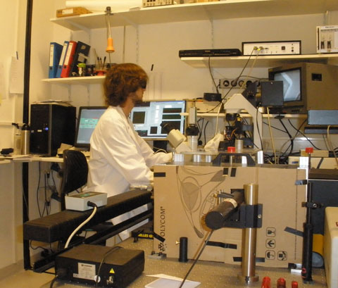
Check out UBRP!
Interested in scientific research?
Experience how research is done!
UA’s Undergraduate Biology Research Program provides opportunities for students to participate in a paid, mentored research experience involving inquiry, design, investigation, research, scholarship, discovery, and the presentation of experimental results.
Learn more and apply for UBRP at ubrp.arizona.edu! Applications are due February 1.
Come to an information session to learn more about UBRP!
Monday, November 18, 4PM, Life Sciences South #340
or
Tuesday, November 19, 4PM, Life Sciences South #240

